Slide 1
Section 1.1 What Is a Function?

Slide 2
Table 1.1 Daily low temperature in International Falls, Minnesota, December 17-26, 2008
Date | 17 | 18 | 19 | 20 | 21 | 22 | 23 | 24 | 25 | 26
Low temperature (°F) | -14 | -15 | -12 | -4 | -15 | -18 | 1 | -9 | -10 | 16

Slide 3
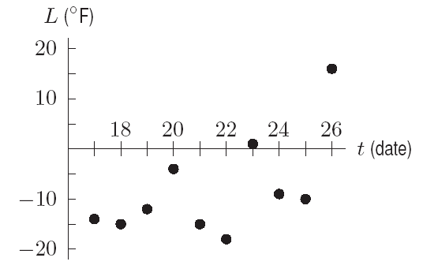
Table 1.1 Daily low temperature in International Falls, Minnesota, December 17-26, 2008
Date | 17 | 18 | 19 | 20 | 21 | 22 | 23 | 24 | 25 | 26
Low temperature (°F) | -14 | -15 | -12 | -4 | -15 | -18 | 1 | -9 | -10 | 16
Figure 1.1: Daily low temperatures, International Falls, December 2008

Slide 4
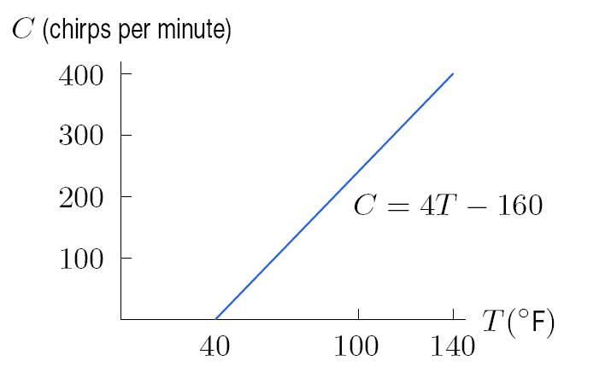
Figure 1.3: Cricket chirp rate as a function of temperature

Slide 5
Section 1.2 Linear Functions

Slide 6
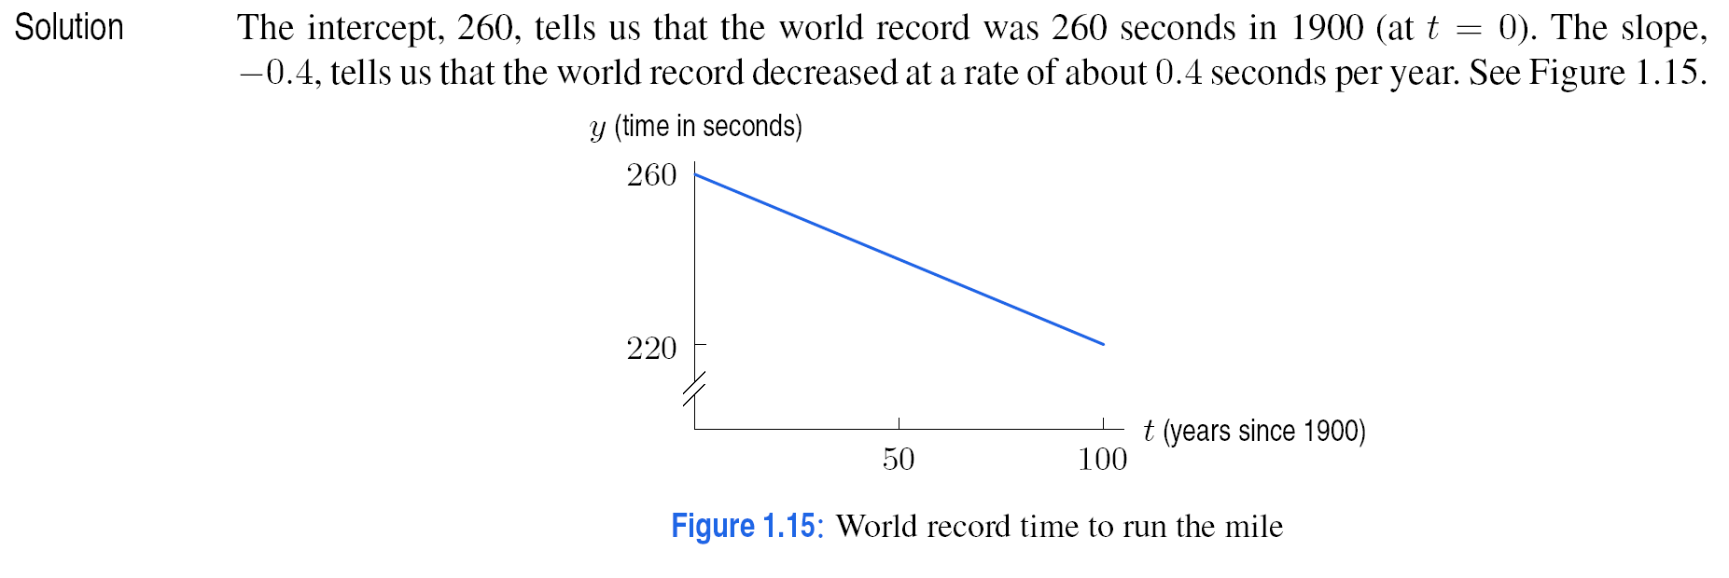

Slide 7
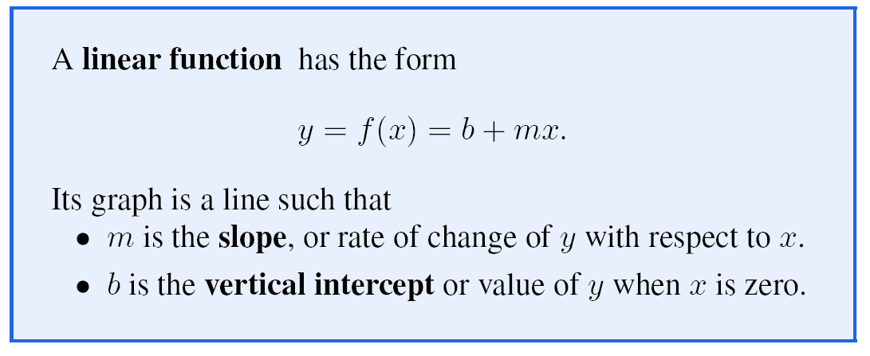

Slide 9
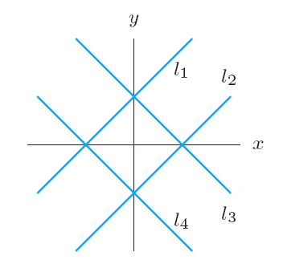
Problem 9 Figure 1.21 shows four lines given by equation y = b + mx. Match the lines to the conditions on the parameters m and b. (a) m > 0, b > 0 (b) m < 0, b > 0 (c) m > 0, b < 0 (d) m < 0, b < 0
Figure 1.21

Slide 10
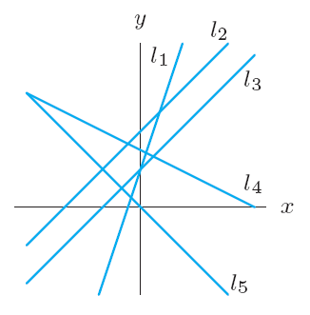
Problem 10 (a) Which two lines in Figure 1.22 have the same slope? Of these two lines, which has the larger y-intercept? (b) Which two lines have the same y-intercept? Of these two lines, which has the larger slope?
Figure 1.22

Slide 11
Problem 16
Which of the following tables could represent linear functions?
(a)
(b)
(c)
x | 0 | 1 | 2 | 3
y | 27 | 25 | 23 | 21
x | 15 | 20 | 25 | 30
y | 62 | 72 | 82 | 92
x | 1 | 2 | 3 | 4
y | 5 | 10 | 18 | 28

Slide 12
Problem 24 Annual sales of music compact discs (CDs) have declined since 2000. Sales were 942.5 million in 2000 and 384.7 million in 2008. (a) Find a formula for annual sales, S, in millions of music CDs, as a linear function of the number of years, t, since 2000. (b) Give units for and interpret the slope and vertical intercept of this function. (c) Use the formula to predict music CD sales in 2012.

Slide 13
Section 1.3 Average Rate of Change And Relative Change

Slide 14
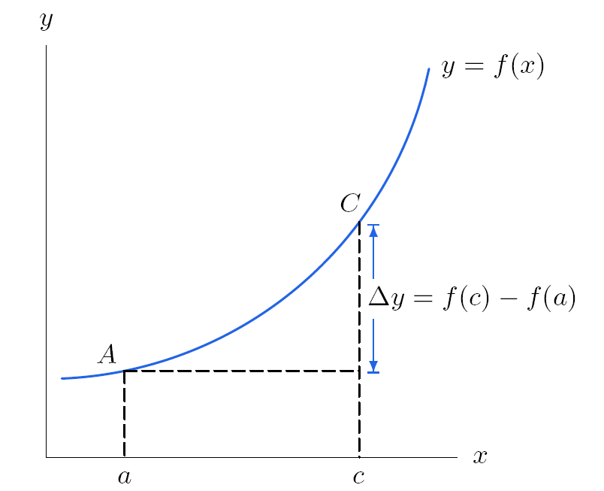
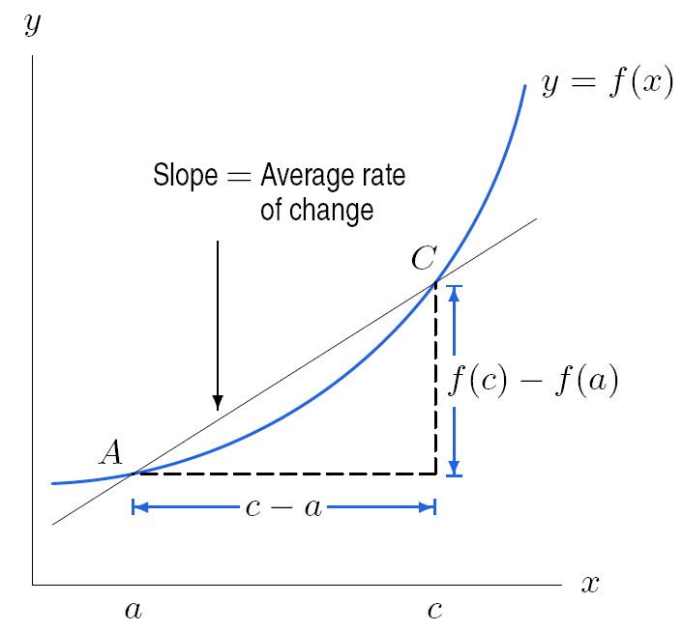
Figure 1.26: The change in a function is
represented by a vertical distance.
Figure 1.27: The average rate of change is
represented by the slope of the line.

Slide 15
Problem 24
Table 1.16 shows the production of tobacco in the US.
(a) What is the average rate of change in tobacco production
between 1996 and 2003? Give units and interpret your answer
in terms of tobacco production.
(b) During this seven-year period, is there any interval during
which the average rate of change was positive? If so, when?
Table 1.16 Tobacco production, in millions of pounds
Year | 1996 | 1997 | 1998 | 1999 | 2000 | 2001 | 2002 | 2003
Production | 1517 | 1787 | 1480 | 1293 | 1053 | 991 | 879 | 831

Slide 17
Problem 9
Table 1.10 gives values of a function w = f(t).
Is this function increasing or decreasing?
Is the graph of this function concave up or concave down?
Table 1.10
t | 0 | 4 | 8 | 12 | 16 | 20 | 24
w | 100 | 58 | 32 | 24 | 20 | 18 | 17

Slide 18
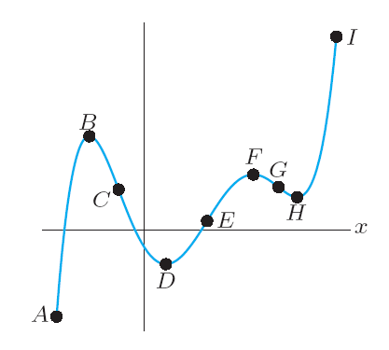
Problem 10
For which pairs of consecutive points in Figure 1.33 is the
function graphed:
(a) Increasing and concave up
Increasing and concave down
Decreasing and concave up
Decreasing and concave down
Figure 1.33

Slide 19
Section 1.4 Applications of Functions to Economics

Slide 21
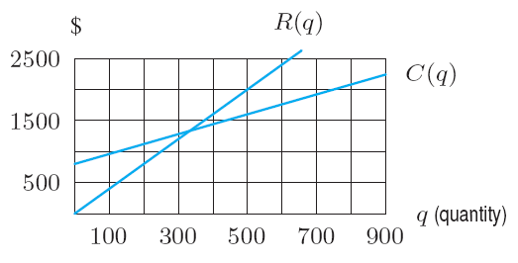
Problem 1
Figure 1.52 shows cost and revenue for a company.
(a) Approximately what quantity does this
company have to produce to make a profit?
(b) Estimate the profit generated by 600 units.
Figure 1.52

Slide 22
Figure 1.47: Supply and demand curves

Slide 23
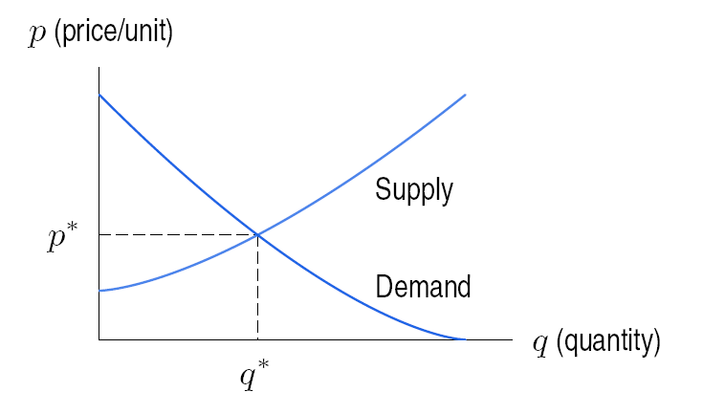
Figure 1.48: The equilibrium price and quantity

Slide 24
Section 1.5 Exponential Functions

Slide 25
Population Growth
The population of Nevada from 2000 to 2006 is given in Table 1.30. To see how the population is growing, we look at the increases in population in the third column of Table 1.30. If the population had been growing linearly, all the numbers in the third column would be the same. But populations usually grow much faster as they get bigger, so it is not surprising that the numbers in the third column increase.
Table 1.30 Population of Nevada (estimated) 2000 – 2006
Year | Population (millions) | Change in population (millions)
2000 | 2,020 | 0.073
2001 | 2,093 | 0.075
2002 | 2,168 | 0.078
2003 | 2,216 | 0.081
2004 | 2,327 | 0.084
2005 | 2,411 | 0.087
2006 | 2,498

Slide 26
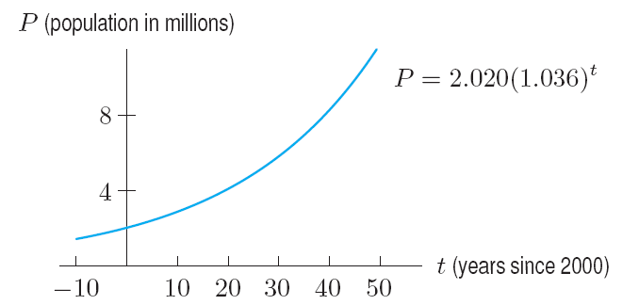
P = 2.020 (1.036)^{t} million
Figure 1.58: Population of Nevada (estimated): Exponential Growth

Slide 28
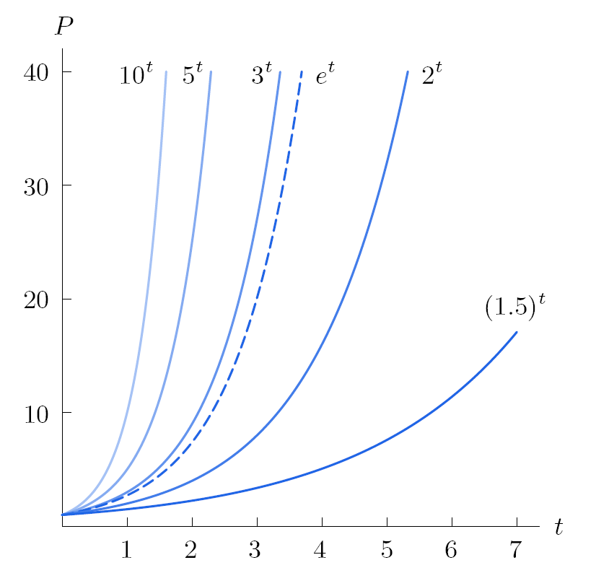
Figure 1.61: Exponential growth: P = a^{t} , for a > 1

Slide 29
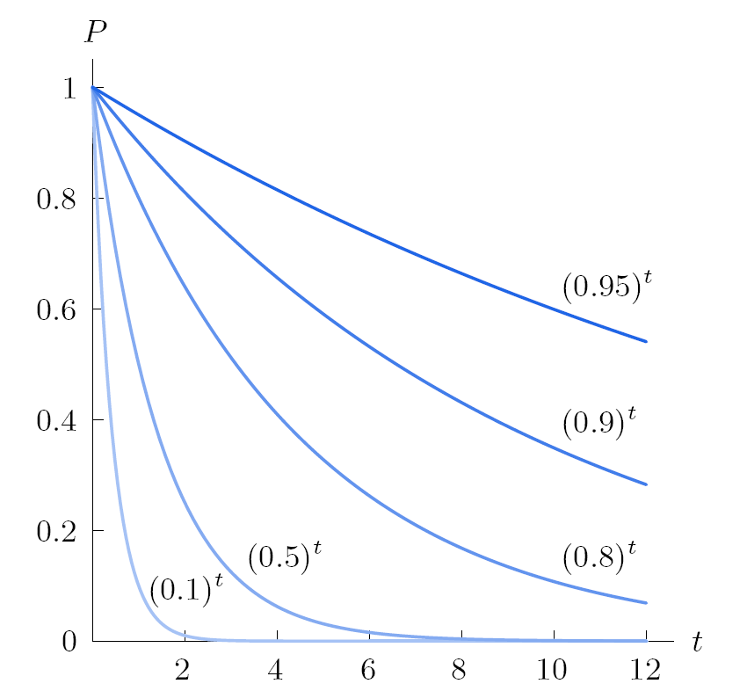
Figure 1.62: Exponential decay: P = a^{t} , for 0 < a < 1

Slide 30
Problem 6
A product costs $80 today. How much will the
product cost in t days if the price is reduced by
(a) $4 a day
(b) 5% a day

Slide 31
Section 1.6 The Natural Logarithm

Slide 32
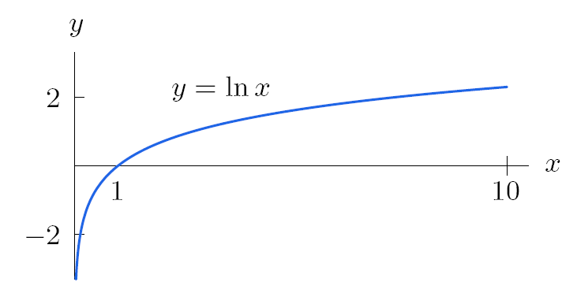
Figure 1.63: The natural logarithm function climbs very slowly.

Slide 35
Section 1.7 Exponential Growth and Decay

Slide 36
Problem 2
The half-life of nicotine in the blood is 2 hours. A person absorbs 0.4 mg of nicotine by smoking a cigarette. Fill in the following table with the amount of nicotine remaining in the blood after t hours. Estimate the length of time until the amount of nicotine is reduced to 0.04 mg.
t (hours) | 0 | 2 | 4 | 6 | 8 | 10
Nicotine (mg) | 0.4

Slide 37
Problem 6
Suppose $1000 is invested in an account paying interest at a rate of 5.5% per year. How much is in the account after 8 years if the interest is compounded
Annually?
Continuously?

Slide 38
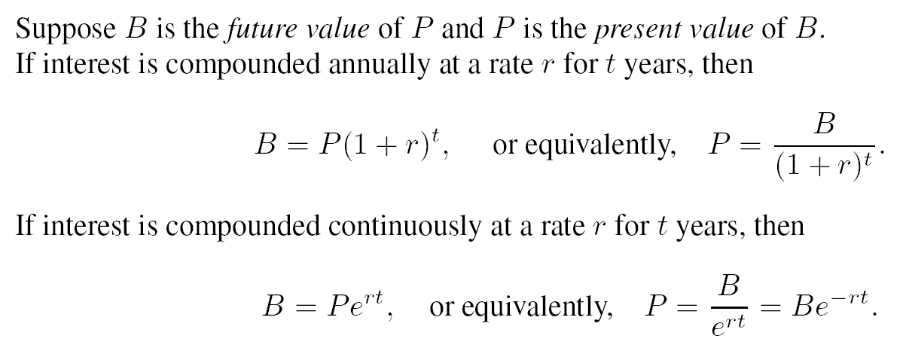

Slide 39
Section 1.8 New Functions From Old

Slide 40
Example 1
Solution

Slide 41
Example 2
If f(x) = e^{x} and g(x) = 5x + 1, find (a) f(g(x)) (b) g(f(x))

Slide 42
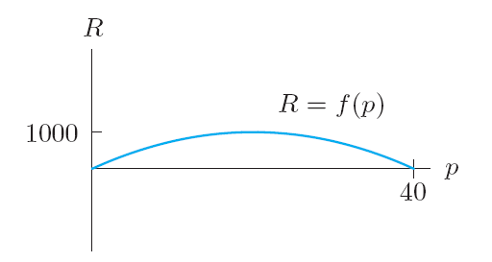
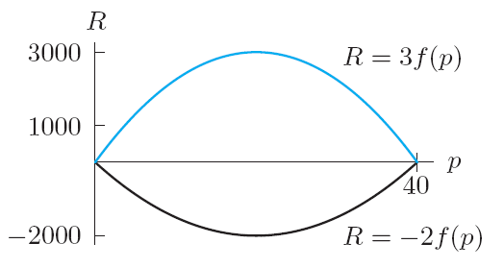
Figure 1.69: Graph of f(p)
Figure 1.70: Multiples of the function f(p)

Slide 43
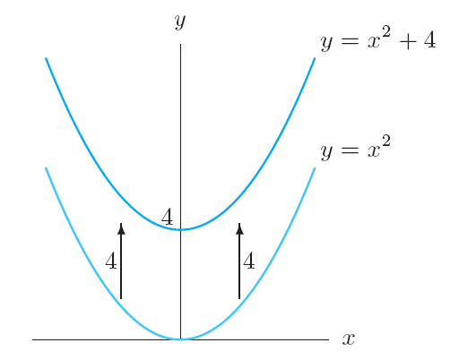
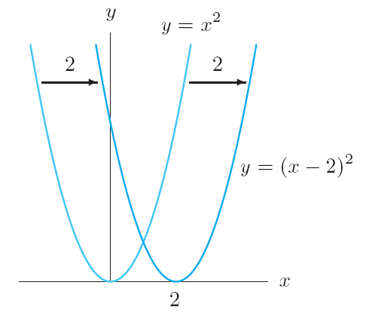
Figure 1.71: Vertical shift
Figure 1.72: Horizontal shift

Slide 44
Section 1.9 Proportionality
and Power Functions

Slide 45
Example 1
The heart mass of a mammal is proportional to its body mass.
Solution

Slide 46
Example 4
Solution

Slide 47
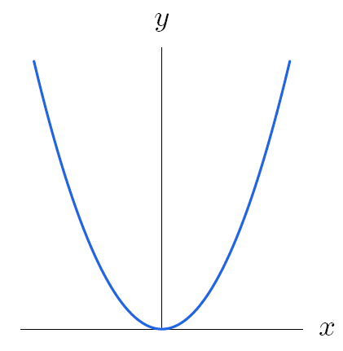
Figure 1.82 Graph of y = x²

Slide 48
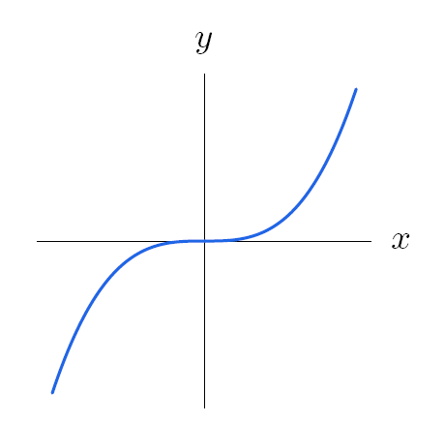
Figure 1.83 Graph of y = x³

Slide 49
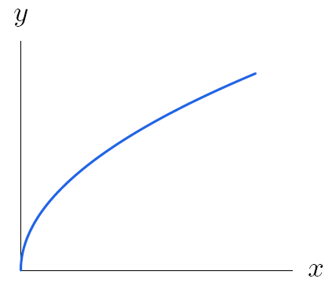
Figure 1.84 Graph of y = x ^{1/2}

Slide 50
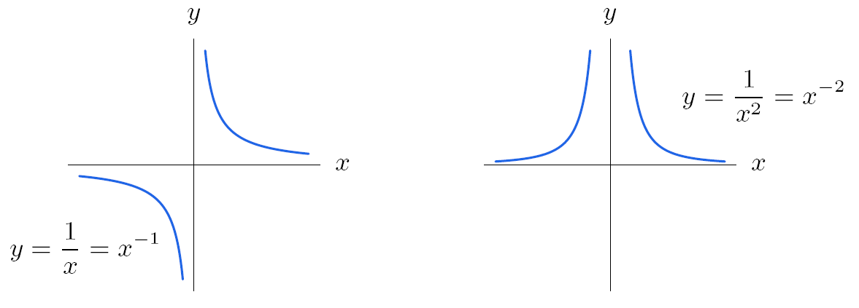
Figure 1.85: Graphs of negative powers of x

Slide 51
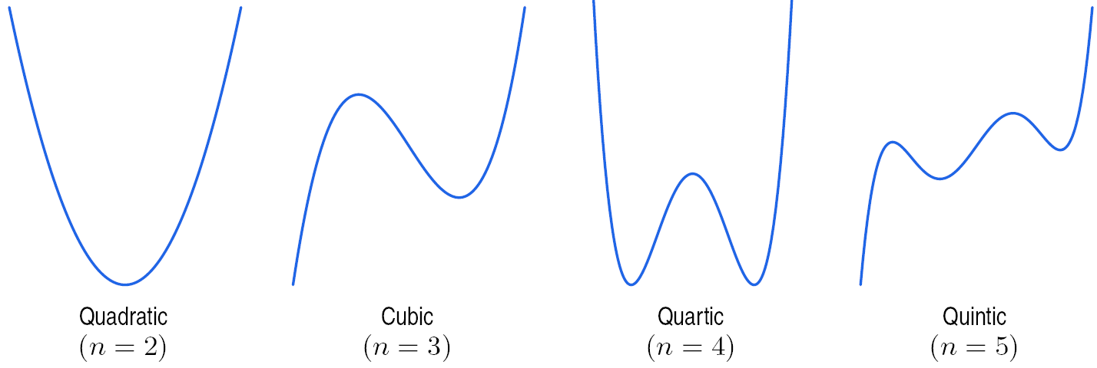
Graphs of typical polynomials of degree n

Slide 52
Section 1.10 Periodic Functions

Slide 54
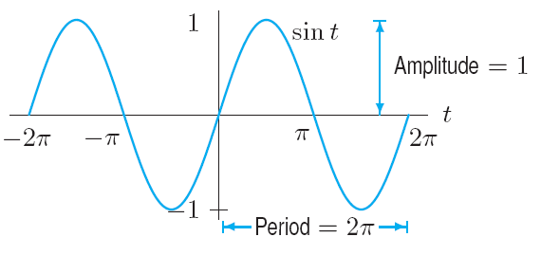
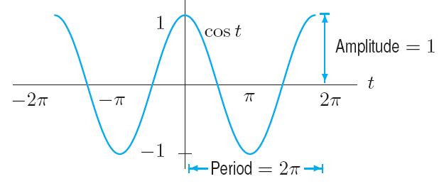
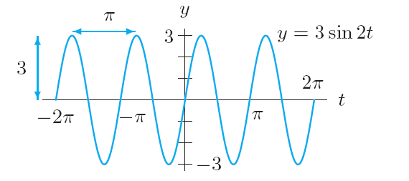
Figure 1.90: Graph of sin t
Figure 1.91: Graph of cos t
Example 3
Solution
In Figure 1.92, the waves have a maximum of +3 and a minimum of -3, so the amplitude is 3. The graph completes one complete cycle between t = 0 and t = π, so the period is π.
Figure 1.92: The amplitude is 3 and the period is π

Slide 55
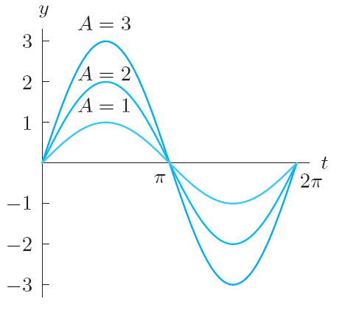
Example 5(a)
Solution
From the graphs of y = A sin t for A = 1, 2, 3 in figure 1.96, we see that A is
the amplitude.
Figure 1.96: Graphs of y = A sin t with A = 1, 2, 3

Slide 56
Example 5(b)
Solution
The parameter B affects the period of the function. The graphs suggest that the larger
the B is, the shorter the period. In fact, the period is 2π/B
Figure 1.97: Graphs of y = sin (Bt) with B = ½, 1, 2

