Slide 1
Section 2.1 Instantaneous Rate of Change

Slide 3
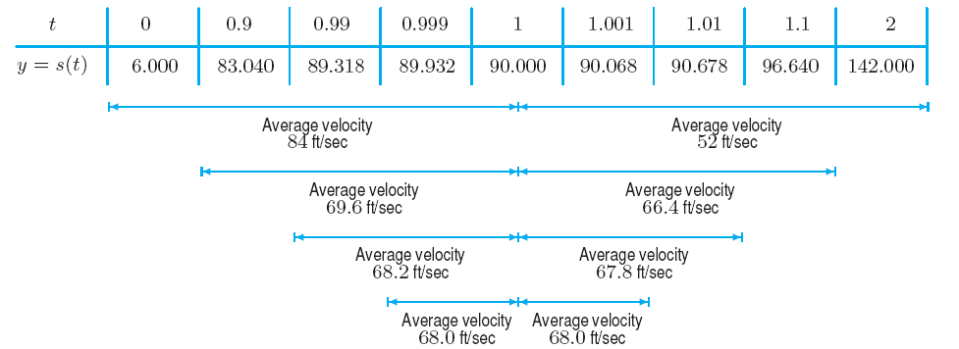
Figure 2.1: Average velocities over intervals on either side of t = 1
showing successively smaller intervals

Slide 5
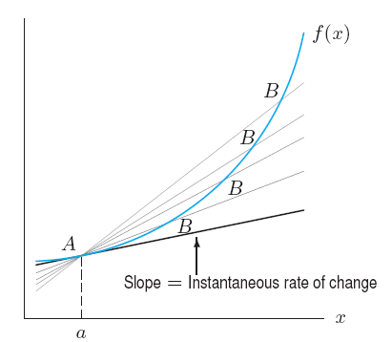
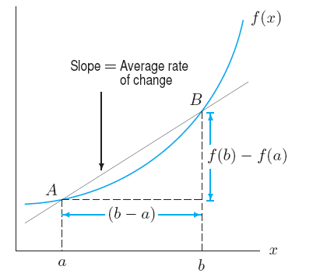
Figure 2.2: Visualizing the average
rate of change of f between a and b
Figure 2.3: Visualizing the instantaneous
rate of change of f at a

Slide 6
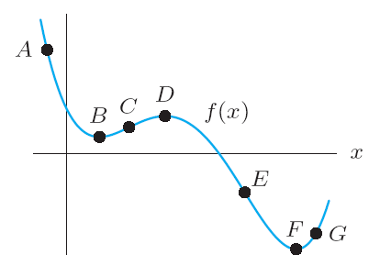
Problem 11
(a) The function f is given in Figure 2.13. At which of the labeled
points is f’(x) positive? Negative? Zero?
(b) At which labeled point is f’ largest? At which labeled point
is f’ most negative?
Figure 2.13

Slide 7
Problem 16
Table 2.4 gives the percent of households in the US with cable
television t years since 1990.
(a) Does f ’(6) appear to be positive or negative? What does this
tell you about the percent of households with cable television?
(b) Estimate f ’(2). Estimate f ’(10). Explain what each is telling you,
in terms of cable television.
Table 2.4
t (years since 1990) | 0 | 2 | 4 | 6 | 8 | 10 | 12
P (% with cable) | 50.0 | 61.5 | 63.4 | 66.7 | 67.4 | 67.8 | 68.9

Slide 8
Section 2.2 The Derivative Function

Slide 9
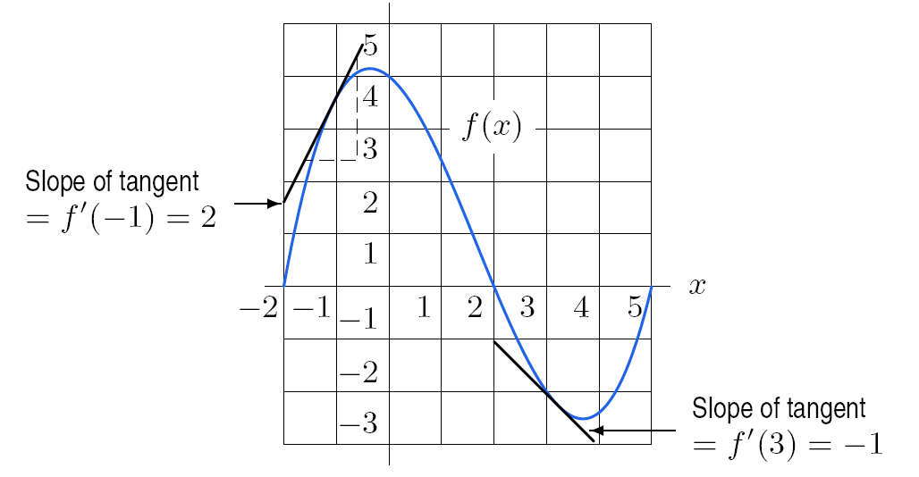
Figure 2.18: Estimating the
derivative graphically as the
slope of the tangent line
Table 2.5 Estimated values of derivative of function in Figure 2.18
x | –2 | –1 | 0 | 1 | 2 | 3 | 4 | 5
Derivative of x | 6 | 2 | –1 | –2 | –2 | –1 | 1 | 4

Slide 10
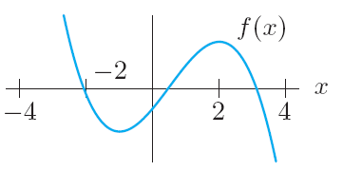
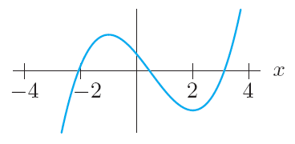
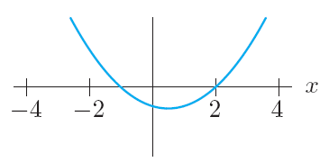
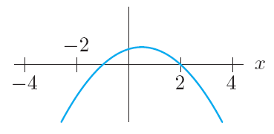
Example 3
The graph of f is in Figure 2.21. Which of the graphs (a) – (c) is a graph of the derivative f ’ ?
Figure 2.21
(a)
(b)
(c)
Solution

Slide 12
Example 4
Table 2.6 gives values of c(t), the concentration (mg/cc) of a drug in the bloodstream
at time t (min). Construct a table of estimated values for c’(t), the rate of change of
c(t) with respect to t.
Table 2.6 Concentration of a drug as a function of time
t (min) | 0 | 0.1 | 0.2 | 0.3 | 0.4 | 0.5 | 0.6 | 0.7 | 0.8 | 0.9 | 1.0
c(t) (mg/cc) | 0.84 | 0.89 | 0.94 | 0.98 | 1.00 | 1.00 | 0.97 | 0.90 | 0.79 | 0.63 | 0.41
Solution (continued on next slide)

Slide 13
Example 4 (continued)
We estimate the derivative for each value of t using a difference quotient. For example,
Similarly, we get the estimates
(mg/cc) per minute
and so on. These values are tabulated in Table 2.7. Notice that the derivative has small
positive values up until t = 0.4, and then it gets more and more negative, as we expected.
Table 2.7 Derivative of concentration
t | 0 | 0.1 | 0.2 | 0.3 | 0.4 | 0.5 | 0.6 | 0.7 | 0.8 | 0.9
c’(t) | 0.5 | 0.5 | 0.4 | 0.2 | 0.0 | –0.3 | –0.7 | –1.1 | –1.6 | –2.2

Slide 14
Section 2.3 Interpretations of the Derivative

Slide 15
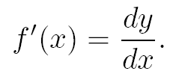

Slide 16
Example 2
Solution
In the Leibniz notation,
Since C is measured in dollars and T is measured in tons, dC/dT is measured in dollars per ton. You can think of dC as the extra cost of extracting an extra dT tons of ore. So the statement
says that when 2000 tons of ore have already been extracted from the mine, the cost of extracting the next ton is approximately $100. Another way of saying this is that it costs about $100 to extract the 2001st ton.

Slide 17
Local Linear Approximation
If y = f(x) and Δy ≈ f’(x) Δx. Then for x near a and Δx = x – a
f(x) ≈ f(a) + f’(a) Δx
This is called the Tangent Line Approximation.
Problem 27
Annual net sales, in billions of dollars, for the Hershey Company, the largest
US producer of chocolate, is a function S = f(t) of time, t, in years since 2000.
Interpret the statements f(8) = 5.1 and f’(8) = 0.22 in terms of Hershey sales.
Estimate f(12) and interpret it in terms of Hershey sales.

Slide 18
Relative Rate of Change
The relative rate of change of y = f(t) at t = a is defined to be
Relative rate of change
of y at a
Problem 43
The number of active Facebook users hit 175 million at the end of February 2009
and 200 million at the end of April 2009. With t in months since the start of 2009,
let f(t) be the number of active users in millions. Estimate f(4) and f’(4) and the
relative rate of change of f at t = 4. Interpret your answers in terms of Facebook
users.

Slide 19
Section 2.4 The Second Derivative

Slide 20
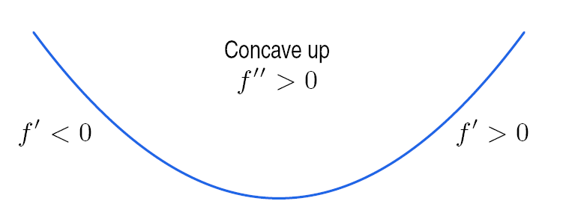
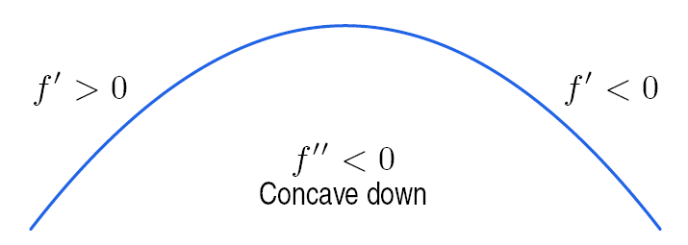
Figure 2.33: Meaning of f’’:
The slope increases from negative
to positive as you move from left
to right, so f’’ is positive and f is
concave up.
Figure 2.34: Meaning of f’’:
The slope decreases from positive
to negative as you move from left
to right, so f’’ is negative and f is
concave down.

Slide 21
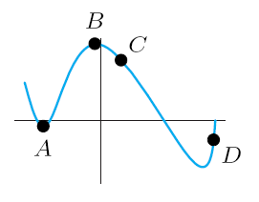
Problem 19
At exactly two of the labeled points in Figure 2.40, the derivative f’ is 0; the second derivative f’’ is not zero at any of the labeled points. On a copy of the table, give the signs of f, f’, f’’ at each marked point.
Point | f | f’ | f’’
A
B
C
D
Figure 2.40

Slide 22
Problem 23
A function f has f(5) = 20, f’(5) = 2 and f’’(x) < 0., for x ≥ 5. Which of the following are possible values for f(7) and which are impossible?
26 (b) 24 (c) 22

Slide 23
Section 2.5 Marginal Cost and Revenue

Slide 24
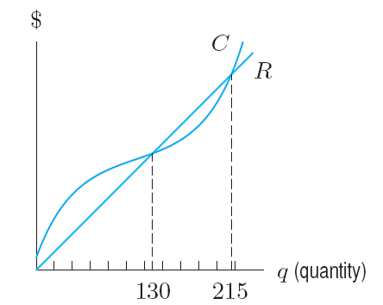
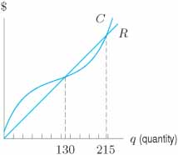
Example 1
If cost, C, and revenue, R, are given by the graph in Figure 2.47, for what production quantities does the firm make a profit?
Figure 2.47:
Costs and revenues
Solution

Slide 25
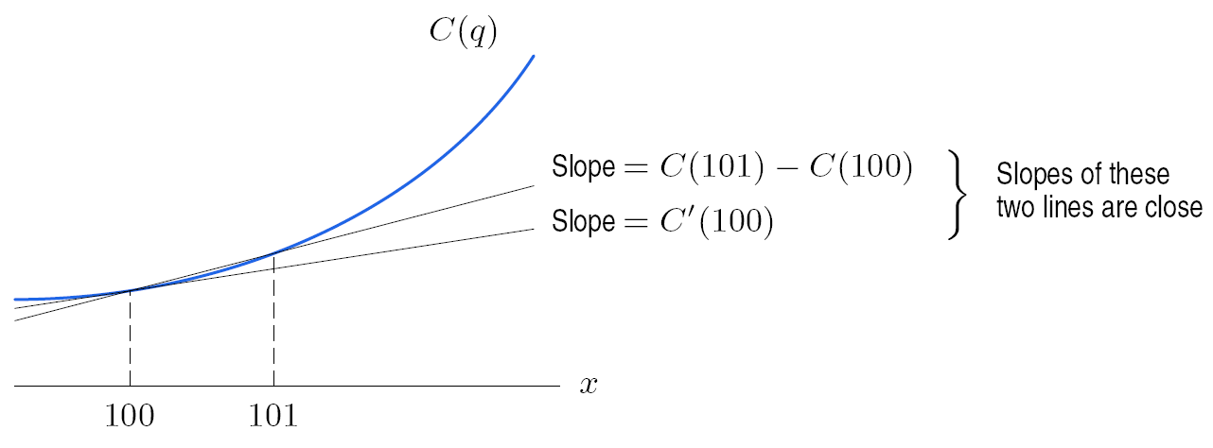
Suppose C(q) is the function giving the cost of running q flights. If the airline had
originally planned to run 100 flights, its costs would be C(100). With the additional
flight, its costs would be C(101). Therefore,
Marginal cost = C(101) – C(100).
Now
and this quantity is the average rate of change of cost between 100 and 101 flights.
Figure 2.48: Marginal cost: Slope of one of these lines

Slide 26
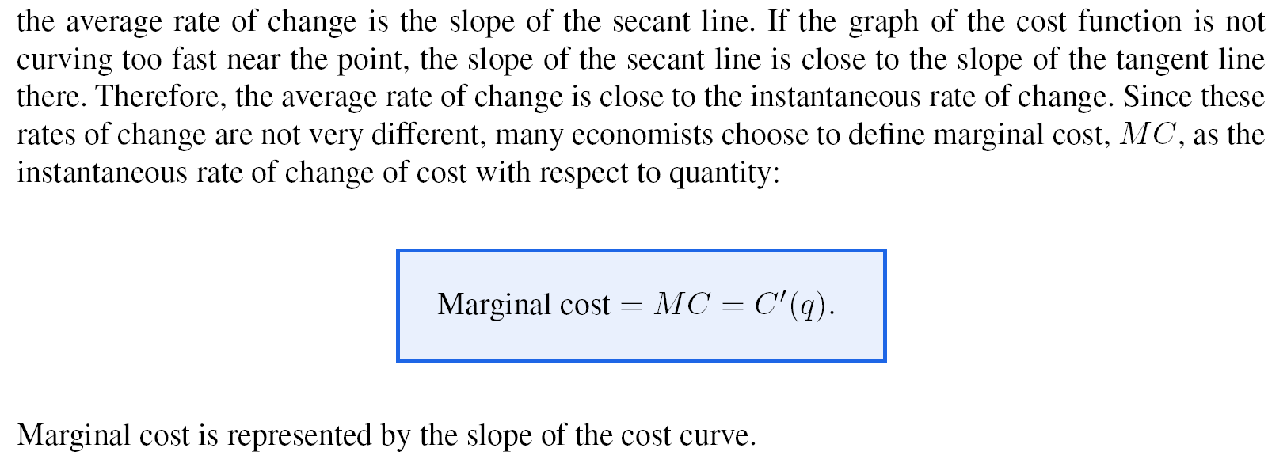
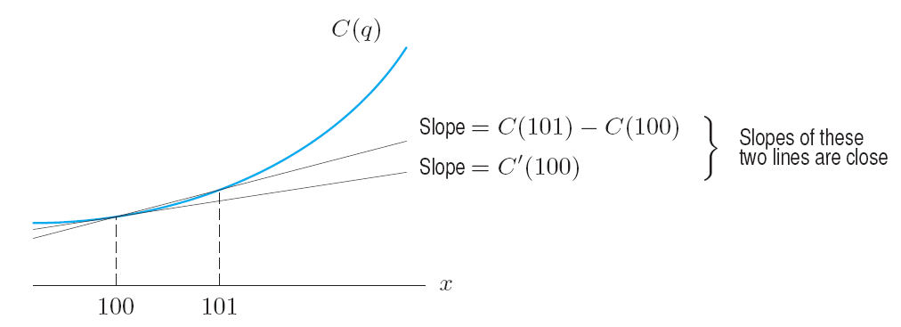
In Figure 2.48,
Figure 2.48: Marginal cost:
Slope of one of these lines

Slide 27
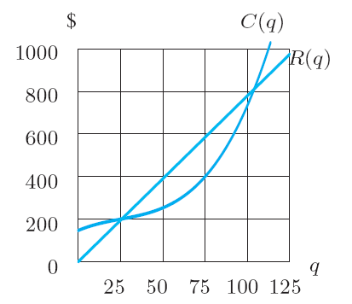
Problem 12
Cost and revenue functions for a charter bus company are shown in Figure 2.57. Should the company add a 50th bus? How about a 90th ? Explain your answers using marginal revenue and marginal cost.
Figure 2.57

