Slide 1
Section 3.1 Derivative Formulas for Powers and Polynomials

Slide 2
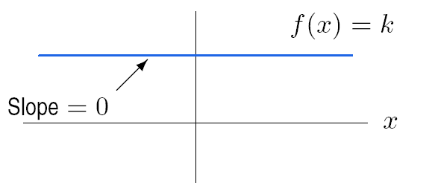
Figure 3.1 A constant function

Slide 6
Problem 39
Let
Find f’(t)
Find f’(1) and f’(2)
Use a graph of f(t) to check that your answers to part (b) are reasonable. Explain.
f (t) = t² – 4t + 5.

Slide 7
Section 3.2 Exponential and Logarithmic Functions

Slide 8
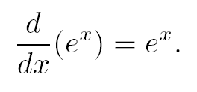
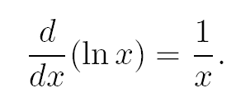

Slide 9
Differentiate the functions in Problems 1 – 28. Assume that A, B, and C are constants.
3.
y = 5 t²+ 4 e^{t}
19.
y = t² + 5 ln t

Slide 10
Section 3.3 The Chain Rule

Slide 11
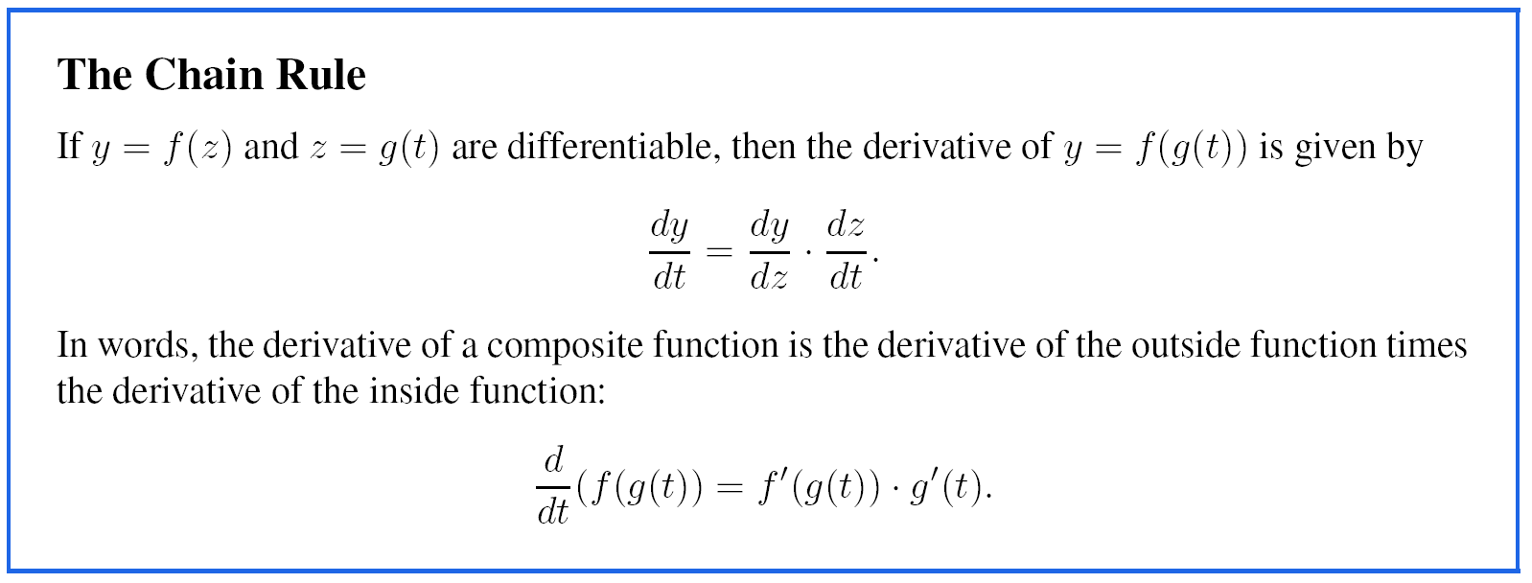
Example 2
Solution

Slide 12
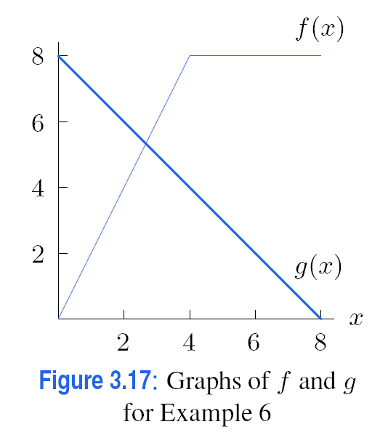
Example 6 (continued on next page)

Slide 13
Example 6 (continued)

Slide 14
Section 3.4 The Product and Quotient Rules

Slide 16
Example 1
Solution

Slide 18
Section 3.5 Derivatives of Periodic Functions

Slide 20
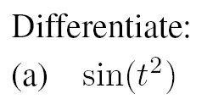
Example 4
Solution

