Slide 1
Section 4.1 Local Maxima and Minima

Slide 2
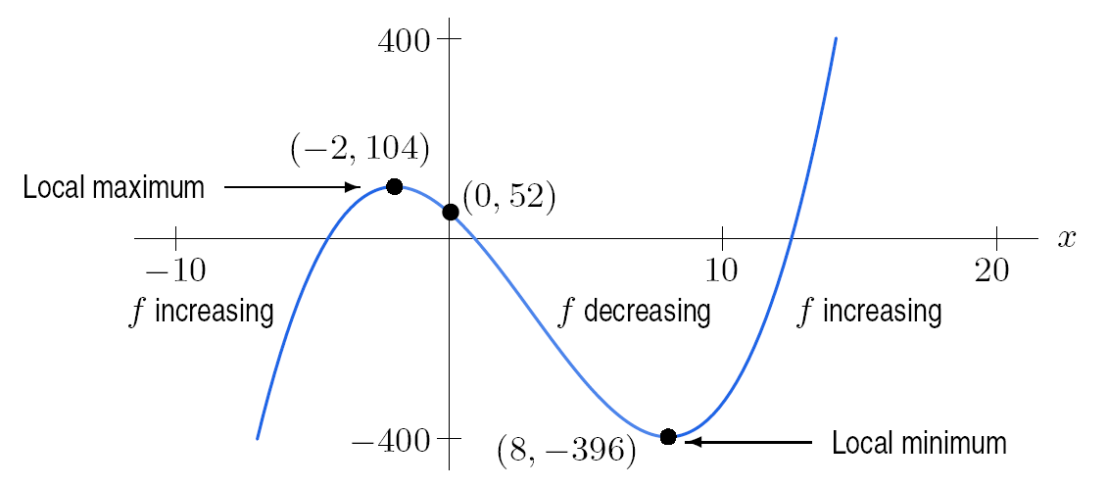
y
Figure 4.2: Useful graph of f (x) = x³ – 9 x² – 48 x +52
Notice that the scales on the x- and y-axes are different.

Slide 3
Figure 4.6: Changes in direction at a critical point, p: Local maxima or minima

Slide 4
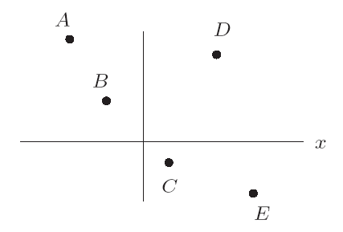
Problem 7
Graph two continuous functions f and g, each of which has exactly five critical points, the points A-E in Figure 4.12, and which satisfy the following conditions:
(a) f (x) → ∞ as x → – ∞ and
f (x) → ∞ as x → ∞
(b) g (x) → – ∞ as x → – ∞ and
g (x) → 0 as x → ∞
Figure 4.12

Slide 5
Problem 36
Assume f has a derivative everywhere and just one critical point, at x = 3. In parts (a) – (d), you are given additional conditions. In each case, decide whether x = 3 is a local maximum, a local minimum, or neither. Sketch possible graphs for all four cases.
(a) f ‘(1) = 3 and f ‘(5) = – 1
(b) f (x) → ∞ as x → ∞ and as x → – ∞
(c) f (1) = 1, f (2) = 2, f (4) = 4, f (5) = 5
(d) f ‘(2) = – 1, f (3) = 1, f (x) → 3 as x → ∞

Slide 6
Section 4.2 Periodic Functions

Slide 7
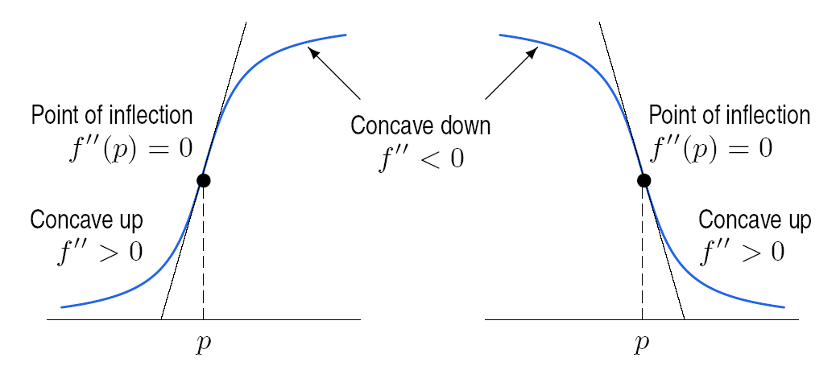
Figure 4.16: Change in concavity (from positive to negative or vice versa) at point p

Slide 8
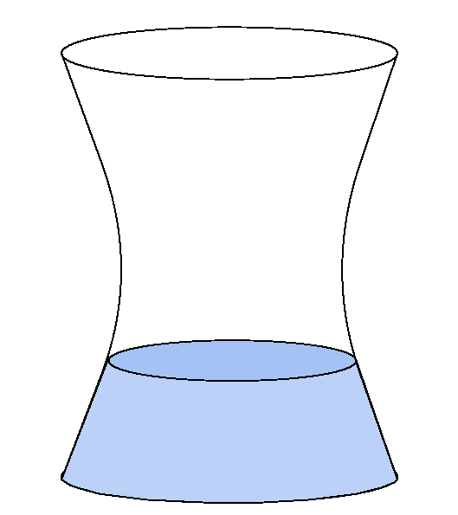
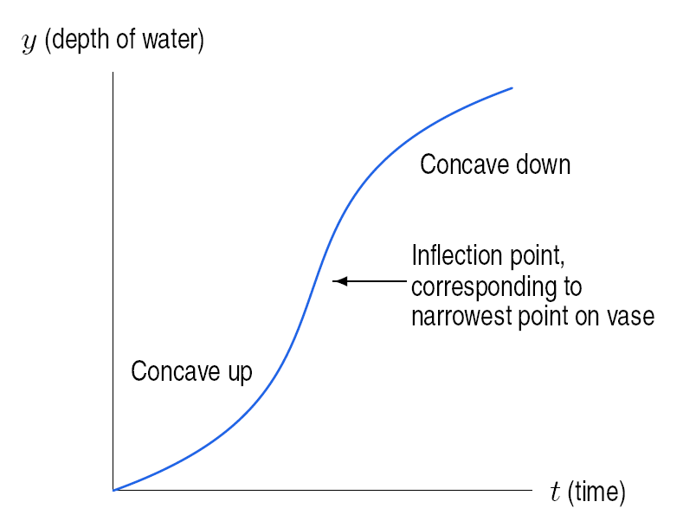
Figure 4.23: Graph of depth of water in
the vase, y, against time, t
Figure 4.22: A vase

Slide 9
Section 4.3 Global Maxima and Minima

Slide 10
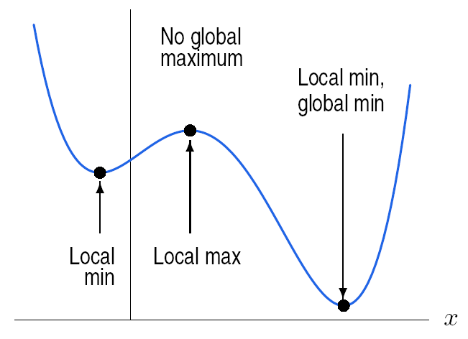
Figure 4.30: Global maximum and minimum on an interval domain, a ≤ x ≤ b
Figure 4.31: Global maximum and minimum on the entire real line

Slide 11
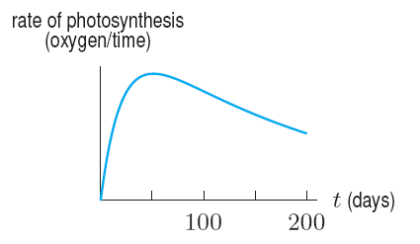
Problem 16
Figure 4.38 shows the rate at which photosynthesis is taking place in a leaf.
(a) At what time, approximately, is photosynthesis proceeding
fastest for t ≥ 0?
(b) If the leaf grows at a rate proportional to the rate of
photosynthesis, for what part of the interval 0 ≤ t ≤ 200
is the leaf growing? When is it growing fastest?
Figure 4.38

Slide 12
Section 4.4 Profit, Cost, and Revenue

Slide 13
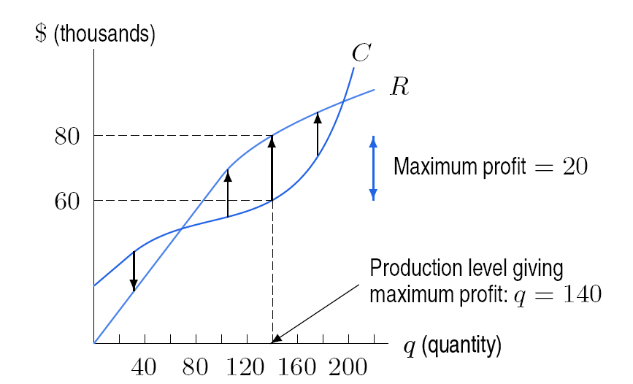
Example 1: Estimate the maximum profit if the revenue and cost are given by the curves R and C, respectively, in Figure 4.42
Figure 4.42: Maximum profit at q = 140

Slide 14
Problem 3
Table 4.2 shows cost, C(q), and revenue, R(q).
(a) At approximately what production level, q, is profit
maximized? Explain your reasoning.
(b) What is the price of this product?
(c) What are the fixed costs?
Table 4.2
q | 0 | 500 | 1000 | 1500 | 2000 | 2500 | 3000
R(q) | 0 | 1500 | 3000 | 4500 | 6000 | 7500 | 9000
C(q) | 0 | 3800 | 4200 | 4500 | 4800 | 5500 | 7400

Slide 15
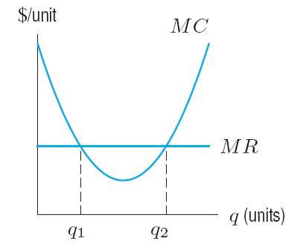
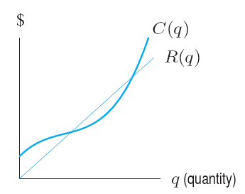
Problem 6
Figure 4.45 in Section 4.4 shows the points, q₁ and q₂ , where marginal revenue equals marginal cost.
(a) On the graph of the corresponding total cost and total
revenue functions in Figure 4.50, label the points q₁ and q₂ Using slopes, explain the significance of these points.
(b) Explain in terms of profit why one is a local minimum and
one is a local maximum.
Figure 4.45: Marginal revenue
and marginal cost
Figure 4.50: Revenue and cost

Slide 16
Section 4.5 Average Cost

Slide 17
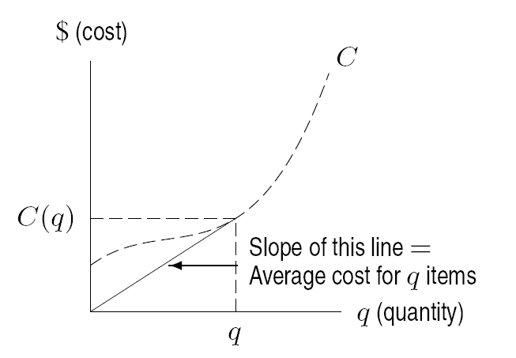
Figure 4.55: Average cost is the slope of the line from the origin to a point on the cost curve.

Slide 18
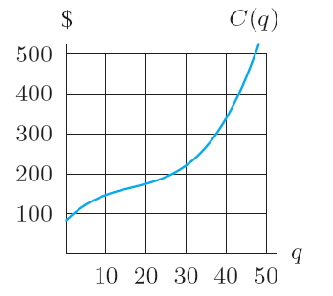
Problem 2
The graph of a cost function is given in Figure 4.62.
(a) At q = 25, estimate the following quantities and represent your
answers graphically.
(i) Average cost (ii) Marginal cost
(b) At approximately what value of q is average cost minimized?
Figure 4.62

Slide 19
Section 4.6 Elasticity of Demand

Slide 20
Is the demand of each of the following products elastic or inelastic?
Light bulbs
Furniture
Baby formula
Jewelry
Milk
Batteries
Vacation cruise packages
Gasoline
New cars

Slide 22
Relationship Between Elasticity and Revenue
If E < 1, demand is inelastic and revenue is increased by raising the price.
If E > 1, demand is elastic and revenue is increased by lowering the price.
E = 1 occurs at critical points of the revenue function

Slide 23
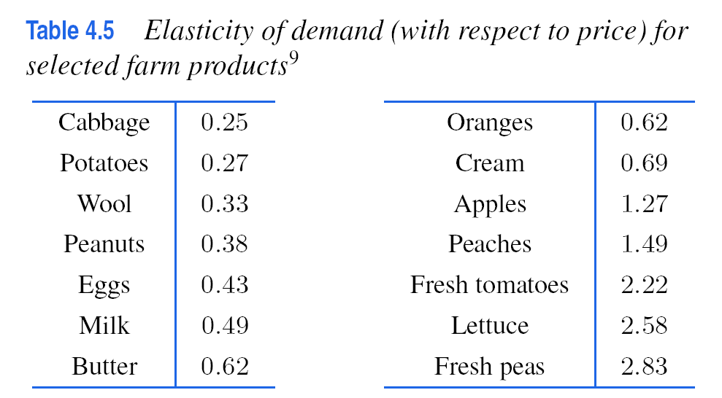

Slide 24
Section 4.7 Logistic Growth

Slide 25
Modeling the US Population
Population projection first became important to political philosophers in the late eighteenth century. As concern for scarce resources has grown, so has the interest in accurate population projections. In the US, the population is recorded every ten years by a census. The first such census was in 1790. Table 6 contains the census data from 1790 to 2000.

Slide 26
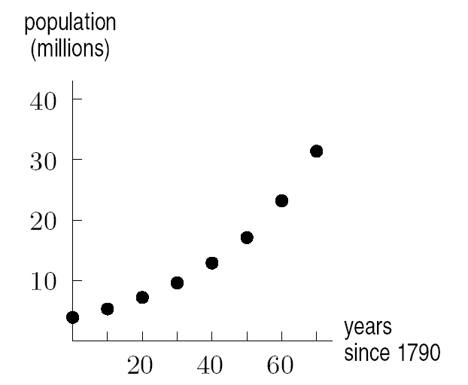
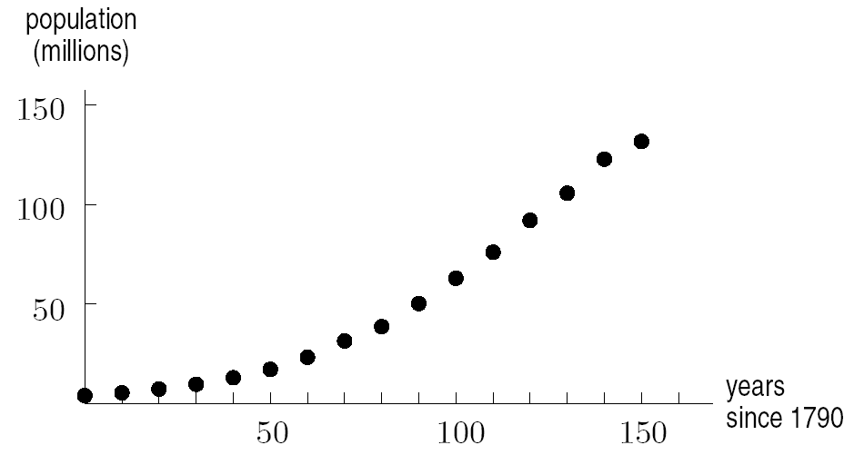
Visual Perspectives of US Population Growth
Figure 4.67: US Population, 1790 – 1860
Figure 4.68: US Population,
1790 – 1940

Slide 27
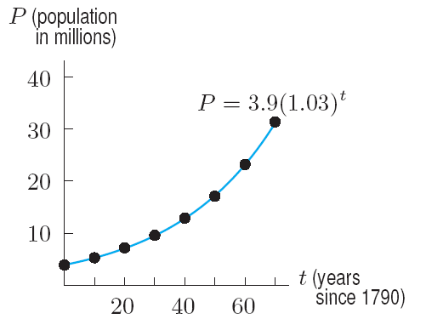
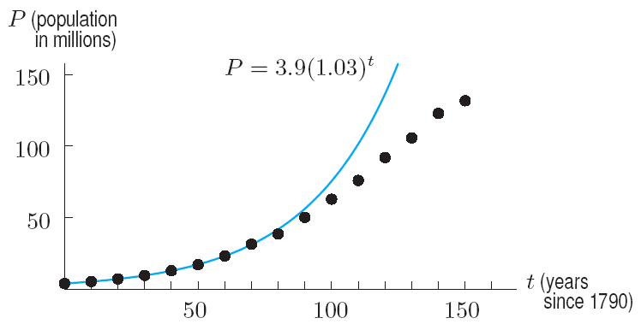
Visual Perspectives of US Population Growth
Figure 4.69: An exponential model
for the US Population, 1790 – 1860
Figure 4.70: The exponential model and the US Population, 1790 – 1940. Not a good fit beyond 1860

Slide 28
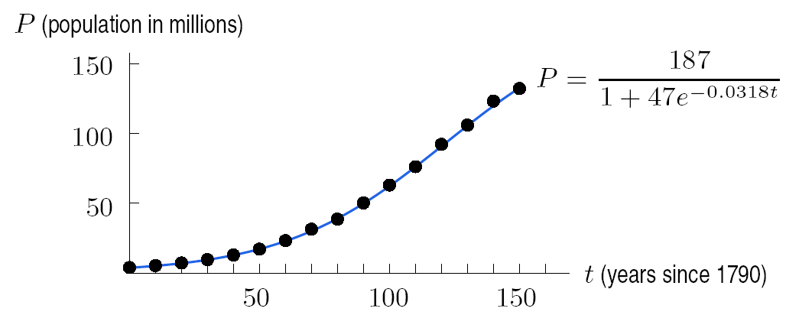
Figure 4.71: A logistic model for the US population, 1791 – 1940

Slide 29
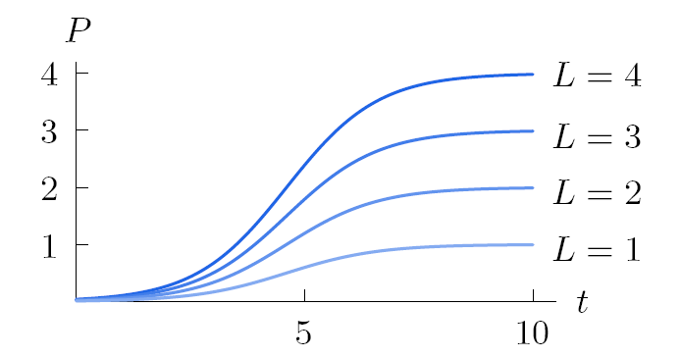
Figure 4.75: Graph of for various values of L

Slide 30
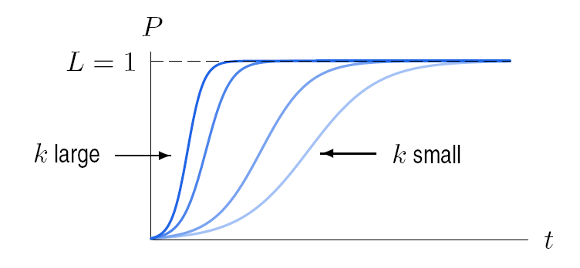
Figure 4.75: Graph of for various values of k

Slide 31
Section 4.8 The Surge Function and Drug Concentration

Slide 32
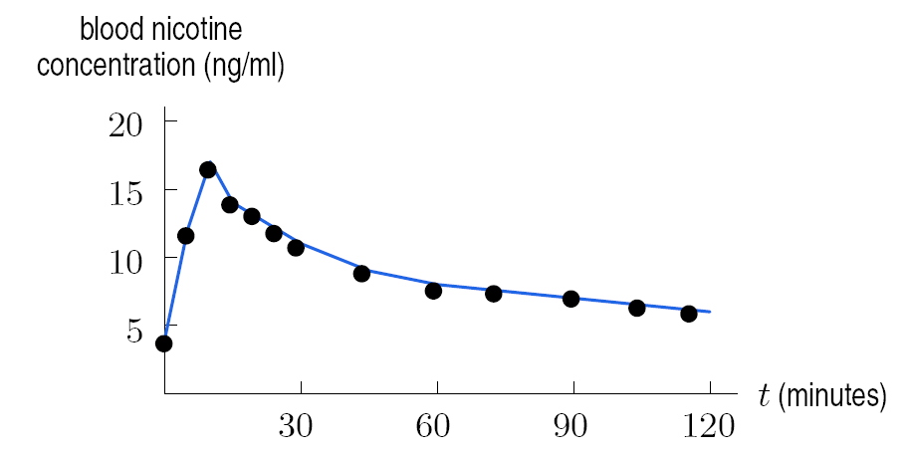
Nicotine in the Blood
Figure 4.83: Blood nicotine concentrations during and after the use of cigarettes

Slide 33
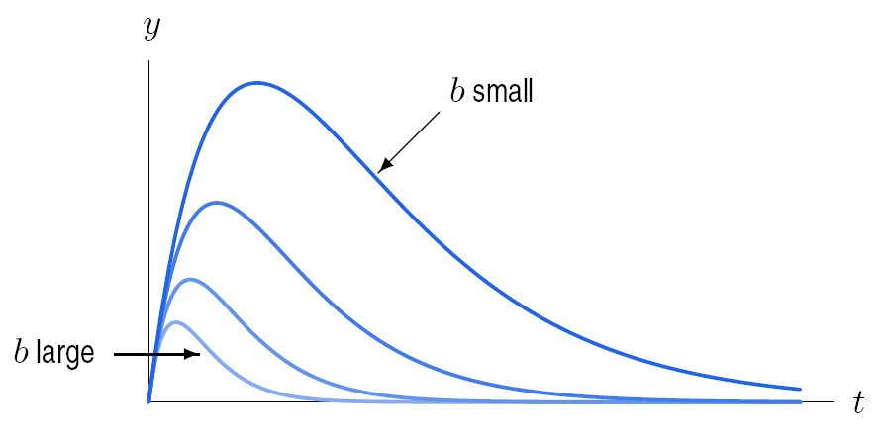
The Family of Functions y = ate^{-bt} & the Effect of the Parameter b
Figure 4.85: Graph of y = t e^{-bt}, with varying values of t

Slide 34
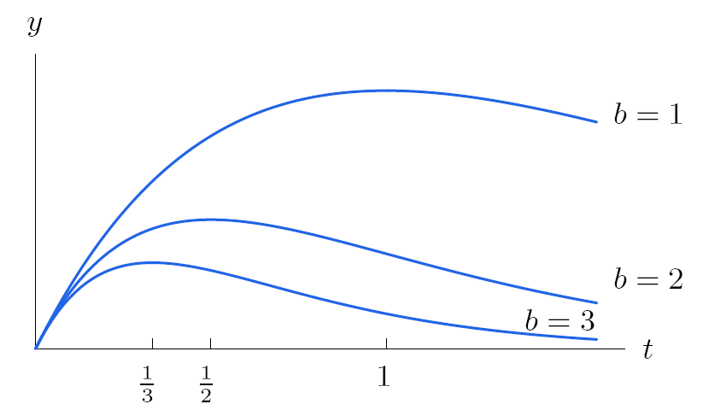
The surge function y = ate^{-bt} increases rapidly and then decreases toward zero with a maximum of t = 1/b.
Figure 4.86: How does the maximum depend on b?

