Slide 1
Section 5.1 Distance and Accumulated Change

Slide 2
Suppose a car is moving with increasing velocity and suppose we measure the car's velocity every two seconds, obtaining the data in Table 5.1:
At most how far has the car traveled?
At least how far has the car traveled? the data in Table 5.1:

Slide 3
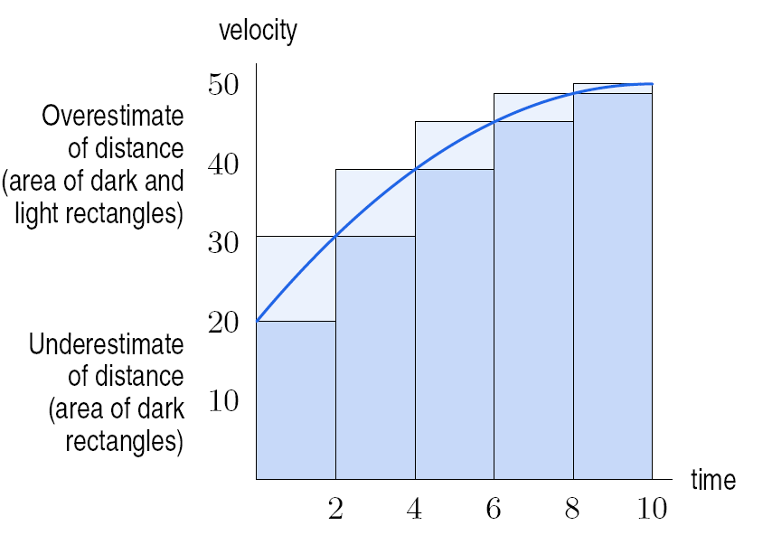
Figure 5.2: Shaded area estimates distance traveled. Velocity measured every 2 seconds

Slide 4
How do we improve our estimate?

Slide 5
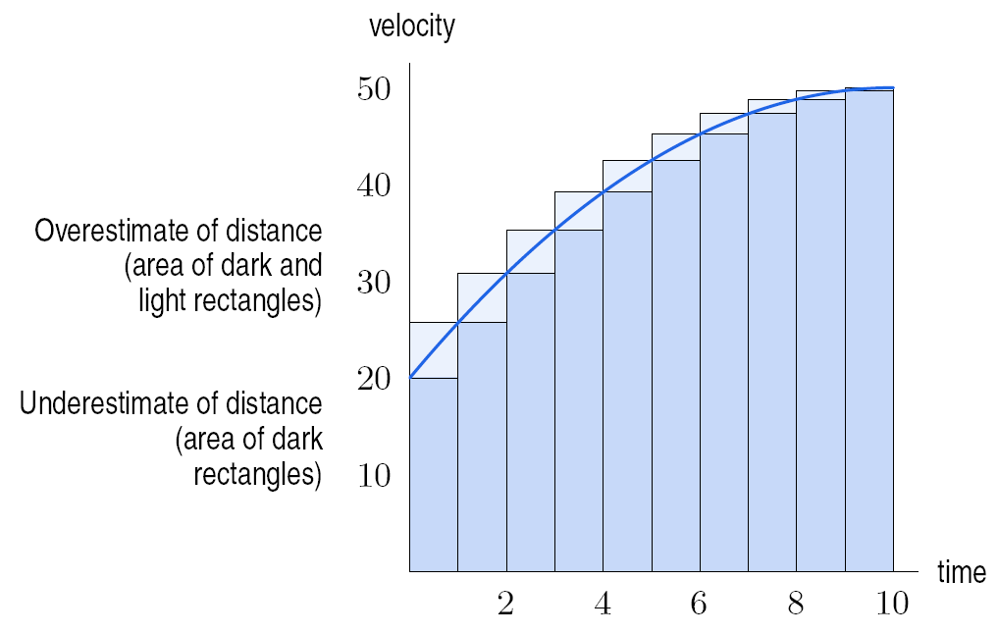
Figure 5.3: Shaded area estimates distance traveled. Velocity measured every 2 seconds

Slide 6
If the velocity is positive, the total distance traveled is the area under the velocity curve.
Figure 5.4:
Velocity
measured every
½ second
Figure 5.5:
Velocity measured every
¼ second
Figure 5.6:
Distance traveled is area
under curve

Slide 7
Problem 10
The rate of change of the world’s population, in millions of people per year, is given in the following table.
Use this data to estimate the total change in the world’s
population between 1950 and 2000.
The world population was 2555 million people in 1950 and 6085 million people in 2000. Calculate the true value of the total change in the population. How does this compare with your estimate in part (a)?
Year | 1950 | 1960 | 1970 | 1980 | 1990 | 2000
Rate of Change | 37 | 41 | 78 | 77 | 86 | 79

Slide 8
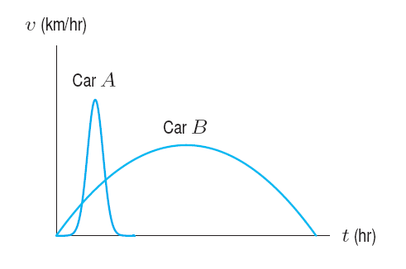
Problem 15
Two cars start at the same time and travel in the same direction along a straight road. Figure 5.11 gives the velocity, v, of each car as a function of time, t. Which car:
Attains the larger maximum velocity?
Stops first?
Travels farther?
Figure 5.11

Slide 9
Section 5.2 The Definite Integral

Slide 10
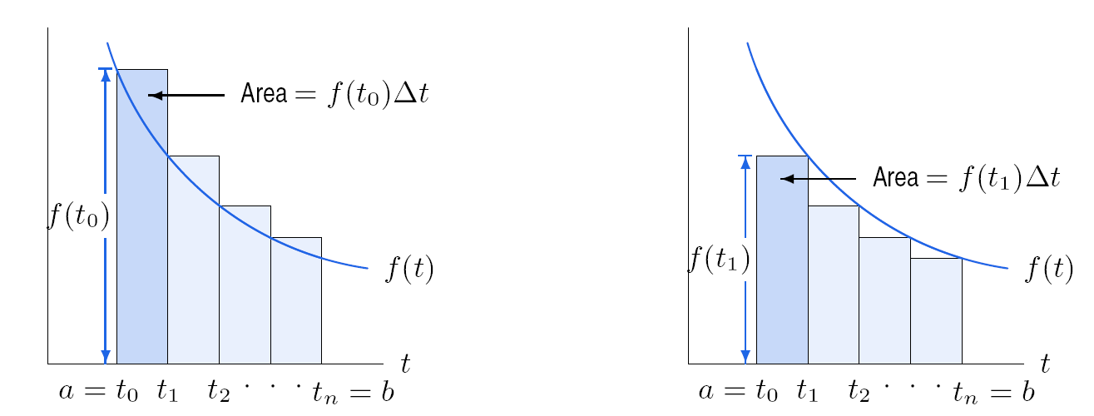
Left- and Right-Hand Sums
Figure 5.14: Left-hand sum:
Area of rectangles
Figure 5.15: Right-hand sum:
Area of rectangles

Slide 12
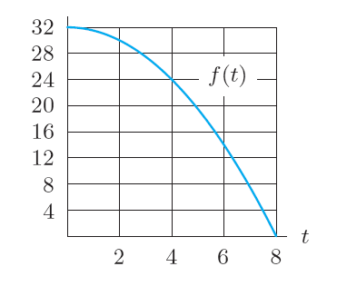
Problem 7
Using figure 5.21, draw rectangles representing each of the following Riemann sums for the function f on the interval 0 ≤ t ≤ 8. Calculate the value of each sum.
(a) Left-hand sum with Δt = 4
(b) Right-hand sum with Δt = 4
(c) Left-hand sum with Δt = 2
(d) Right-hand sum with Δt = 2
Figure 5.21

Slide 13
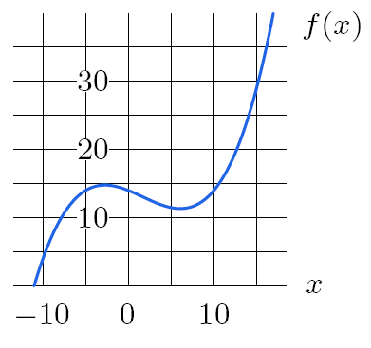
Problem 9
Use Figure 5.23 to estimate
Figure 5.23

Slide 14
Section 5.3 The Definite Integral As Area

Slide 15
Figure 5.26: Area of rectangles
approximating the area under the curve
Figure 5.27: Shaded area is the definite
integral

Slide 17
Section 5.4 Interpretations of the Definite Integral

Slide 18
Example
If r(t) represents the rate at which the heart is pumping blood, in liters per second, and t is time in seconds, give the units and meaning of the following integral .
Note that this integral represents the total amount of blood (in liters) pumped by the heart between time t = 0 and t = 10.

Slide 19
Example

Slide 20
Section 5.5 The Fundamental Theorem of Calculus

Slide 21
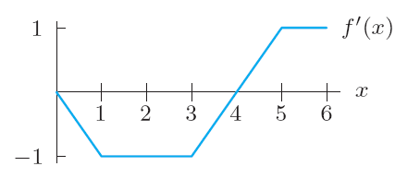
Problem 13
The graph of a derivative f’(x) is shown in Figure 5.67. Fill in the table of values for f (x) given that f (0) = 2.
x | 0 | 1 | 2 | 3 | 4 | 5 | 6
f (x) | 2
Figure 5.67: Graph of f’ , not f

Slide 22
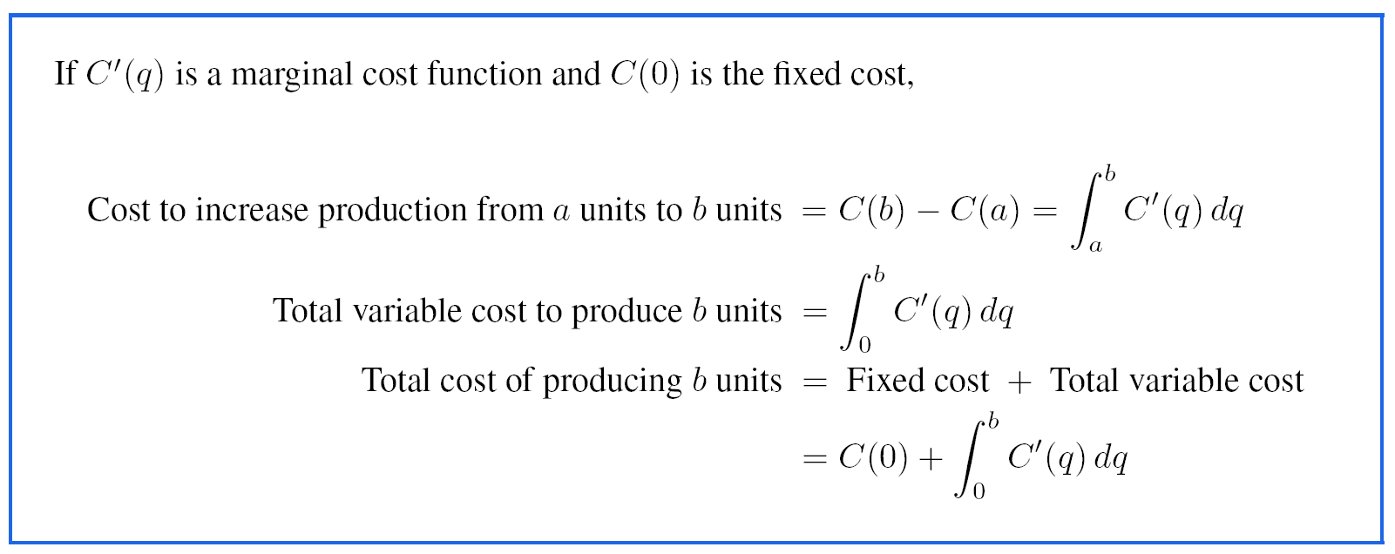
Problem 7
The marginal cost C’(q) (in dollars per unit) of producing q units is given in the following table.
If fixed cost is $10,000, estimate the total cost of producing 400 units.
How much would the total cost increase if production were increased one unit, to 401 units?
q | 0 | 100 | 200 | 300 | 400 | 500 | 600
C’(q) | 25 | 20 | 18 | 22 | 28 | 35 | 45

