Slide 1
Section 6.1 Average Value

Slide 2
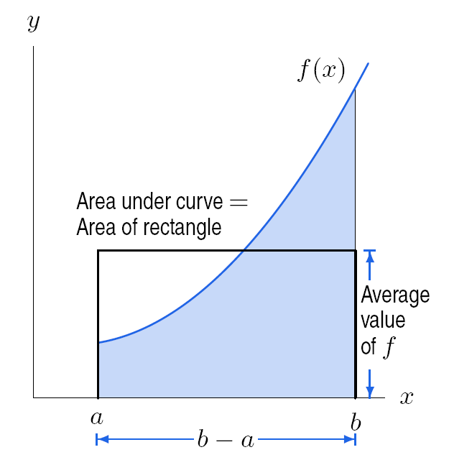
Figure 6.1:
Area and average value

Slide 3
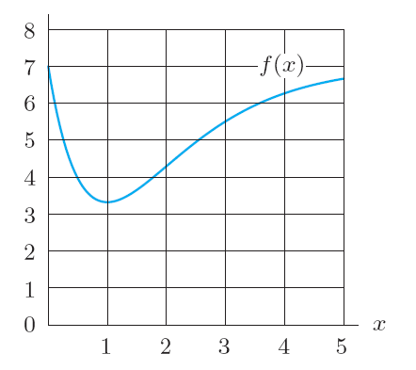
Problem 2
Use Figure 6.5 to estimate the following:
(a) The integral
(b) The average value of f between x = 0 and x = 5 by estimating visually the average height.
(c) The average value of f between x = 0 and x = 5 by using your answer to part (a).
Figure 6.5

Slide 4
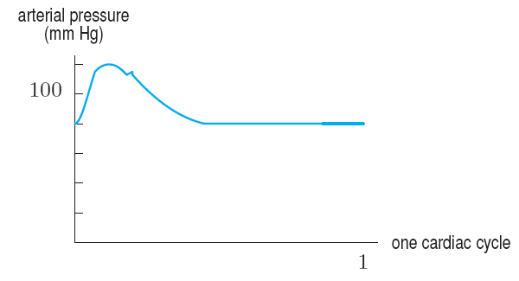
Problems 13 – 14
Refer to Figure 6.6. which shows human arterial blood pressure during the course of one heartbeat.
Figure 6.6
13. (a) Estimate the maximum blood pressure, called the systolic pressure.
(b) Estimate the minimum blood pressure, called the diastolic pressure.
(c) Calculate the average of the systolic and diastolic pressures.
(d) Is the average arterial pressure over the entire cycle greater than, less than or equal to the answer for part (c)?
14. Estimate the average arterial blood pressure over one cardiac cycle.

Slide 5
Section 6.2 Consumer and Producer Surplus

Slide 6
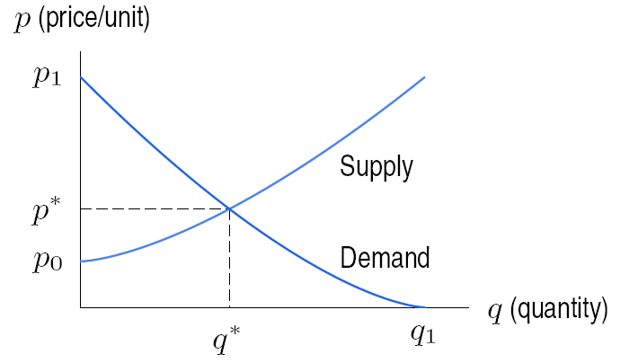
Figure 6.10:
Supply and
demand curves

Slide 7
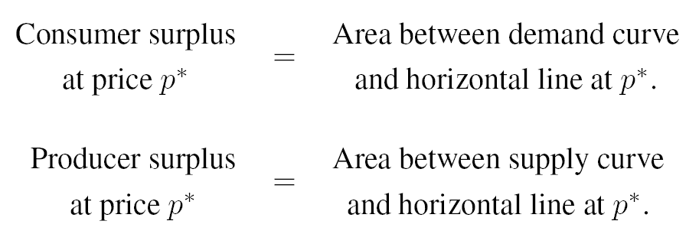
Figure 6.12: Consumer surplus
Figure 6.13: Producer surplus

Slide 8
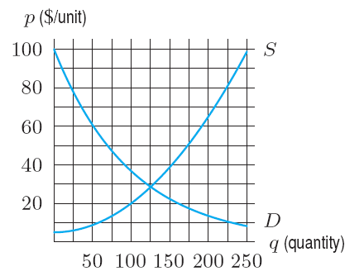
Problems 7 – 8
Supply and demand curves for a product are in Figure 6.27.
(a) Estimate the equilibrium price and quantity.
(b) Estimate the consumer and producer surplus.
Shade them.
(c) What are the total gains from trade for this
product?
Supply and demand curves are in Figure 6.27. A price of $40 is artificially imposed.
(a) At the $40 price, estimate the consumer surplus, the producer surplus, and the total gains from trade.
(b) Compare your answers in this problem to your answers in Problem 7. Discuss the effect of price controls on the consumer surplus, producer surplus, and total gains from trade in this case.
Figure 6.27

Slide 9
Section 6.3 Present and Future Value

Slide 10
Suppose that we want to calculate the present value of the income stream described by a rate of S(t) dollars per year, and that we are interested in the period from now until M years in the future. If the interest rate is r, then the present value is given by
The value M years in the future is given by

Slide 11
Section 6.4 Integrating
Relative Growth Rates

Slide 12
Example

Slide 13
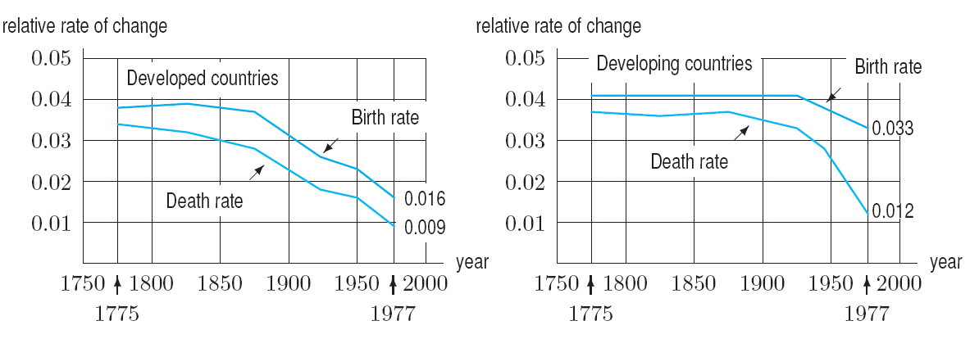
Example 2
Figure 6.30 shows relative birth rates and relative death rates for developed and developing countries.
Figure 6.30:
Birth and death
rates in developed
and developing
countries, 1775-1977
(a) Which is changing faster, the birth rate or the death rate? What does this tell you about how the populations are changing?
Solution

Slide 14
Example 2 continued
Solution
The relative rate of growth of the population is the difference between the relative birth rate and the relative death rate, so it is represented in Figure 6.30 by the vertical distance between the birth-rate curve and the death-rate curve. The area of the region between the two curves from 1800 to 1900, shown in Figure 6.31, gives the change in ln P(t). The region has area approximately equal to a rectangle of height 0.005 and width 100, so has area 0.5. We have
so
During the nineteenth century the population of developing countries increased by about 65%, a factor of 1.65

Slide 15
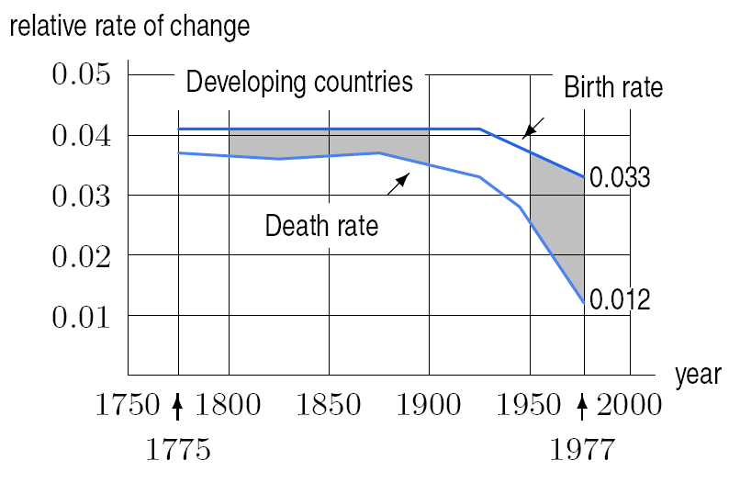
Example 2 continued
Solution
The shaded region between the birth rate and death rate curves from 1950 to 1977 in Figure 6.31 consists of approximately 1.5 rectangles, each of which has area (0.01)(27) = 0.27. The area of this region is approximately (1.5)(0.27) = 0.405. We have
so
Between 1950 and 1970, the population of
developing countries increased by about
50%, a factor of 1.5.
Figure 6.31: Relative growth of population =
Relative birth rate – Relative death rate

