Slide 1
Section 7.1 Constructing Antiderivatives Analytically

Slide 2
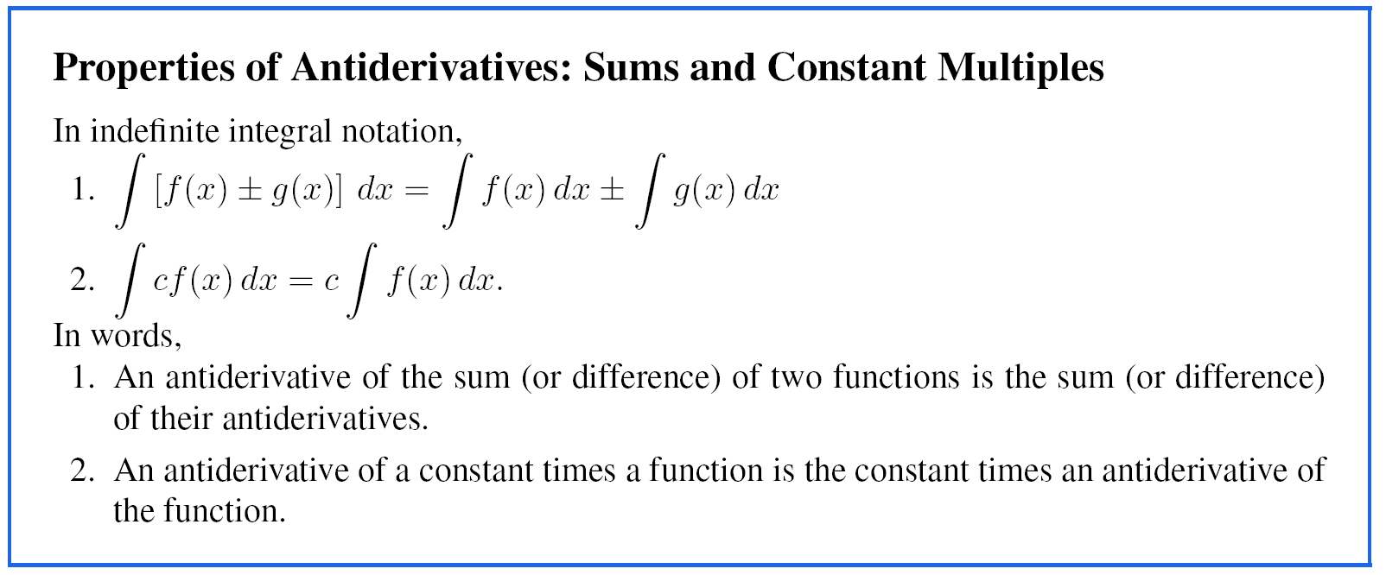

Slide 3
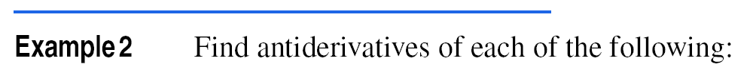






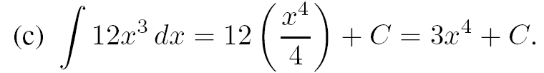
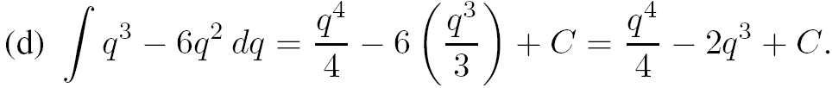
Solution

Slide 4
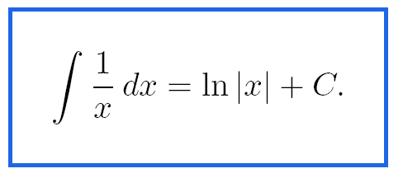
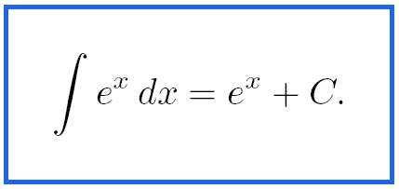
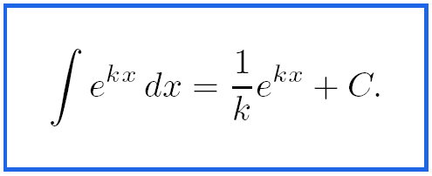

Slide 5

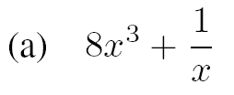

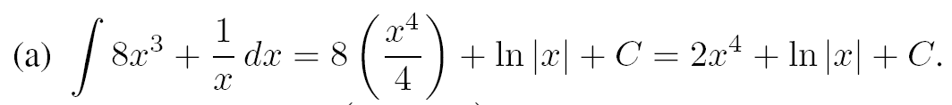
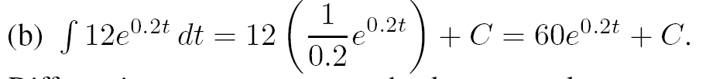
Example 3
Solution

Slide 6
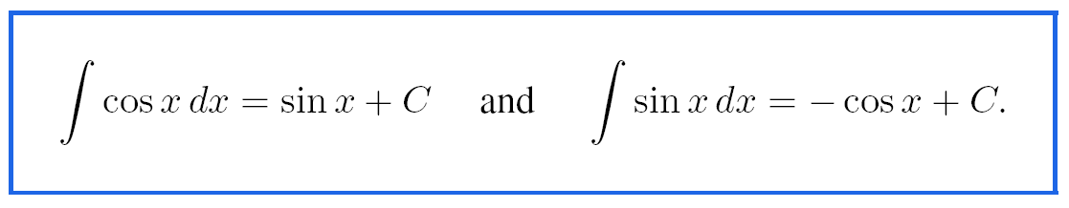
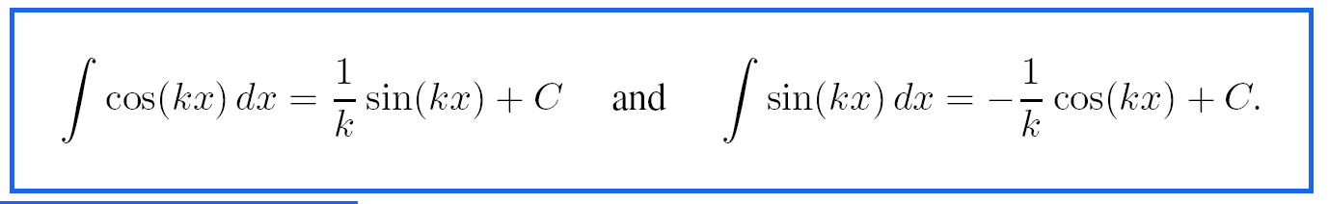

Slide 7
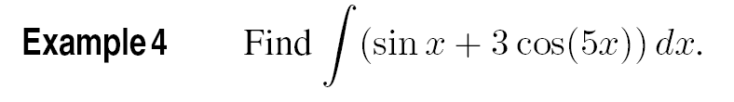
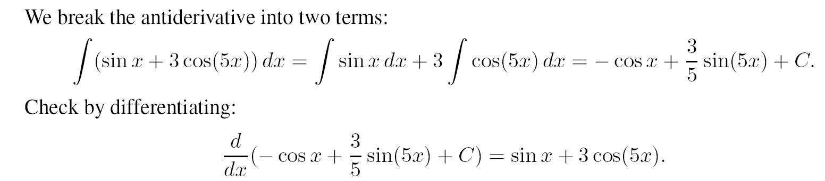
Solution

Slide 8
Section 7.2 Integration by Substitution

Slide 9
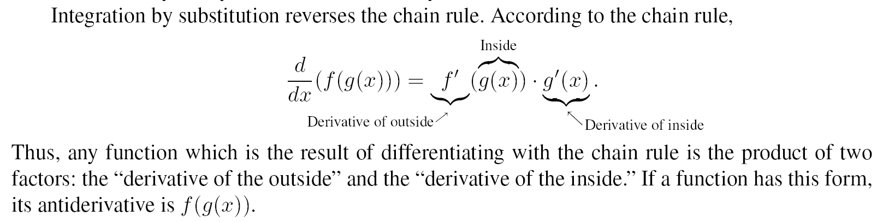

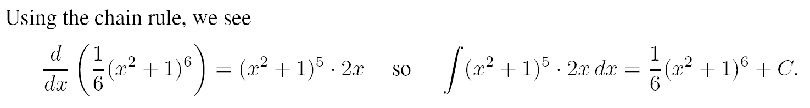
Solution (continued on next slide)

Slide 10
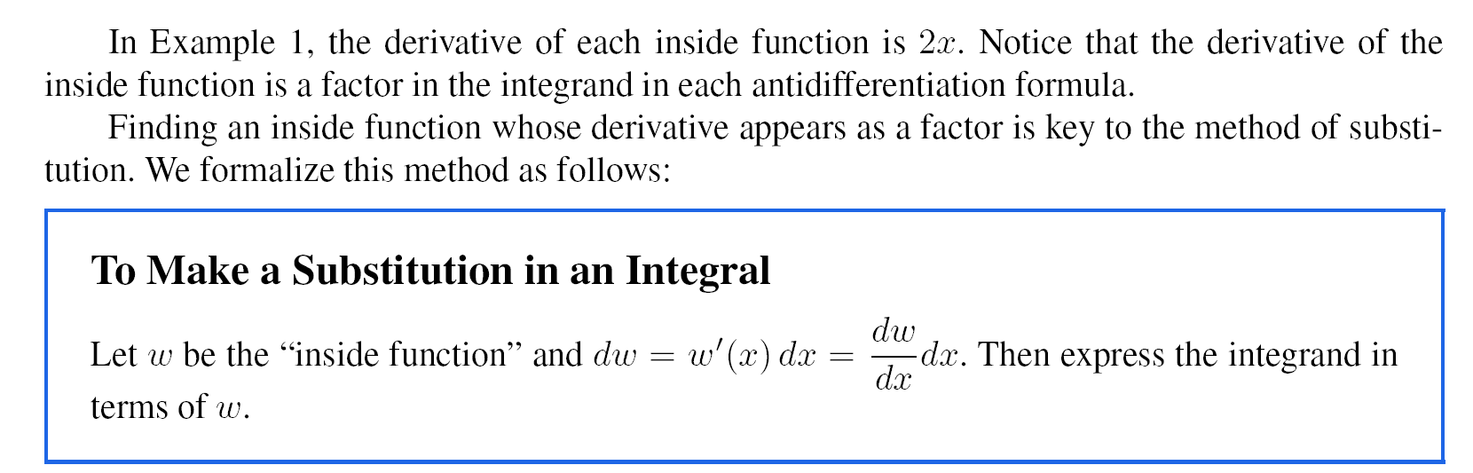

Slide 11
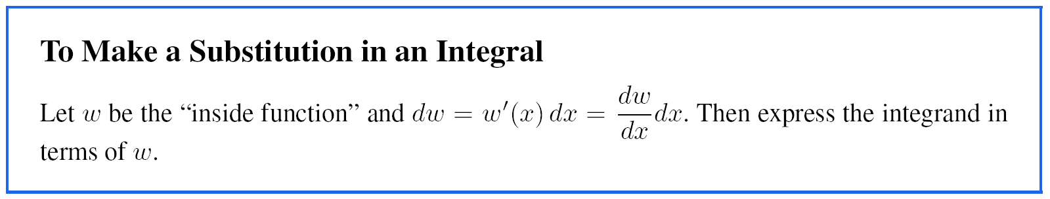
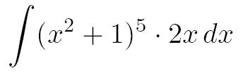
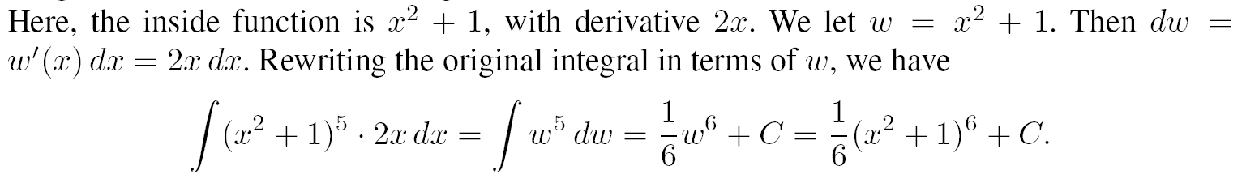
(b)
Solution for (b)

Slide 12
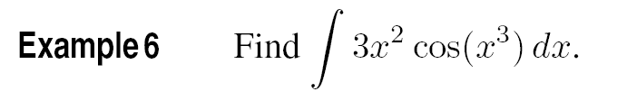
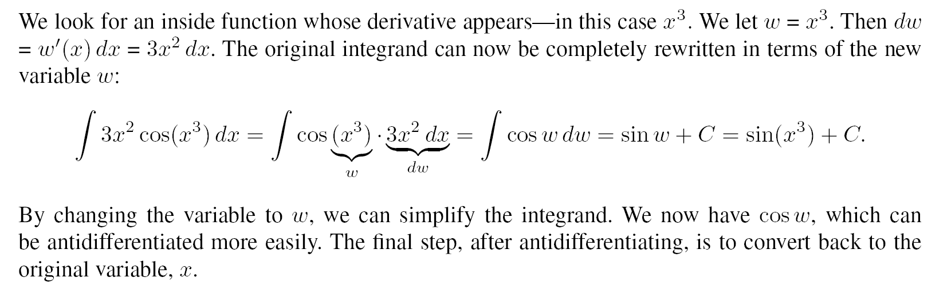
Solution

Slide 13
Section 7.3 Using the Fundamental Theorem to Find Definite Integrals

Slide 14
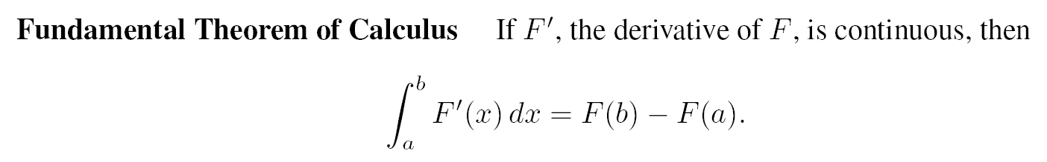
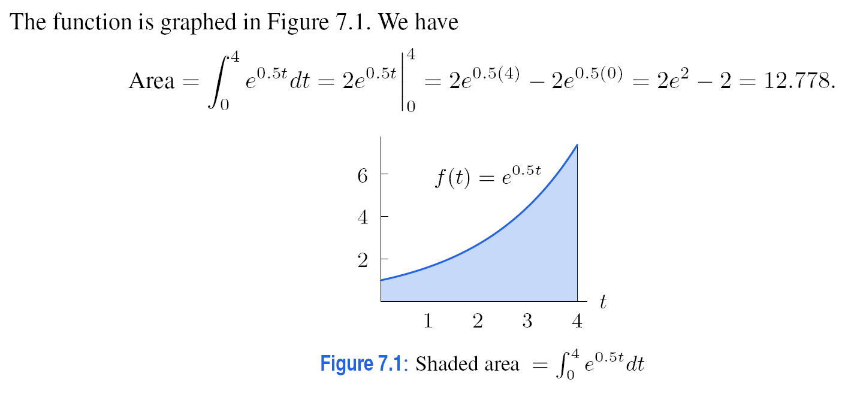
Example 3
Solution

Slide 15
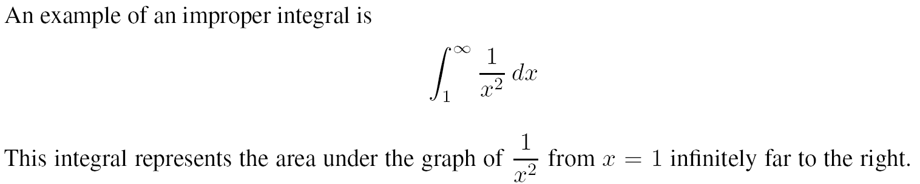
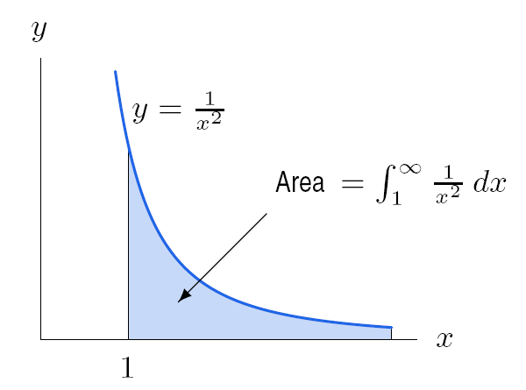
Improper Integrals
Figure 7.2: Area representation of improper integral

Slide 16
Section 7.4 Integration by Parts

Slide 17



The General Formula for Integration by Parts
Integration by Parts
Problem 4
Use integration by parts to find
Solution
Let u = ln y and dv = y dy. Then du = 1/y dy and v = y² /2 giving
Note that by letting u = ln y, the natural log was eliminated from the second integral. Also, u’ dv was something that could be integrated easily.

Slide 18
Section 7.5 Analyzing Antiderivatives Graphically and Numerically

Slide 19
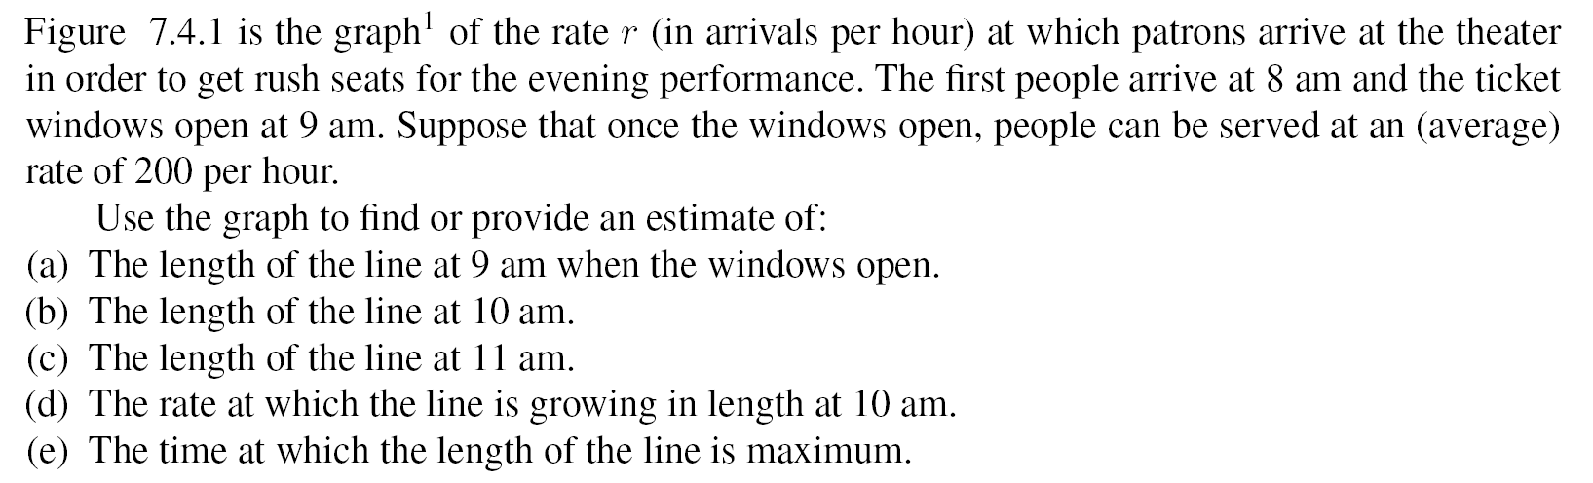
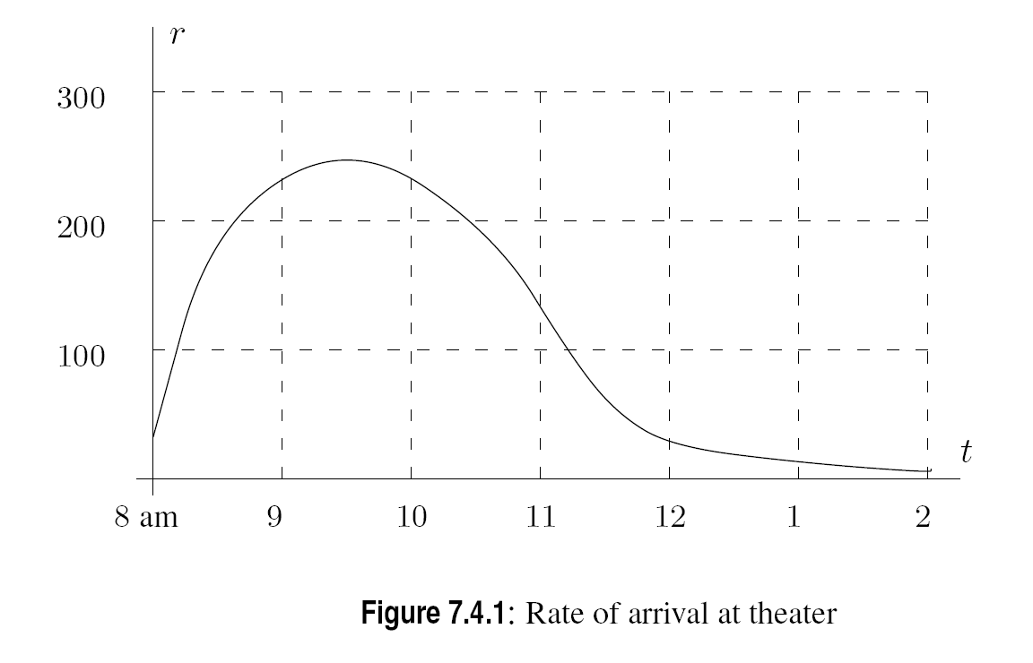
Example

Slide 20
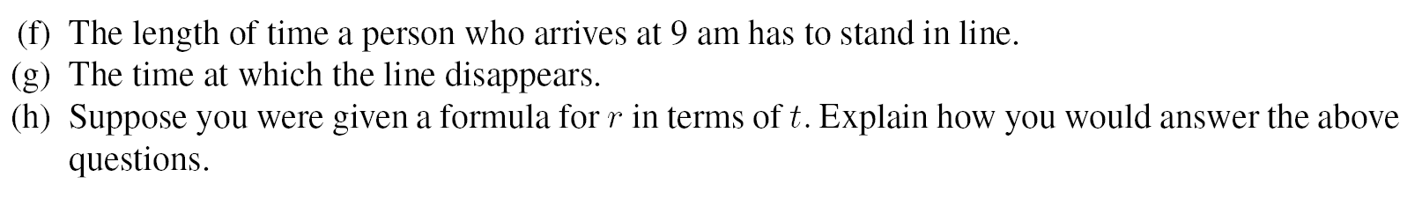
Example continued

Slide 21
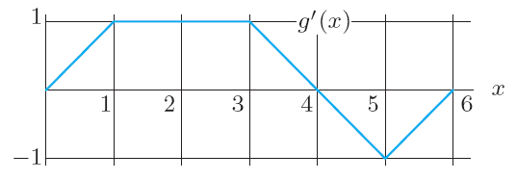
Problem 2
Figure 7.10 shows the derivative g’ . If g (0) = 0, graph g. Give (x, y)-coordinates of all local maxima and minima.
Figure 7.10

