Slide 1
Section 8.1 Density Functions

Slide 2
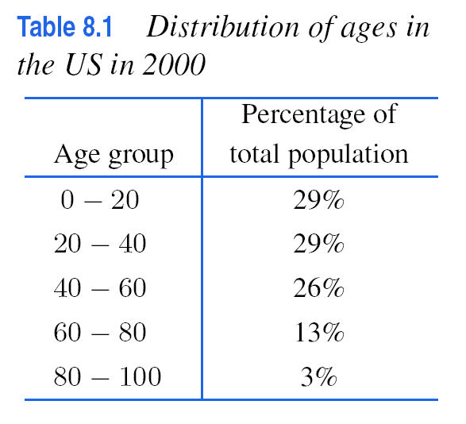
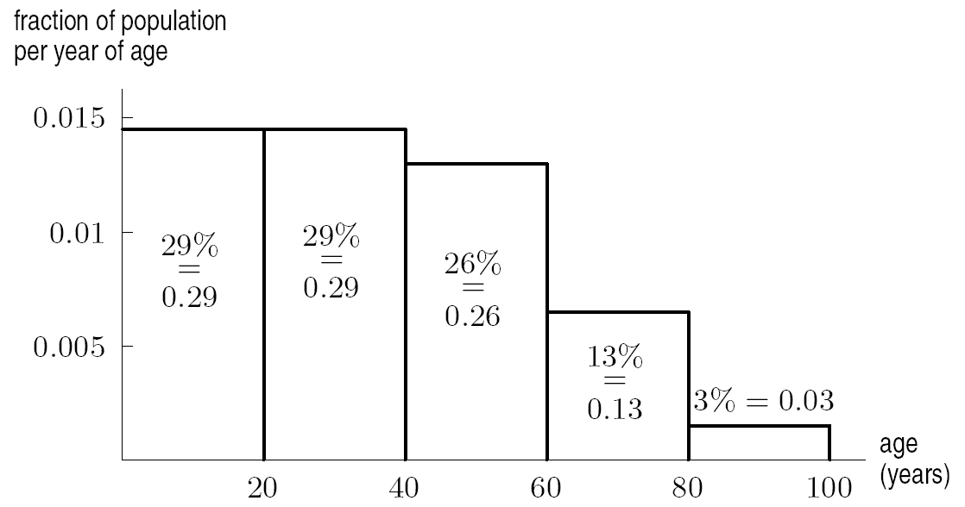
US Age Distribution
Figure 8.1:
How ages were distributed in the US in 2000

Slide 3
Solution
Continued on next slide

Slide 4
Solution
Continued on next slide

Slide 5
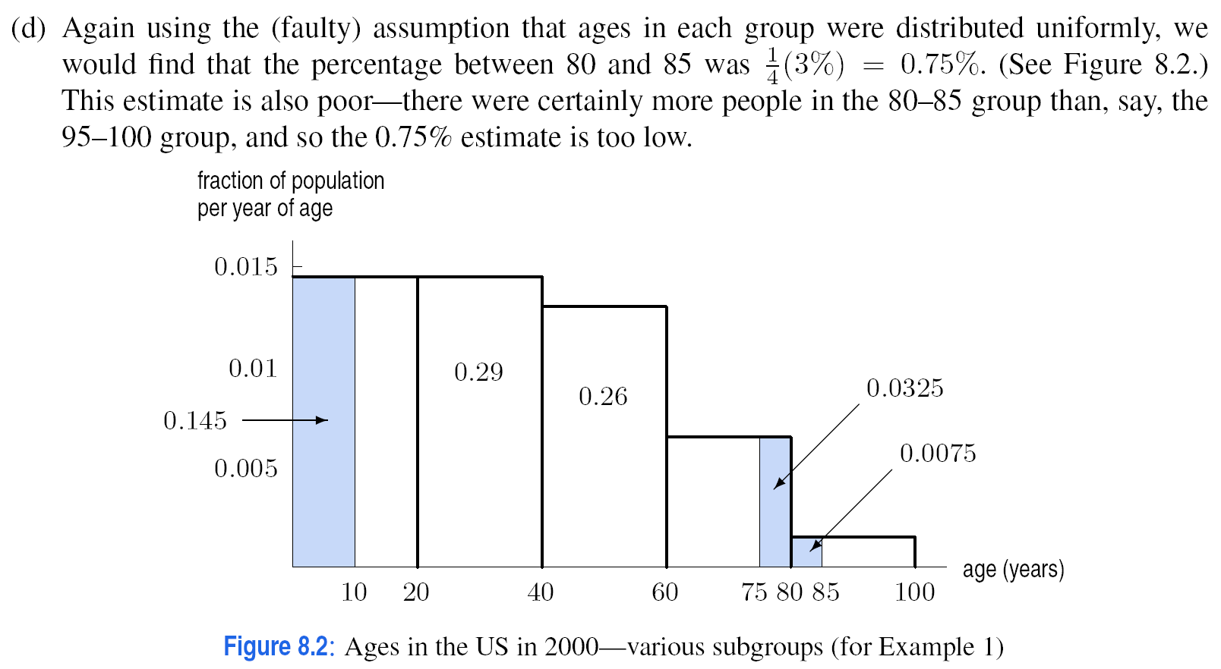
Solution

Slide 6
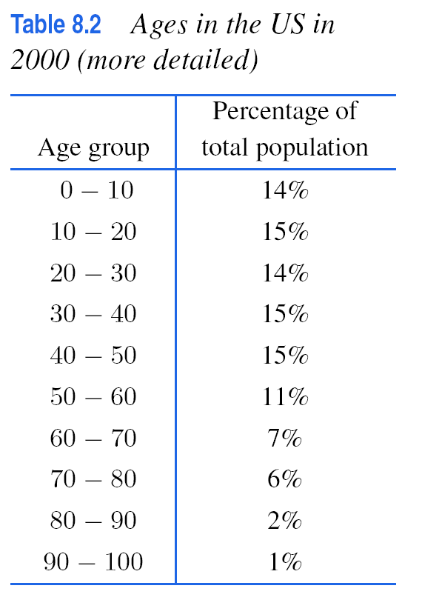
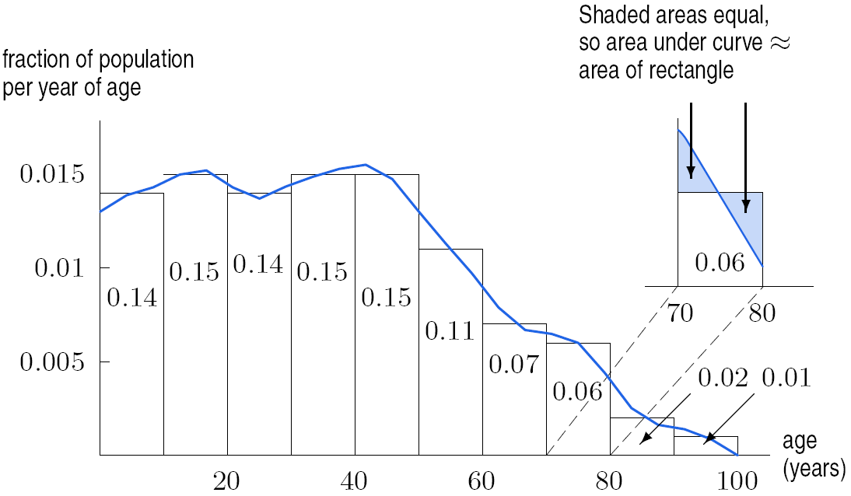
Figure 8.3: Smoothing out the age histogram

Slide 7
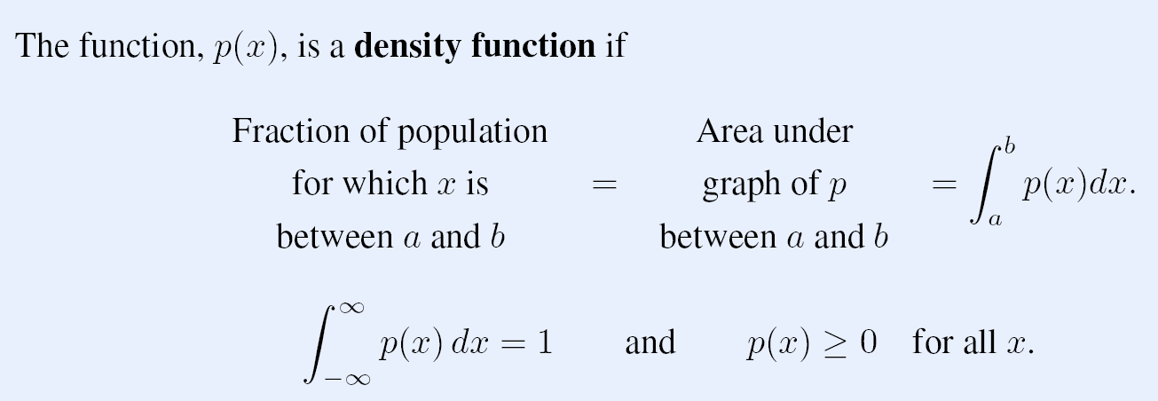

Slide 8
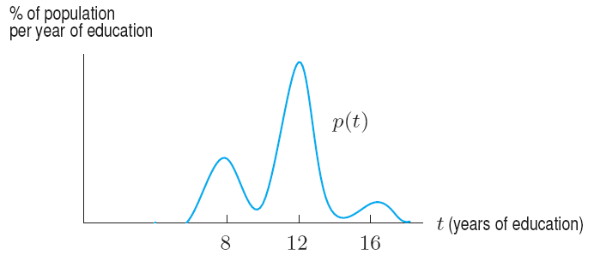
Problem 8
Figure 8.7 shows the distribution of the number of years of education completed by adults in a population. What does the shape of the graph tell you? Estimate the percentage of adults who have completed less than 10 years of education,
Figure 8.7

Slide 9
Section 8.2 Cumulative Distribution Functions and Probability

Slide 10
Figure 8.8: Graph of p(x), the age density function and its relation to P(t), the cumulative age distribution function.

Slide 11
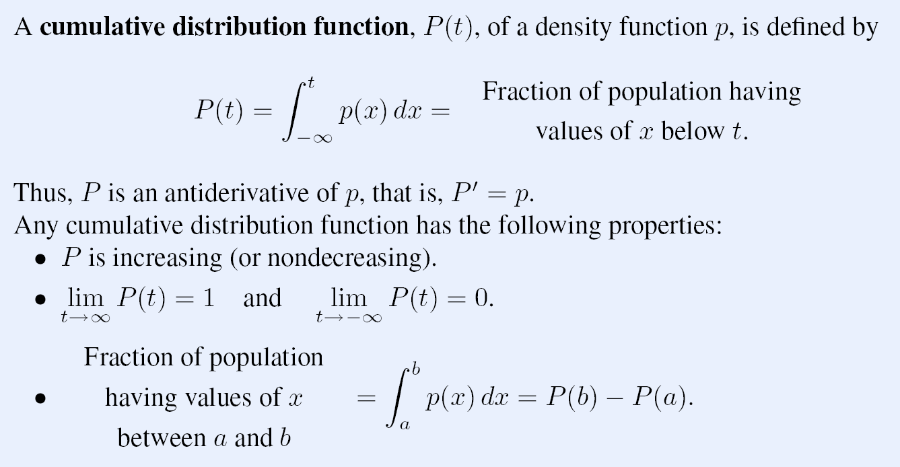

Slide 13
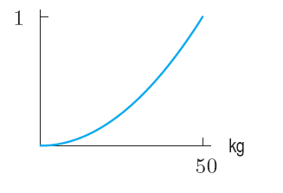
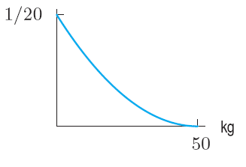
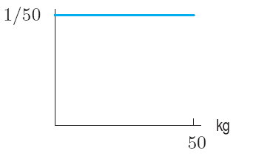
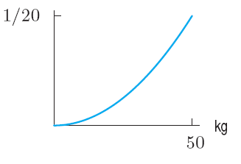
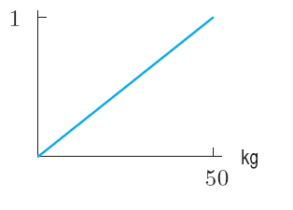
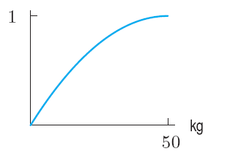
Problem 2
In an agricultural experiment, the quantity of grain from a given size field is measured. The yield can be anything from 0 kg to 50 kg. For each of the following situations, pick the graph that best represents the
(i) Probability density function
(ii) Cumulative distribution function
Situation (a) Low yields are more likely than high yields.
Situation (b) All yields are equally likely.
Situation (c) High yields are more likely than low yields.
l
ll
lll
lV
V
Vl

Slide 14
Section 8.3 The Median and the Mean

Slide 15
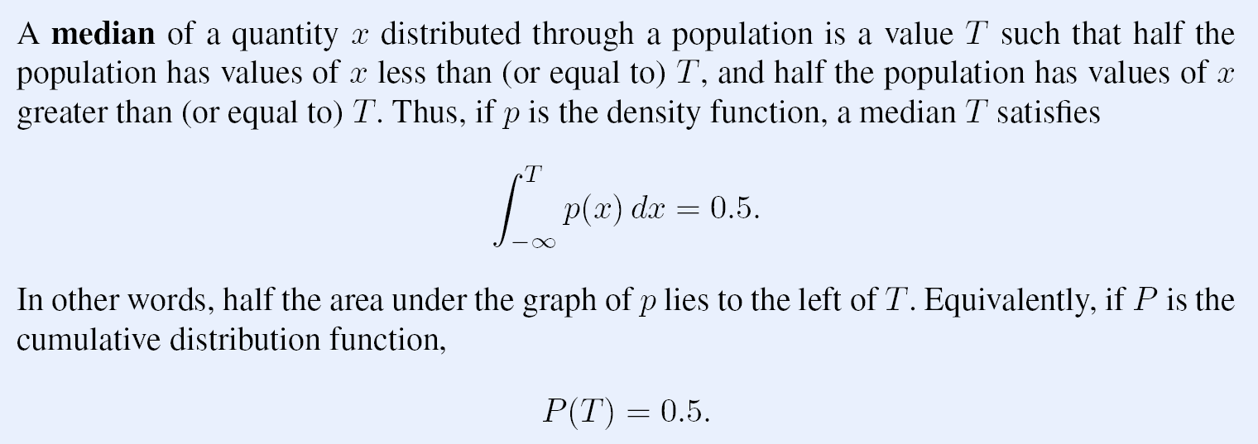

Slide 16
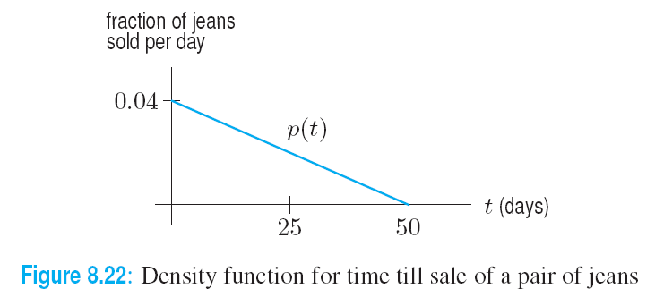
Example 1
Solution

Slide 17
Example 1 continued
Find the median time
required to sell a pair of jeans.
Solution continued on next slide
Let P be the cumulative distribution function. We want to find the value of T such that
Using a calculator to evaluate the integrals, we obtain the values for P in Table 8.7
Table 8.7 Cumulative distribution for selling time
T(days) | 0 | 5 | 10 | 15 | 20 | 25
P(T) (fraction of jeans sold by day T | 0 | 0.19 | 0.36 | 0.51 | 0.64 | 0.75

Slide 18
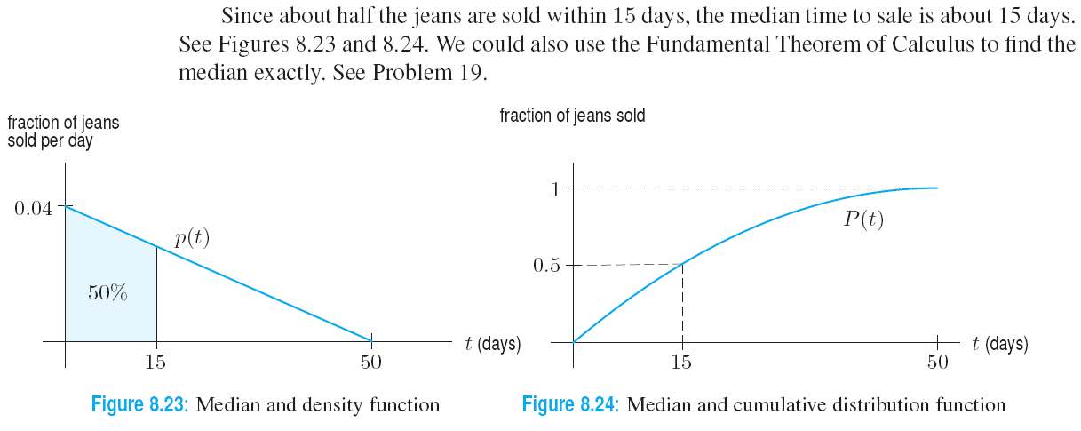
Example 1 (c) continued
Find the median time required to sell a pair of jeans.
Solution continued

Slide 19
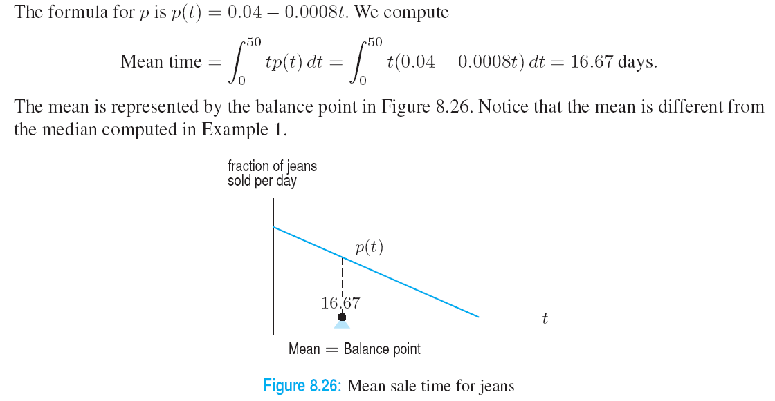
Example 2
Solution

Slide 20
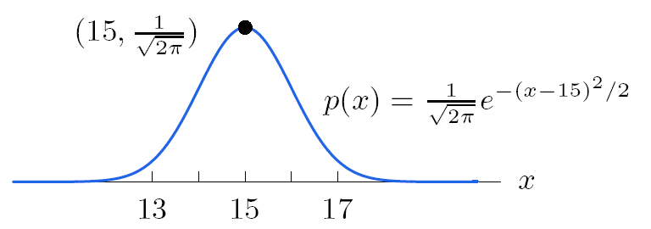
Figure 8.27: Normal distribution with μ = 15 and σ = 1

Slide 21
Example 3
Solution
Continued on next slide

Slide 22
Example 3 continued
Solution

