Slide 1
Section 9.1 Understanding Functions of Two Variables

Slide 2
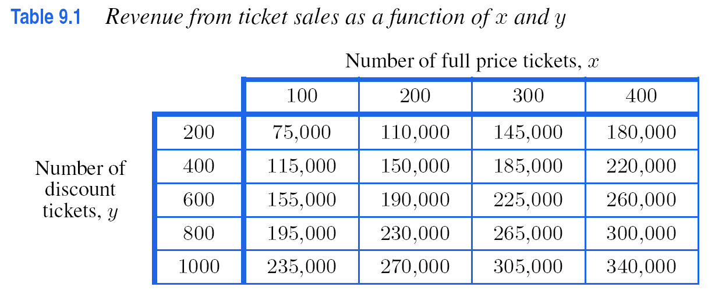

Slide 4
Example 3
Solutions on next two slides

Slide 5
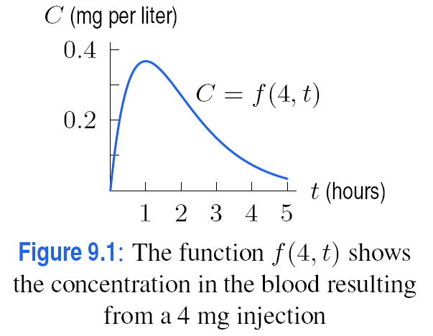
Example 3
Solution

Slide 6
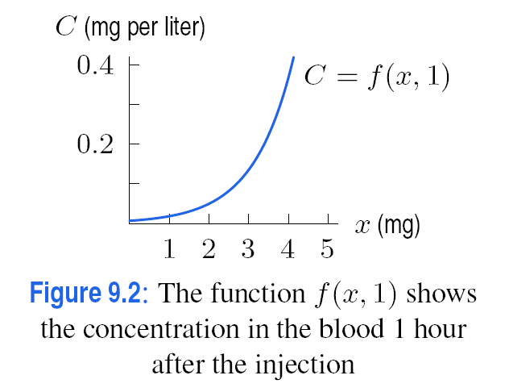
Example 3
Solution

Slide 7
Problem 10
The number, n, of new cars sold in a year is a function of the price of new cars, c, and the average price of gas, g.
(a) If c is held constant, is n an increasing or decreasing function of g? Why?
(b) If g is held constant, is n an increasing or decreasing function of c? Why?

Slide 8
Section 9.2 Contour Diagrams

Slide 9
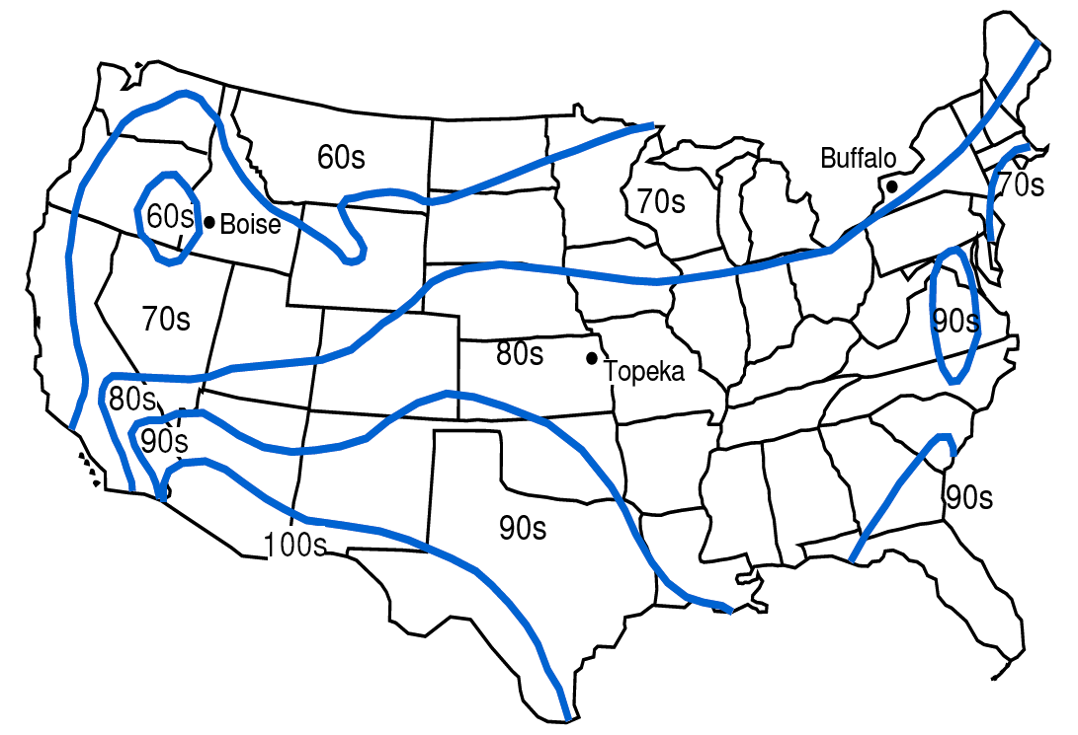
Figure 9.5: Weather map showing predicted high temperatures, T, on a summer day

Slide 10
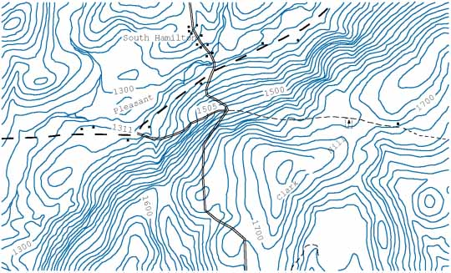
Figure 9.6: A topographical map showing the region around South Hamilton, NY

Slide 11
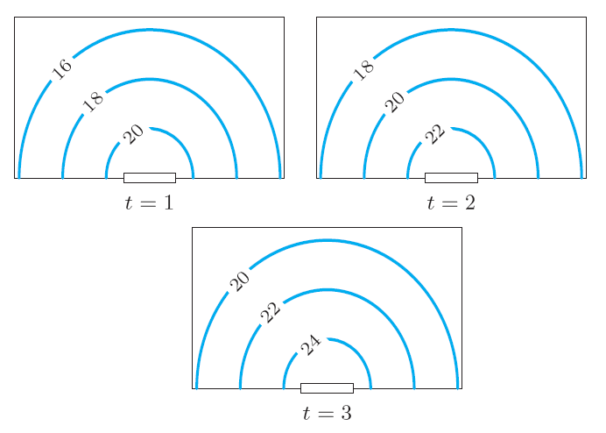
Problem 3
Figure 9.22 shows contour diagrams of temperature in °C in a room at three different times. Describe the heat flow in the room. What could be causing this?
Figure 9.22

Slide 12
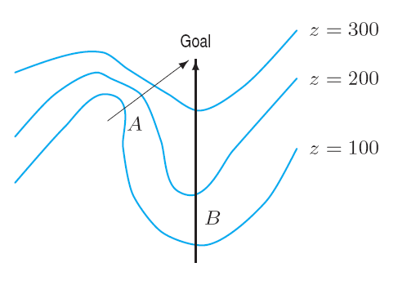
Problem 24
Figure 9.30 shows a contour map of a hill with two paths, A and B.
On which path, A or B, will you have to climb more steeply?
On which path, A or B, will you probably have a better view of the surrounding countryside? (Assume trees do not block your view.)
Alongside which path is there more likely to be a stream?
Figure 9.30

Slide 13
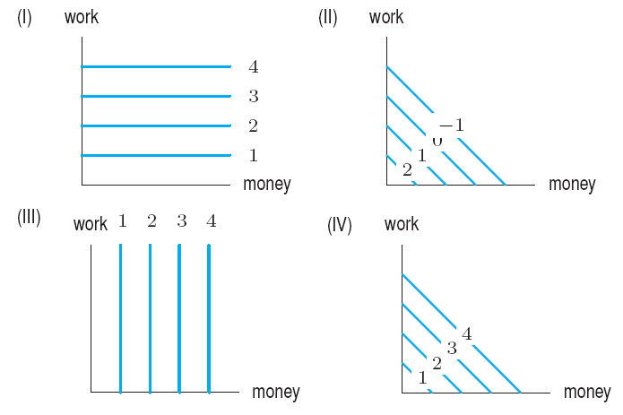
Problem 25
Match the following descriptions of a company’s success with the contour diagrams of success as a function of money and work in Figure 9.31.
Our success is measured in dollars, plain and simple. More hard work won’t hurt, but it won’t help.
No matter how much money or hard work we put into the company, we just can’t make a go of it.
Although we are not always totally successful, it seems that the amount of money invested does not matter. As long as we put hard work into the company, our success increases.
The company’s success is based on both hard work and investment.
Figure 9.31

Slide 15
Section 9.3 Partial Derivatives

Slide 17
Problem 8
Table 9.6 gives the number of calories burned per minute, B = f(s, w), for someone roller-blading, as a function of a person’s weight, w, and speed, s.
Is f_{w} positive or negative? Is f_{s} positive or negative? What do your answers tell us about the effect of weight and speed on calories burned per minute?
Estimate f_{w}(160, 10) and f_{s}(160,10). Interpret your answers.
Table 9.6 Calories burned per minute
w\s | 8 mph | 9 mph | 10 mph | 11 mph
120 lbs. | 4.2 | 5.8 | 7.4 | 8.9
140 lbs. | 5.1 | 6.7 | 8.3 | 9.9
160 lbs. | 6.1 | 7.7 | 9.2 | 10.8
180 lbs. | 7.0 | 8.6 | 10.2 | 11.7
200 lbs. | 7.9 | 9.5 | 11.1 | 12.6

Slide 18
Problem 11
The sales of a product S = f (p, a), are a function of the price, p, of the product (in dollars per unit) and the amount, a, spent on advertising (in thousands of dollars).
Do you expect f_{p} to be positive or negative? Why?
Explain the meaning of the statement f_{a} (8, 12) = 150 in terms of sales.
Problem 15
People commuting to a city can choose to go either by bus or by train. The number of people who choose either method depends in part upon the price of each. Let f (P₁, P₂) be the number of people who take the bus when P₁ is the price of a bus ride and P₂ is the price of a train ride. What can you say about the signs of and ? Explain your answers.

Slide 19
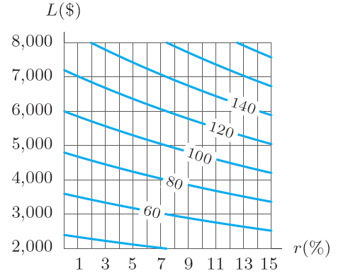
Problem 12
Figure 9.37 shows a contour diagram for the monthly payment P as a function of the interest rate, r%, and the amount, L, of a 5-year loan. Estimate and at the point where r = 8 and L = 5000. Give the units and the financial meaning of your answers.
Figure 9.37

Slide 20
Problem 20
For a function f (x, y), we are given
f (100, 20) = 2750 f_{x}(100, 20) = 4 f_{y}(100, 20) = 7
Estimate f (105, 21).

Slide 21
Section 9.4 Computing Partial Derivatives Algebraically

Slide 22
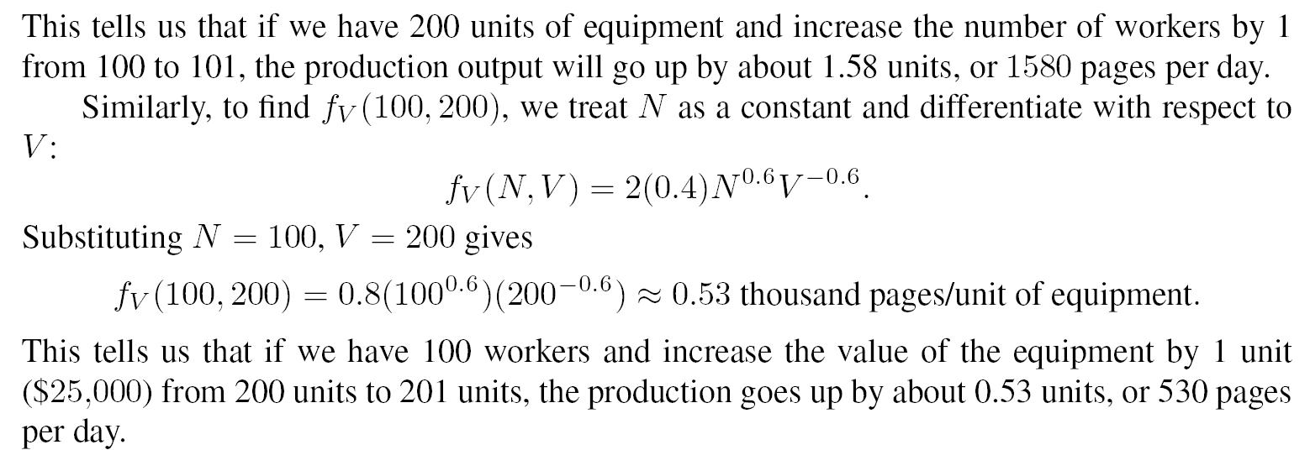
Example 5 (b)
Solution

Slide 25
Section 9.5 Critical Points and Optimization

Slide 27
Example 1
Table 9.8 gives a table of values for a function f (x, y). Estimate the location and value of any global maxima or minima for 0 ≤ x ≤ 1 and 0 ≤ y ≤ 20
Table 9.8 Where are the extreme points of this function f (x, y)?
y\x | 0 | 0.2 | 0.4 | 0.6 | 0.8 | 1.0
0 | 80 | 84 | 82 | 76 | 71 | 65
5 | 86 | 90 | 88 | 73 | 77 | 71
10 | 91 | 95 | 93 | 88 | 82 | 76
15 | 87 | 91 | 89 | 84 | 78 | 72
20 | 82 | 86 | 84 | 79 | 73 | 67

Slide 28
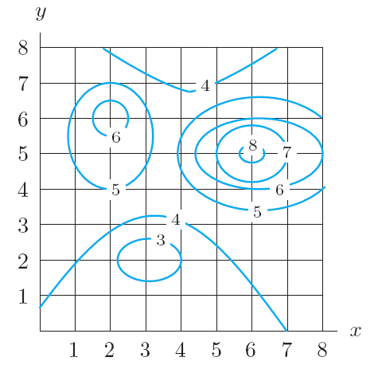
Example 2
Figure 9.42 gives a contour diagram for a function f (x, y). Estimate the location and value of any local maxima or minima. Are any of these global maxima or minima on the square shown?
Figure 9.42: Where are the
local and global extreme points
of this function?

Slide 29
Problem 16
By looking at the weather map in figure 9.5 on page 354, find the maximum and minimum daily high temperatures in the states of Mississippi, Alabama, Pennsylvania, New York, California, Arizona, and Massachusetts.
Figure 9.5

Slide 30
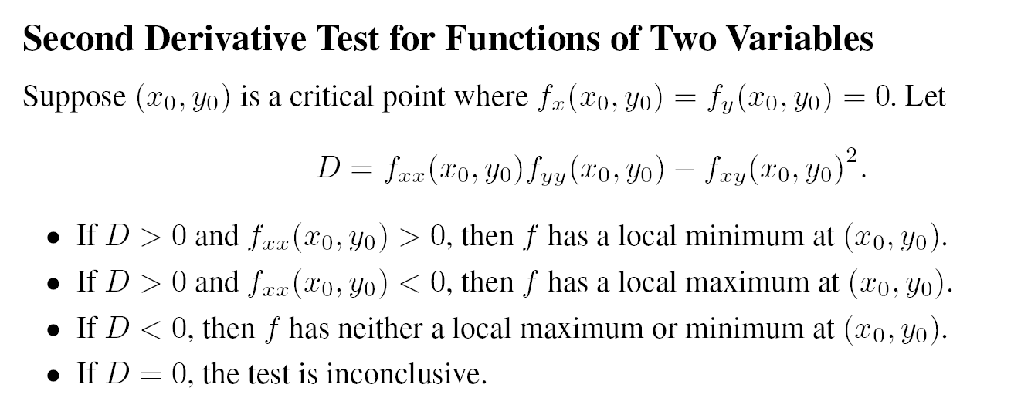

Slide 31
In Problems 6 – 15, find all the critical points and determine whether each is a local maximum, local minimum, or neither.
Problem 8 f (x, y) = x² + y² + 6 x – 10 y + 8
Problem 10 f (x, y) = x² – 2 x y + 3 y² – 8 y
Problem 12 f (x, y) = x³ + y² – 3 x² + 10 y + 6
Problem 15 f (x, y) = 400 – 3 x² – 4 x + 2 x y – 5 y² + 48 y
Problem 18
A missile has a guidance device which is sensitive to both temperature, t°C, and humidity, h. The range in km over which the missile can be controlled is given by
Range = 27,800 – 5 t² – 6 h t – 3 h² + 400 t + 300 h
What are the optimal atmospheric conditions for controlling the missile?

Slide 32
Section 9.6 Constrained Optimization

Slide 33
Example 1
Solution

Slide 34
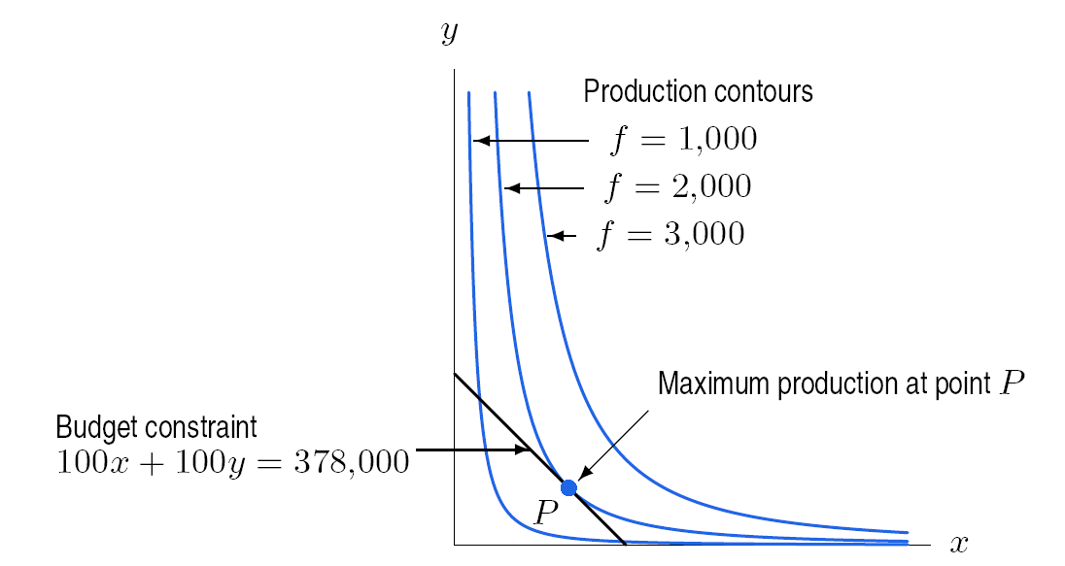
Figure 9.45: At the optimal point P the budget constraint is tangent to a production contour.

Slide 36
Example 3
Solution

Slide 37
Example 4a
Solution
Continued on next slide

Slide 38
Example 4a continued
Solution

Slide 39
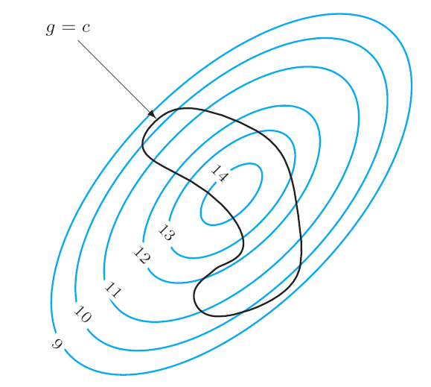
Problem 12
Figure 9.47 shows contours labeled with values of f (x, y) and a constraint g (x, y) = c. Mark the approximate points at which:
(a) f has a maximum
(b) f has a maximum on the constraint g = c.
Figure 9.47

