Slide 1
Section 10.1 Mathematical Modeling: Setting Up A Differential Equation

Slide 2
Marine Harvesting

Slide 3
Examples
Solution

Slide 4
Section 10.2 Solutions of
Differential Equations

Slide 5
Another Look at Marine Harvesting

Slide 6
Example 1
Solution

Slide 7
Problem 14
Fill in the missing values in Table 10.3 given dy/dt = 0.5 y. Assume the rate of growth, given by dy/dt, is approximately constant over each time interval.
Table 10.3
t | 0 | 1 | 2 | 3 | 4
y | 8

Slide 8
Problem 22
Match solutions and differential equations. (Note: Each equation may have more than one solution, or no solution.)
(a) (l) y = x³
(b) (ll) y = 3x
(c) (lll) y = e^{3x}
(d) (lV) y = 3e^{x}
(e) (V) y = x

Slide 9
Section 10.3 Slope Fields

Slide 10
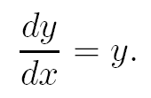
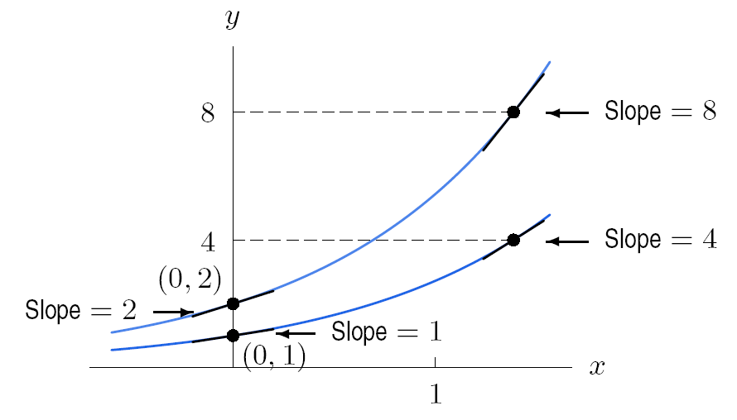
Figure 10.7: Solution to

Slide 11
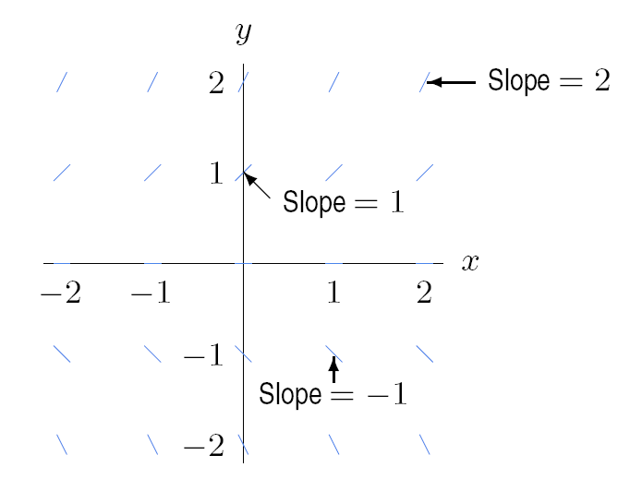
Figure 10.8: Visualizing the slope of y, if

Slide 12
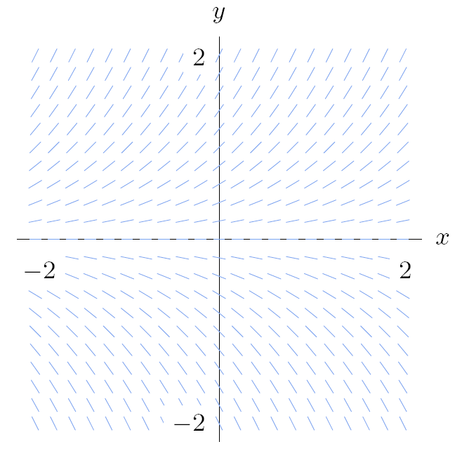
Figure 10.9: Slope field for

Slide 13
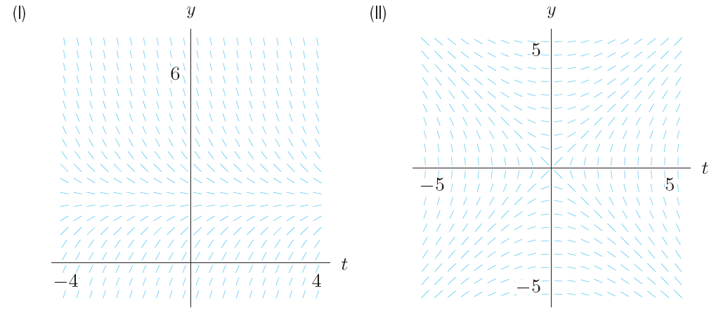
Example 3 a
The slope fields for and are shown in Figure 10.13.
Which slope field corresponds to which differential equation?
Solution
(a) Consider the slopes at different points for the two differential equations. In particular, look at the line y = 2 in Figure 10.12. The equation dy/dt = 2 – y has slope 0 along this line, whereas the equation dy/dt = 1/y has slope ½.. Since slope field (l) looks horizontal at y = 2, it corresponds to dy/dt = 2 – y and slopefield (ll) corresponds to dy/dt = 1/ y .
Figure 10.13: Slope fields for and . Which is which?

Slide 14
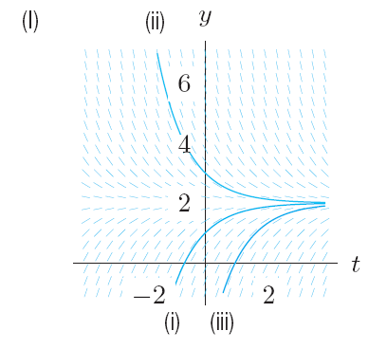
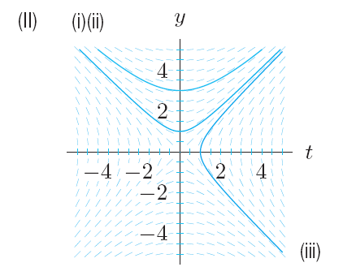
Example 3 b
The slope fields for and are shown in Figure 10.13.
(b) Sketch solution curves on each slope field with initial conditions
(i) y = 0 when t = 0 (ii) y = 3 when t = 0 (iii) y = 0 when t = 1
Solution
(b) The initial conditions (i) and (ii) give the value of y when t = 0, that is, the y-intercept. To draw the solution curve satisfying the condition (i), draw the solution curve with y-intercept 1. For (ii), draw the solution curve with y-intercept 3. For (iii), the solution curve goes through the point (1, 0), so draw this solution curve as in Figures 10.14-10.15
Figure 10.14: Solution curves for Figure 10.15: Solution curves for

Slide 15
Example 3 c
The slope fields and solution curves for and are shown below.
Figure 10.14: Solution curves for Figure 10.15: Solution curves for
(c) For each solution curve, can you say anything about the long-run behavior of y? In particular, as t → ∞, what happens to the value of y?
Solution

Slide 16
Section 10.4 Exponential Growth and Decay

Slide 17
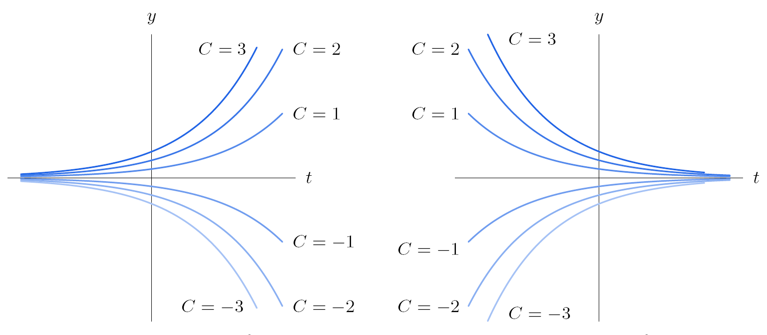
Figure 10.25: k > 0 Figure 10.26: k < 0
Graphs of y = C e ^{kt}, which are solutions to for some fixed k.

Slide 18
Problem 6
Find the solution to the differential equation, subject to the given initial condition.
Problem 14
Oil is pumped continuously from a well at a rate proportional to the amount of oil left in the well. Initially there were 1 million barrels of oil in the well; six years later 500,000 barrels remain.
At what rate was the amount of oil in the well decreasing when there were 600,000 barrels remaining?
When will there be 50,000 barrels remaining?

Slide 19
Section 10.5 Applications and Modeling

Slide 20
Examples

Slide 22
An equilibrium solution is constant for all values of the independent variable. The graph is a horizontal line. Equilibrium solutions can be identified by setting the derivative of the function to zero.
An equilibrium solution is stable if a small change in the initial conditions gives a solution which tends toward the equilibrium as the independent variable tends to positive infinity.
An equilibrium solution is unstable if a small change in the initial conditions gives a solution curve which veers sway from the equilibrium as the independent variable tends to positive infinity.

Slide 23
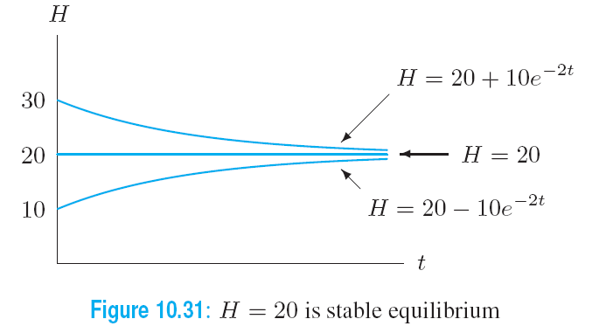
Example 4 a
Solution

Slide 24
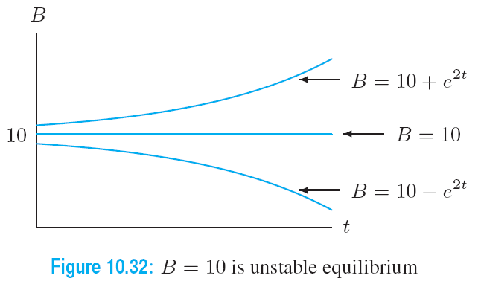
Example 4 b
Solution

Slide 25
Section 10.6 Modeling the Interaction of Two Populations

Slide 26
A Predator-Prey Model: Robins and Worms

Slide 27
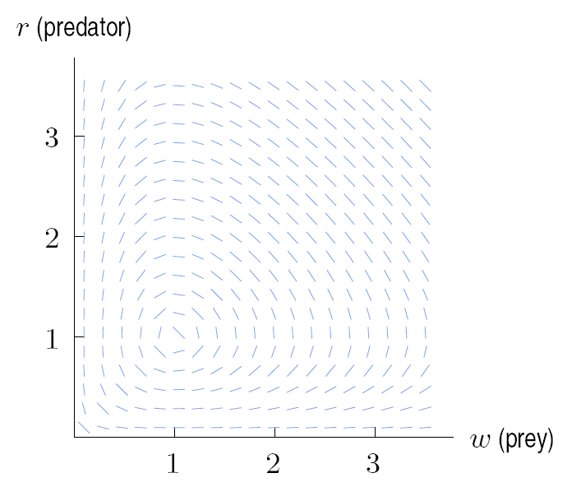
A Predator-Prey Model: Robins and Worms – The w-r Phase Plane
We can eliminate the independent variable t and write these equations as
Figure 10.37: Slope field for

Slide 28
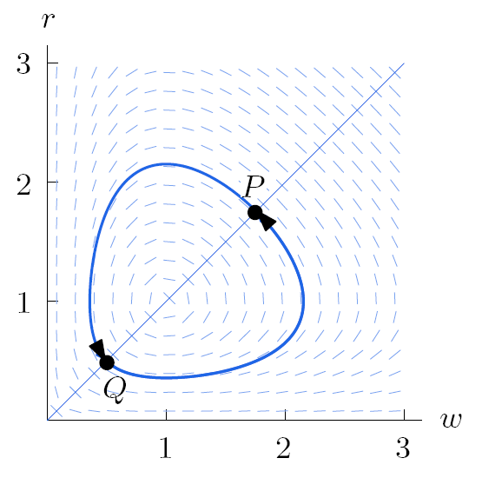
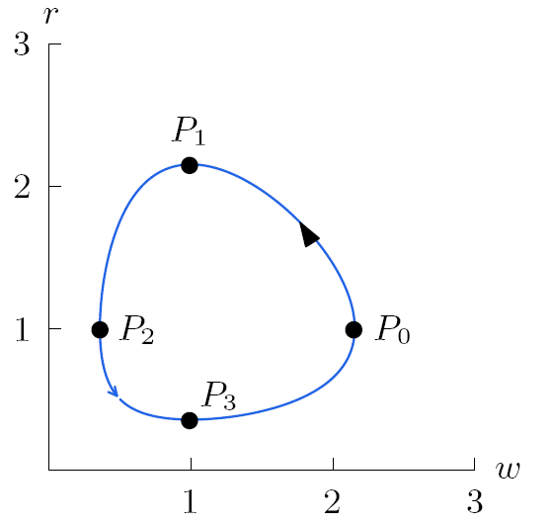
A Predator-Prey Model: Robins and Worms – Trajectories in w-r the Phase Plane
Figure 10.38: Solution curve is closed Figure 10.39: A trajectory

Slide 29
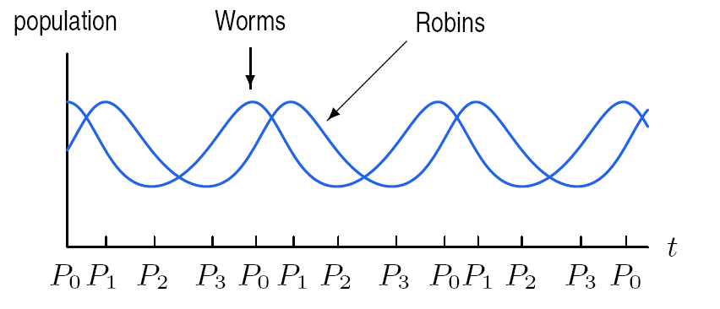
A Predator-Prey Model: Robins and Worms
The Populations as Functions of Time
Figure 10.40: Populations of robins (in thousands) and worms (in millions) over time

Slide 30
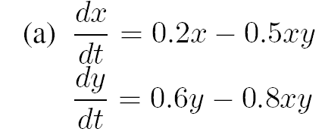
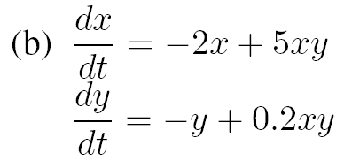
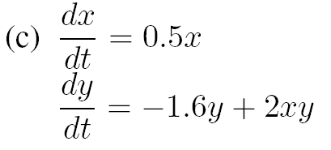
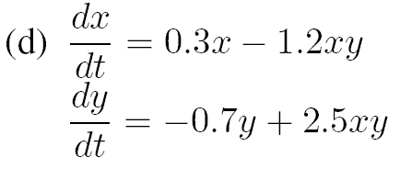
Example 2
Solution

Slide 31
Section 10.7 Modeling the Spread of a Disease

Slide 32
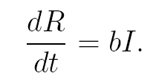
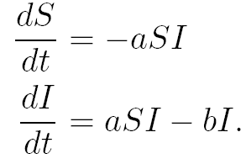
The S-I-R Model
continued

Slide 33
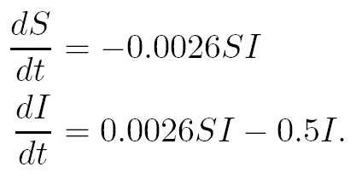
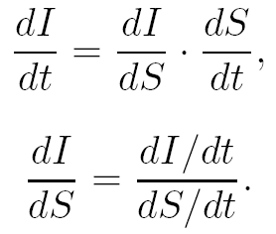
The Case of the Flu
In the case of the flu it is reasonable to let a = 0.0026 and b = 0.5. Thus our equations are:

Slide 34
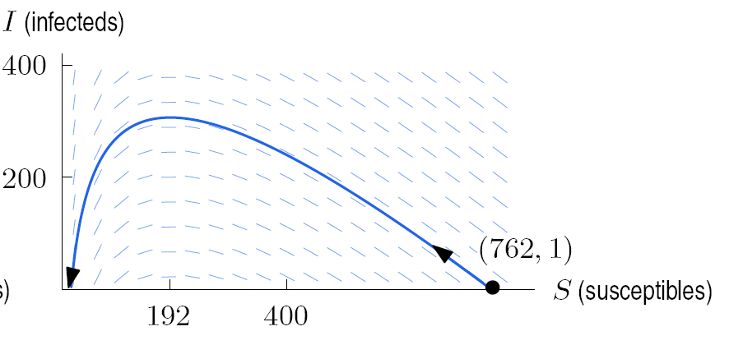
The Phase Plane for the Spread of the Flu
Figure 10.44: Slope field and trajectory for

Slide 35
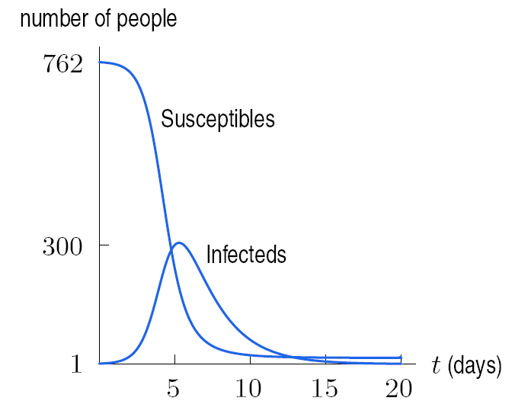
People Susceptible and Infected Over Time
Figure 10.45: Progress of the flu over time

