Slide 1
Section 11.1 Geometric Series

Slide 2
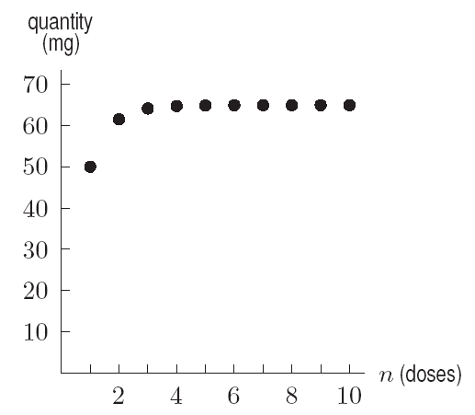
Example
Figure 11.1: Quantity
of quinine levels off

Slide 3
Problem 2
Find the sum of the following series in two ways: by adding terms and by using the geometric series formula.
50 + 50 (0.9) + 50 (0.9)² + 50 (0.9)³

Slide 4
Problem 14
Find the sum if it exists.

Slide 5
Section 11.2 Applications to
Business and Economics

Slide 6
Example 1
Solution

Slide 7
Example 2
Solution
The present value of the payment to be made immediately is $10,000. The present value of next year’s payment is $10,000 (1.08)⁻¹. Since the 20th payment is made 19 years in the future, the present value of the 20th payment is $10,000 (1.08)⁻¹⁹. The present value, P, of the entire annuity, in dollars, is the sum
P = 10,000 + 10,000 (1.08)⁻¹ + 10,000 (1.08)⁻² + … + 10,000 (1.08)⁻¹⁹
Rewriting (1.08)⁻² = (1.08⁻¹)², etc. shows that P is the sum of the finite geometric series
P = 10,000 + 10,000 (1.08)⁻¹ + 10,000 (1.08⁻¹)² + … + 10,000 (1.08⁻¹)¹⁹
We use the formula for the sum with a = 10,000 and r = (1.08)⁻¹ and n = 20, giving
Thus $106,035.99 must be deposited now to cover the payments for this annuity. Notice that the annuity pays out a total of 20∙$10,000 = $200,000, so the present value is considerably less than the amount eventually paid out.

Slide 8
Example 4
Solution
The additional spending refers to all the additional money spent by consumers as a result of this tax rebate. The recipients of the 3 billion dollars spend 75% of what they receive, that is 3(0.75) = 2.25 billion dollars. The recipients of this 2.25 billion dollars spend 75% of that, or 2.25 (0.75) = 1.6875 billion dollars. The recipients of this money spend 75% of this amount and so on. Thus,
Total additional spending = 2.25 + 2.25 (0.75) + 2.25 (1.75)² + … billion dollars
(Notice that the initial amount spent was 2.25, not 3 billion dollars.) This is an infinite geometric series with a = 2.25 abd r = 0.75. Since |r| < 1, this series converges to a finite sum:
Thus, a 3 billion dollar tax rebate generates 9 billion dollars of additional spending.

Slide 9
Section 11.3 Applications to the Natural Sciences

Slide 10
Example 1a
Solution

Slide 11
Example 1b
Solution

Slide 12
Example 1c
Solution
(c)
Problem 4 shows how this can be used to calculate Q,
The long-run quantity of ampicillin right after a dose.

Slide 13
Example 2
Solution

Slide 14
Example 3
Solution

