Slide 1
Inferential Statistics and Probability a Holistic Approach
Chapter 11
Chi-square Tests for Categorical Data
This Course Material by Maurice Geraghty is licensed under a Creative Commons Attribution-ShareAlike 4.0 International License. Conditions for use are shown here: https://creativecommons.org/licenses/by-sa/4.0/

Slide 2
Characteristics of the Chi-Square Distribution
14-2
The major characteristics of the chi-square distribution are:
It is positively skewed
It is non-negative
It is based on degrees of freedom
When the degrees of freedom change a new distribution is created

Slide 3
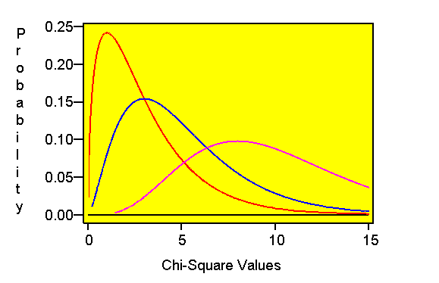
2-2
CHI-SQUARE DISTRIBUTION
df = 3
df = 5
df = 10
χ²

Slide 4
Goodness-of-Fit Test: Equal Expected Frequencies
14-4
Let O_{i} and E_{i} be the observed and expected frequencies respectively for each category.
: there is no difference between Observed and Expected Frequencies
: there is a difference between Observed and Expected Frequencies
The test statistic is:
The critical value is a chi-square value with (k-1) degrees of freedom, where k is the number of categories

Slide 5
EXAMPLE 1
14-5
The following data on absenteeism was collected from a manufacturing plant. At the .01 level of significance, test to determine whether there is a difference in the absence rate by day of the week.

Slide 6
EXAMPLE 1 continued
14-6
Assume equal expected frequency: (95+65+60+80+100)/5=80

Slide 7
EXAMPLE 1 continued
14-7
H_{o}: there is no difference between the observed and the expected frequencies of absences.
H_{a}: there is a difference between the observed and the expected frequencies of absences.
Test statistic: chi-square=Σ(O-E)²/E=15.625
Decision Rule: reject H_{o} if test statistic is greater than the critical value of 13.277. (4 df, α=.01)
Conclusion: reject H_{o} and conclude that there is a difference between the observed and expected frequencies of absences.

Slide 8
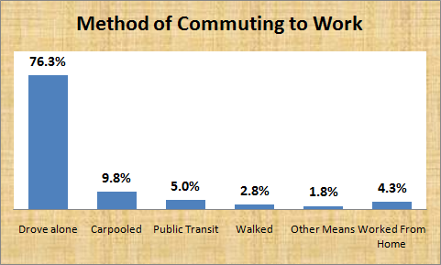
Goodness-of-Fit Test: Unequal Expected Frequencies EXAMPLE 2
14-8
In the 2010 United States census, data was collected on how people get to work -- their method of commuting.
Suppose you wanted to know if people who live in the San Jose metropolitan area (Santa Clara County) commute with similar proportions as the United States.
Design and conduct a hypothesis test at the 5% significance level.

Slide 9
EXAMPLE 2 continued
14-9
Method Of Commuting | Observed Frequency O_{i} | Expected Proportion p_{i} | Expected Frequency E_{i}
Drive Alone | 764 | 0.763 | 763 | 0.0013
Carpooled | 105 | 0.098 | 98 | 0.5000
Public Transit | 34 | 0.050 | 50 | 5.1200
Walked | 20 | 0.028 | 28 | 2.2857
Other Means | 30 | 0.018 | 18 | 8.0000
Worked from Home | 47 | 0.043 | 43 | 0.3721
TOTAL | 1000 | 1.000 | 1000 | 16.2791

Slide 10
EXAMPLE 2 continued
14-10
Design: Ho: p₁ = .763 p₂ = .098 p₃ = .050 p₄ = .028 p₅ = .018 p₆ = .043 Ha: At least one p_{i} is different than what was stated in Ho
α=.05
Model: Chi-Square Goodness of Fit, df=5
H_{o} is rejected if χ² > 11.071
Data:
χ² = 16.2791, Reject Ho
Conclusion: Workers in Santa Clara County do not have the same frequencies of method of commuting as workers in the entire United States.

Slide 11
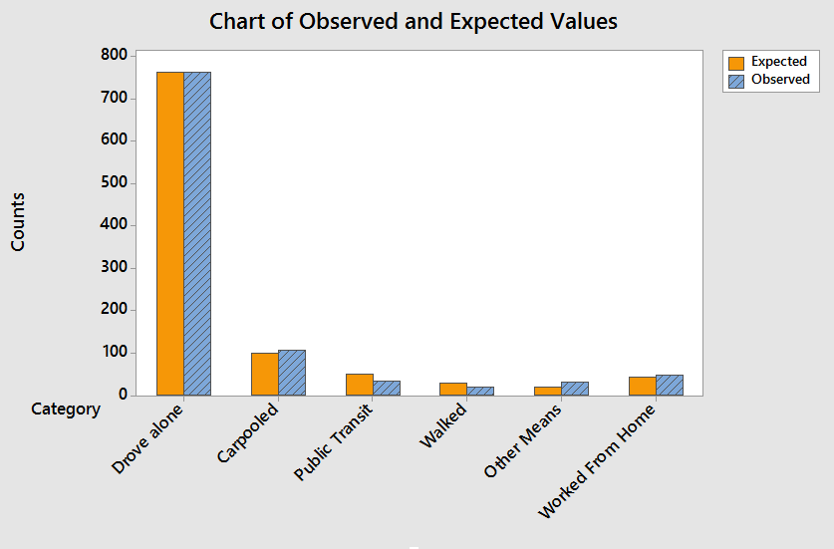
EXAMPLE 2 continued

Slide 12
Contingency Table Analysis
14-15
Contingency table analysis is used to test whether two traits or variables are related.
Each observation is classified according to two variables.
The usual hypothesis testing procedure is used.
The degrees of freedom is equal to: (number of rows-1)(number of columns-1).
The expected frequency is computed as: Expected Frequency = (row total)(column total)/grand total

Slide 13
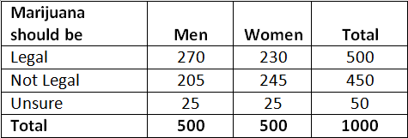
EXAMPLE 3
14-16
In May 2014, Colorado became the first state to legalize the recreational use of marijuana.
A poll of 1000 adults were classified by gender and their opinion about legalizing marijuana
At the .05 level of significance, can we conclude that gender and the opinion about legalizing marijuana for recreational use are dependent events?

Slide 14
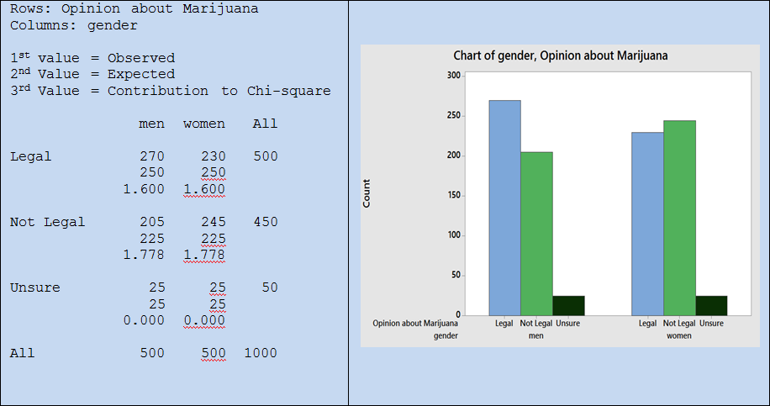
EXAMPLE 3 continued
14-17

Slide 15
EXAMPLE 3 continued
14-18
Design: H_{o}: Gender and Opinion are independent. H_{a}: Gender and Opinion are dependent.
α=.05
Model: Chi-Square Test for Independence, df=2
H_{o} is rejected if χ² > 5.99
Data: χ² = 6.756, Reject Ho
Conclusion: Gender and opinion are dependent variables. Men are more likely to support legalizing marijuana for recreational use.

