Slide 1
Inferential Statistics and Probability a Holistic Approach
Chapter 2
Descriptive Statistics
This Course Material by Maurice Geraghty is licensed under a Creative Commons Attribution-ShareAlike 4.0 International License. Conditions for use are shown here: https://creativecommons.org/licenses/by-sa/4.0/

Slide 2
Measures of Central Tendency
Mean
Arithmetic Average
Median
“Middle” Value after ranking data
Not affected by “outliers”
Mode
Most Occurring Value
Useful for non-numeric data

Slide 3
Example
Anthony’s Pizza, a Detroit based company, offers pizza delivery to its customers. A driver for Anthony’s Pizza will often make several deliveries on a single delivery run. A sample of 5 delivery runs by a driver showed that the total number of pizzas delivered on each run
2 2 5 9 12
What is the Average?
2
5
6

Slide 4
Example – 5 Recent Home Sales
$500,000
$600,000
$600,000
$700,000
$2,600,000

Slide 5
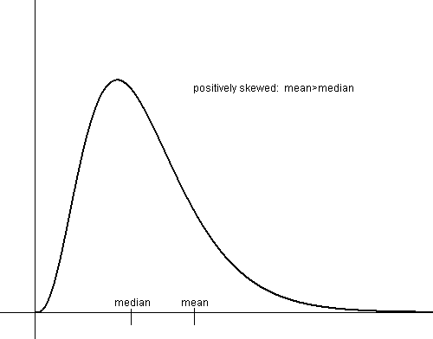
Positively Skewed Data Set Mean > Median

Slide 6
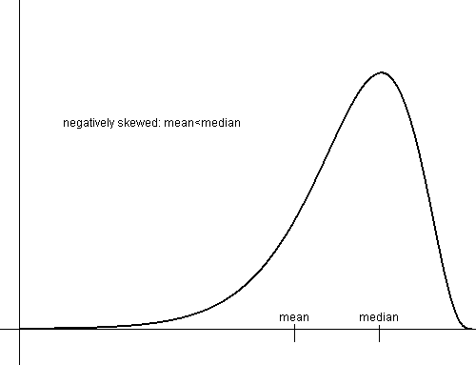
Negatively Skewed Data Set Mean < Median

Slide 7
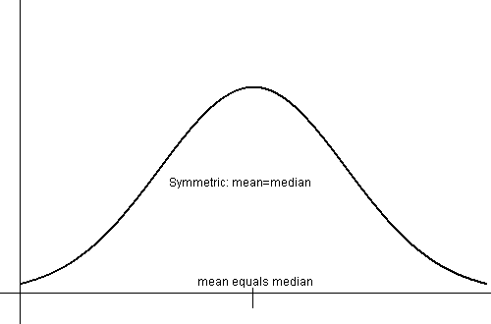
Symmetric Data Set Mean = Median

Slide 8
Measures of Variability
Range
Variance
Standard Deviation
Interquartile Range (percentiles)

Slide 9
Range
Max(Xi) –Min(Xi)
125 – 67 = 58

Slide 10
Sample Variance

Slide 11
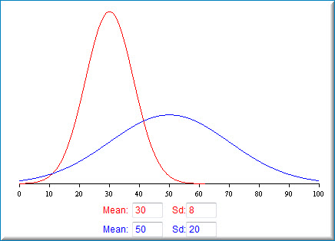
Sample Standard Deviation

Slide 12
Variance and Standard Deviation
2 | -4 | 16
2 | -4 | 16
5 | -1 | 1
9 | 3 | 9
12 | 6 | 36
30 | 0 | 78

Slide 13
Interpreting the Standard Deviation
Chebyshev’s Rule
At least 100 x (1-(1/k)²)% of any data set must be within k standard deviations of the mean.
Empirical Rule (68-95-99 rule)
Bell shaped data
68% within 1 standard deviation of mean
95% within 2 standard deviations of mean
99.7% within 3 standard deviations of mean

Slide 14
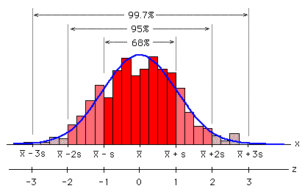
Empirical Rule

Slide 15
Measures of Relative Standing
Z-score
Percentile
Quartiles
Box Plots

Slide 16
Z-score
The number of Standard Deviations from the Mean
Z>0, X_{i} is greater than mean
Z<0, X_{i} is less than mean

Slide 17
Percentile Rank
Formula for ungrouped data
The location is (n+1)p (interpolated or rounded)
n= sample size
p = percentile

Slide 18
Quartiles
25th percentile is 1st quartile
50th percentile is median
75th percentile is 3rd quartile
75th percentile – 25th percentile is called the Interquartile Range which represents the “middle 50%”

Slide 19
IQR example
n+1=31
.25 x 31 = 7.75 location 8 = 87 ← 1st Quartile
.75 x 31 = 23.25 location 23 = 108 ← 3rd Quartile
Interquartile Range (IQR) =108 – 87 = 21

Slide 20
Box Plots
4-26
A box plot is a graphical display, based on quartiles, that helps to picture a set of data.
Five pieces of data are needed to construct a box plot:
Minimum Value
First Quartile
Median
Third Quartile
Maximum Value.

Slide 21
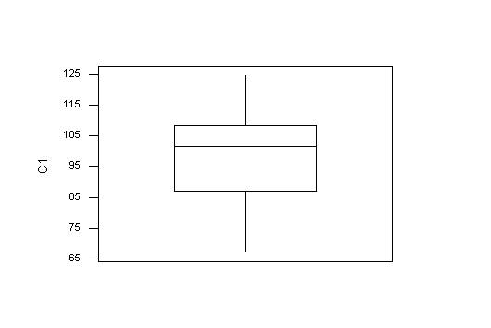
Box Plot

Slide 22
Outliers
An outlier is data point that is far removed from the other entries in the data set.
Outliers could be
Mistakes made in recording data
Data that don’t belong in population
True rare events

Slide 23
Outliers have a dramatic effect on some statistics
Example quarterly home sales for 10 realtors:
2 | 2 | 3 | 4 | 5 | 5 | 6 | 6 | 7 | 50
 | with outlier | without outlier
Mean | 9.00 | 4.44
Median | 5.00 | 5.00
Std Dev | 14.51 | 1.81
IQR | 3.00 | 3.50

Slide 24
Using Box Plot to find outliers
The “box” is the region between the 1st and 3rd quartiles.
Possible outliers are more than 1.5 IQR’s from the box (inner fence)
Probable outliers are more than 3 IQR’s from the box (outer fence)
In the box plot below, the dotted lines represent the “fences” that are 1.5 and 3 IQR’s from the box. See how the data point 50 is well outside the outer fence and therefore an almost certain outlier.

Slide 25
Using Z-score to detect outliers
Calculate the mean and standard deviation without the suspected outlier.
Calculate the Z-score of the suspected outlier.
If the Z-score is more than 3 or less than -3, that data point is a probable outlier.

Slide 26
Outliers – what to do
Remove or not remove, there is no clear answer.
For some populations, outliers don’t dramatically change the overall statistical analysis. Example: the tallest person in the world will not dramatically change the mean height of 10000 people.
However, for some populations, a single outlier will have a dramatic effect on statistical analysis (called “Black Swan” by Nicholas Taleb) and inferential statistics may be invalid in analyzing these populations. Example: the richest person in the world will dramatically change the mean wealth of 10000 people.

Slide 27
Bivariate Data
Ordered numeric pairs (X,Y)
Both values are numeric
Paired by a common characteristic
Graph as Scatterplot

Slide 28
Example of Bivariate Data
Housing Data
X = Square Footage
Y = Price

Slide 29
Example of Scatterplot

Slide 30
Another Example

Slide 31
Correlation Analysis
12-3
Correlation Analysis: A group of statistical techniques used to measure the strength of the relationship (correlation) between two variables.
Scatter Diagram: A chart that portrays the relationship between the two variables of interest.
Dependent Variable: The variable that is being predicted or estimated. “Effect”
Independent Variable: The variable that provides the basis for estimation. It is the predictor variable. “Cause?” (Maybe!)

Slide 32
The Coefficient of Correlation, r
12-4
The Coefficient of Correlation (r) is a measure of the strength of the relationship between two variables.
It requires interval or ratio-scaled data (variables).
It can range from -1 to 1.
Values of -1 or 1 indicate perfect and strong correlation.
Values close to 0 indicate weak correlation.
Negative values indicate an inverse relationship and positive values indicate a direct relationship.

Slide 33
Perfect Positive Correlation
12-6
10
9
8
7
6
5
4
3
2
1
0
Y
0 1 2 3 4 5 6 7 8 9 10
X

Slide 34
Perfect Negative Correlation
12-5
10
9
8
7
6
5
4
3
2
1
0
Y
0 1 2 3 4 5 6 7 8 9 10
X

Slide 35
Zero Correlation
12-7
10
9
8
7
6
5
4
3
2
1
0
Y
0 1 2 3 4 5 6 7 8 9 10
X

Slide 36
Strong Positive Correlation
12-8
10
9
8
7
6
5
4
3
2
1
0
Y
0 1 2 3 4 5 6 7 8 9 10
X

Slide 37
Weak Negative Correlation
12-8
10
9
8
7
6
5
4
3
2
1
0
Y
0 1 2 3 4 5 6 7 8 9 10
X

Slide 38
Causation
Correlation does not necessarily imply causation.
There are 4 possibilities if X and Y are correlated:
X causes Y
Y causes X
X and Y are caused by something else.
Confounding - The effect of X and Y are hopelessly mixed up with other variables.

Slide 39
Causation - Examples
City with more police per capita have more crime per capita.
As Ice cream sales go up, shark attacks go up.
People with a cold who take a cough medicine feel better after some rest.

Slide 40
Formula for correlation coefficient r
12-9

Slide 41
Example
X = Average Annual Rainfall (Inches)
Y = Average Sale of Sunglasses/1000
Make a Scatter Diagram
Find the correlation coefficient
X | 10 | 15 | 20 | 30 | 40
Y | 40 | 35 | 25 | 25 | 15

Slide 42
Example continued
Make a Scatter Diagram
Find the correlation coefficient

Slide 43
Example continued

Slide 44
Example continued
SSX = 3225 - 115²/5 = 580
SSY = 4300 - 140²/5 = 380
SSXY= 2775 - (115)(140)/5 = -445

Slide 45
Example continued
Strong negative correlation

