Slide 1
Inferential Statistics and Probability a Holistic Approach
Chapter 6
Continuous Random Variables
This Course Material by Maurice Geraghty is licensed under a Creative Commons Attribution-ShareAlike 4.0 International License. Conditions for use are shown here: https://creativecommons.org/licenses/by-sa/4.0/

Slide 2
Continuous Distributions
“Uncountable” Number of possibilities
Probability of a point makes no sense
Probability is measured over intervals
Comparable to Relative Frequency Histogram – Find Area under curve.

Slide 3
Discrete vs Continuous
Countable
Discrete Points
p(x) is probability distribution function
p(x) ≥ 0
Σp(x) =1
Uncountable
Continuous Intervals
f(x) is probability density function
f(x) ≥ 0
Total Area under curve =1

Slide 4
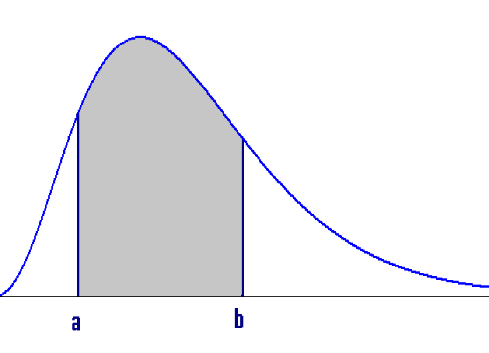
Continuous Random Variable
f(x) is a density function
P(X<x) is a distribution function.
P(a<X<b) = area under function between a and b

Slide 5
Exponential distribution
Waiting time
“Memoryless”
f(x) = (1/μ)e^{−(1/μ)x}
P(x>a) = e^{–(a/μ)}
μ=μ σ²=μ²
P(x>a+b|x>b) = e ^{–(a/μ)}

Slide 6
Examples of Exponential Distributiuon
Time until…
a circuit will fail
the next RM 7 Earthquake
the next customer calls
An oil refinery accident
you buy a winning lotto ticket

Slide 7
Relationship between Poisson and Exponential Distributions
If occurrences follow a Poisson Process with mean = μ, then the waiting time for the next occurrence has Exponential distribution with mean = 1/μ.
Example: If accidents occur at a plant at a constant rate of 3 per month, then the expected waiting time for the next accident is 1/3 month.

Slide 8
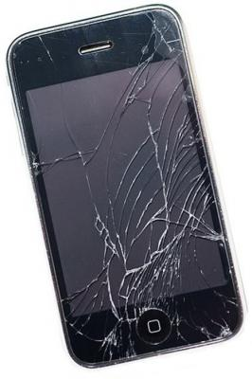
Exponential Example
The time until a screen is cracked on a smart phone has exponential distribution with μ=500 hours of use.
(a) Find the probability screen will not crack for at least 600 hours.
P(x>600) = e^{-600/500} = e^{-1.2}= .3012
(b) Assuming that screen has already lasted 500 hours without cracking, find the chance the display will last an additional 600 hours.
P(x>1100|x>500) = P(x>600) = .3012

Slide 9
Exponential Example
The time until a screen is cracked on a smart phone has exponential distribution with μ=500 hours of use.
(a) Find the median of the distribution
P(x>med) = e^{-(med)/500} = 0.5
med = -500ln(.5) =347
p^{th} Percentile = -μ ln(1-p)

Slide 10
Uniform Distribution
Rectangular distribution
Example: Random number generator

Slide 11
Uniform Distribution - Probability
a c d b

Slide 12
Uniform Distribution - Percentile
Area = p
a Xp b
Formula to find the pth percentile X_{p}:

Slide 13
Uniform Example 1
Find mean, variance, P(X<3) and 70th percentile for a uniform distribution from 1 to 11.

Slide 14
Uniform Example 2
A tea lover orders 1000 grams of Tie Guan Yin loose leaf when his supply gets to 50 grams.
The amount of tea currently in stock follows a uniform random variable.
Determine this model
Find the mean and variance
Find the probability of at least 700 grams in stock.
Find the 80th percentile

Slide 15
Uniform Example 3
A bus arrives at a stop every 20 minutes.
Find the probability of waiting more than 15 minutes for the bus after arriving randomly at the bus stop.
If you have already waited 5 minutes, find the probability of waiting an additional 10 minutes or more. (Hint: recalculate parameters a and b)

Slide 16
Normal Distribution
The normal curve is bell-shaped
The mean, median, and mode of the distribution are equal and located at the peak.
The normal distribution is symmetrical about its mean. Half the area under the curve is above the peak, and the other half is below it.
The normal probability distribution is asymptotic - the curve gets closer and closer to the x-axis but never actually touches it.

Slide 17
The Standard Normal Probability Distribution
7-6
A normal distribution with a mean of 0 and a standard deviation of 1 is called the standard normal distribution.
Z value: The distance between a selected value, designated x, and the population mean μ, divided by the population standard deviation, σ

Slide 18
Areas Under the Normal Curve – Empirical Rule
7-9
About 68 percent of the area under the normal curve is within one standard deviation of the mean.
About 95 percent is within two standard deviations of the mean
99.7 percent is within three standard deviations of the mean.

Slide 19
EXAMPLE
7-11
The daily water usage per person in a town is normally distributed with a mean of 20 gallons and a standard deviation of 5 gallons.
About 68% of the daily water usage per person in New Providence lies between what two values?
That is, about 68% of the daily water usage will lie between 15 and 25 gallons.

Slide 20
Normal Distribution – probability problem procedure
Given: Interval in terms of X
Convert to Z by
Look up probability in table.

Slide 21
EXAMPLE
7-12
The daily water usage per person in a town is normally distributed with a mean of 20 gallons and a standard deviation of 5 gallons.
What is the probability that a person from the town selected at random will use less than 18 gallons per day?
The associated Z value is Z=(18-20)/5=0.
Thus, P(X<18)=P(Z<-0.40)=.3446

Slide 22
EXAMPLE continued
7-12
The daily water usage per person in a town is normally distributed with a mean of 20 gallons and a standard deviation of 5 gallons.
What proportion of the people uses between 18 and 24 gallons?
The Z value associated with x=18 is Z=-0.40 and with X=24, Z=(24-20)/5=0.80.
Thus, P(18<X<24)=P(-0.40<Z<0.80) =.7881-.3446=.4435

Slide 23
EXAMPLE continued
7-14
The daily water usage per person in a town is normally distributed with a mean of 20 gallons and a standard deviation of 5 gallons.
What percentage of the population uses more than 26.2 gallons?
The Z value associated with X=26.2, Z=(26.2-20)/5=1.24.
Thus P(X>26.2)=P(Z>1.24) =1-.8925=.1075

Slide 24
Normal Distribution – percentile problem procedure
Given: probability or percentile desired.
Look up Z value in table that corresponds to probability.
Convert to X by the formula:

Slide 25
EXAMPLE
7-14
The daily water usage per person in a town is normally distributed with a mean of 20 gallons and a standard deviation of 5 gallons. A special tax is going to be charged on the top 5% of water users.
Find the value of daily water usage that generates the special tax
The Z value associated with 95th percentile =1.645
X=20 + 5(1.645) = 28.2 gallons per day

Slide 26
EXAMPLE
7-15
Professor Kurv has determined that the final averages in his statistics course is normally distributed with a mean of 77.1 and a standard deviation of 11.2.
He decides to assign his grades for his current course such that the top 15% of the students receive an A.
What is the lowest average a student can receive to earn an A?
The top 15% would be the finding the 85th percentile. Find k such that P(X<k)=.85.
The corresponding Z value is 1.04. Thus we have X=77.1+(1.04)(11.2), or X=88.75

Slide 27
EXAMPLE
7-17
The amount of tip the servers in an exclusive restaurant receive per shift is normally distributed with a mean of $80 and a standard deviation of $10.
Shelli feels she has provided poor service if her total tip for the shift is less than $65.
What percentage of the time will she feel like she provided poor service?
Let y be the amount of tip. The Z value associated with X=65 is Z= (65-80)/10= -1.5.
Thus P(X<65)=P(Z<-1.5)=.0668.

