Slide 1
Inferential Statistics and Probability a Holistic Approach
Chapter 8
Point Estimation and Confidence Intervals
This Course Material by Maurice Geraghty is licensed under a Creative Commons Attribution-ShareAlike 4.0 International License. Conditions for use are shown here: https://creativecommons.org/licenses/by-sa/4.0/

Slide 2
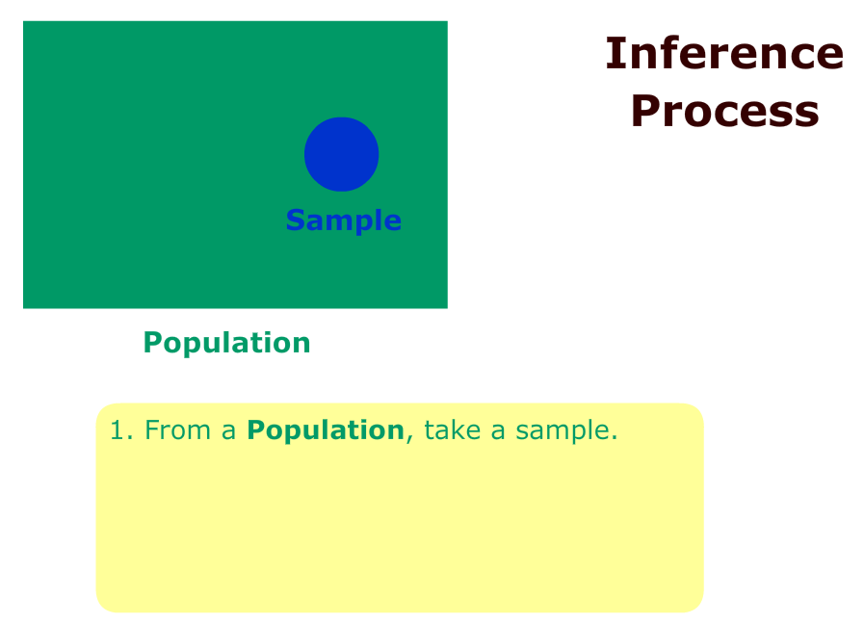
Inference Process

Slide 3
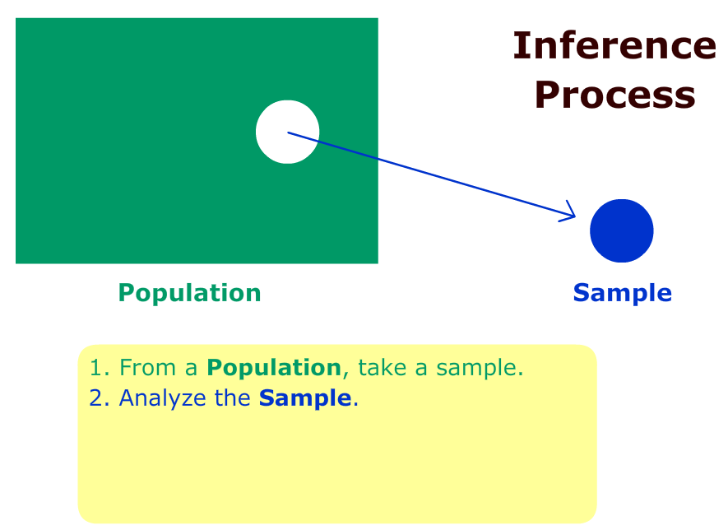
Inference Process

Slide 4
Inference Process

Slide 5
Inference Process

Slide 6
Inferential Statistics
Population Parameters
Mean = μ
Proportion = p
Standard Deviation = σ
Sample Statistics
Mean =
Proportion =
Standard Deviation = s

Slide 7
Inferential Statistics
Estimation
Using sample data to estimate population parameters.
Example: Public opinion polls
Hypothesis Testing
Using sample data to make decisions or claims about population
Example: A drug effectively treats a disease

Slide 8
Estimation of μ
is an unbiased point estimator of μ
Example: The number of defective items produced by a machine was recorded for five randomly selected hours during a 40-hour work week. The observed number of defectives were 12, 4, 7, 14, and 10. So the sample mean is 9.4.
Thus a point estimate for μ, the hourly mean number of defectives, is 9.4.

Slide 9
Confidence Intervals
An Interval Estimate states the range within which a population parameter “probably” lies.
The interval within which a population parameter is expected to occur is called a Confidence Interval.
The distance from the center of the confidence interval to the endpoint is called the “Margin of Error”
The three confidence intervals that are used extensively are the 90%, 95% and 99%.

Slide 10
Confidence Intervals
A 95% confidence interval means that about 95% of the similarly constructed intervals will contain the parameter being estimated, or 95% of the sample means for a specified sample size will lie within 1.96 standard deviations of the hypothesized population mean.
For the 99% confidence interval, 99% of the sample means for a specified sample size will lie within 2.58 standard deviations of the hypothesized population mean.
For the 90% confidence interval, 90% of the sample means for a specified sample size will lie within 1.645 standard deviations of the hypothesized population mean.

Slide 11
90%, 95% and 99% Confidence Intervals for µ
8-18
The 90%, 95% and 99% confidence intervals for are constructed as follows when
90% CI for the population mean is given by
95% CI for the population mean is given by
99% CI for the population mean is given by

Slide 12
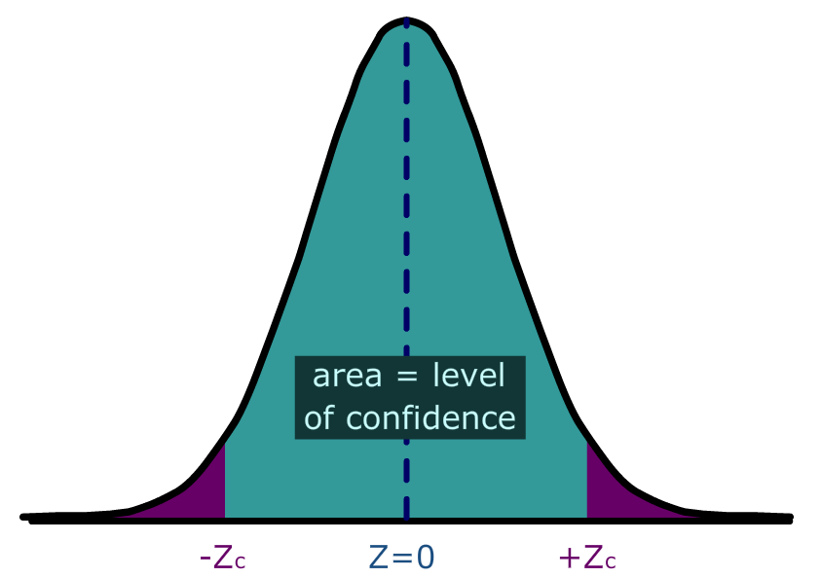
Constructing General Confidence Intervals for µ
8-19
In general, a confidence interval for the mean is computed by:
This can also be thought of as: Point Estimator ± Margin of Error

Slide 13
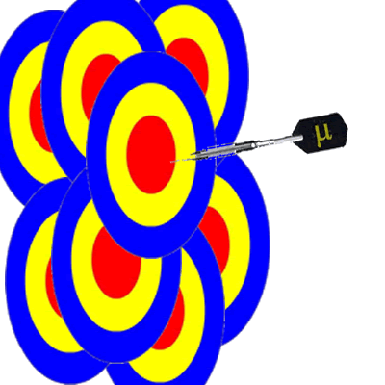
The nature of Confidence Intervals
8-19
The Population mean μ is fixed.
The confidence interval is centered around the sample mean which is a Random Variable.
So the Confidence Interval (Random Variable) is like a target trying hit a fixed dart (μ).

Slide 14
EXAMPLE
8-20
The Dean wants to estimate the mean number of hours worked per week by students. A sample of 49 students showed a mean of 24 hours with a standard deviation of 4 hours.
The point estimate is 24 hours (sample mean).
What is the 95% confidence interval for the average number of hours worked per week by the students?

Slide 15
EXAMPLE continued
8-21
Using the 95% CI for the population mean, we have
The endpoints of the confidence interval are the confidence limits. The lower confidence limit is 22.88 and the upper confidence limit is 25.12

Slide 16
EXAMPLE continued
8-21
Using the 99% CI for the population mean, we have
Compare to the 95% confidence interval. A higher level of confidence means the confidence interval must be wider.

Slide 17
Selecting a Sample Size
8-27
There are 3 factors that determine the size of a sample, none of which has any direct relationship to the size of the population. They are:
The degree of confidence selected.
The maximum allowable error.
The variation of the population.

Slide 18
Sample Size for the Mean
8-28
A convenient computational formula for determining n is:
where E is the allowable error (margin of error), Z is the z score associated with the degree of confidence selected, and σ is the sample deviation of the pilot survey.
σ can be estimated by past data, target sample or range of data.

Slide 19
EXAMPLE
8-29
A consumer group would like to estimate the mean monthly electric bill for a single family house in July. Based on similar studies the standard deviation is estimated to be $20.00. A 99% level of confidence is desired, with an accuracy of $5.00. How large a sample is required?

Slide 20
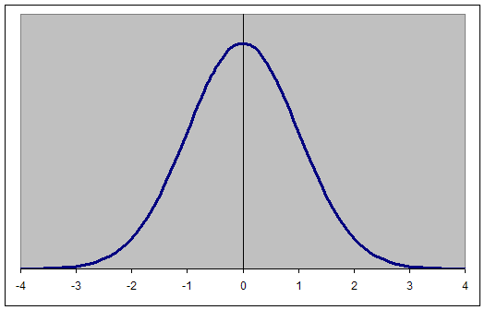
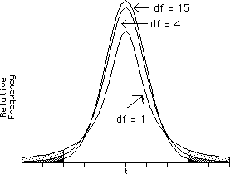
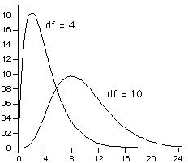
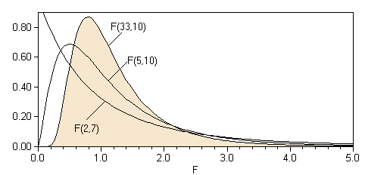
Normal Family of Distributions: Z, t, χ², F

Slide 21
Characteristics of Student’s t-Distribution
10-3
The t-distribution has the following properties:
It is continuous, bell-shaped, and symmetrical about zero like the z-distribution.
There is a family of t-distributions sharing a mean of zero but having different standard deviations based on degrees of freedom.
The t-distribution is more spread out and flatter at the center than the z-distribution, but approaches the z-distribution as the sample size gets larger.

Slide 22
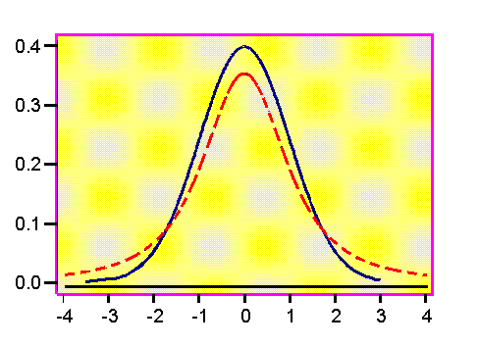
9-3
9-3
The degrees of
freedom for
the t-distribution
is df = n - 1.
z-distribution
t-distribution

Slide 23
Confidence Interval for μ (σ unknown)
Formula to find a confidence interval using the t-distribution for the appropriate level of confidence:

Slide 24
Example – Confidence Interval
In a random sample of 13 American adults, the mean waste recycled per person per day was 5.3 pounds and the standard deviation was 2.0 pounds.
Assume the variable is normally distributed and construct a 95% confidence interval for μ.

Slide 25
Example- Confidence Interval
level of confidence = 95%
df=13-1=12
t=2.18

Slide 26
Confidence Intervals, Population Proportions
Point estimate for proportion of successes in population is:
X is the number of successes in a sample of size n.
Standard deviation of is
Confidence Interval for p:

Slide 27
Population Proportion Example
In a May 2006 AP/ISPOS Poll, 1000 adults were asked if "Over the next six months, do you expect that increases in the price of gasoline will cause financial hardship for you or your family, or not?“
700 of those sampled responded yes!
Find the sample proportion and margin of error for this poll. (This means find a 95% confidence interval.)

Slide 28
Population Proportion Example
Sample proportion
Margin of Error

Slide 29
Sample Size for the Proportion
8-28
A convenient computational formula for determining n is:
where E is the allowable margin of error, Z is the z-score associated with the degree of confidence selected, and p is the population proportion.
If p is completely unknown, p can be set equal to ½ which maximizes the value of (p)(1-p) and guarantees the confidence interval will fall within the margin of error.

Slide 30
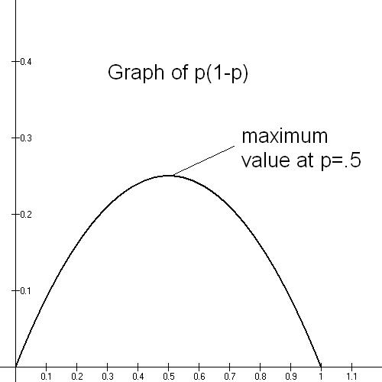

Slide 31
Example
In polling, determine the minimum sample size needed to have a margin of error of 3% when p is unknown.

Slide 32
Example
In polling, determine the minimum sample size needed to have a margin of error of 3% when p is known to be close to 1/4.

Slide 33
Characteristics of the Chi-Square Distribution
14-2
The major characteristics of the chi-square distribution are:
It is positively skewed
It is non-negative
It is based on degrees of freedom
When the degrees of freedom change, a new distribution is created

Slide 34
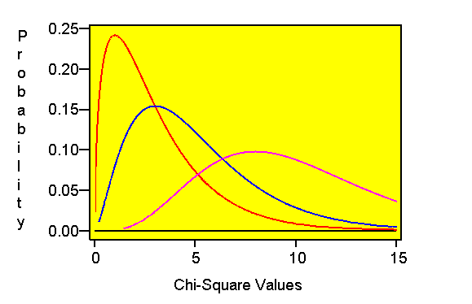
2-2
CHI-SQUARE DISTRIBUTION
df = 3
df = 5
df = 10
χ²

Slide 35
Inference about Population Variance and Standard Deviation
s² is an unbiased point estimator for σ²
s is a point estimator for σ
Interval estimates and hypothesis testing for both σ² and σ require a new distribution – the χ² (Chi-square)

Slide 36
Distribution of s²
has a chi-square distribution
n-1 is degrees of freedom
s² is sample variance
σ² is population variance

Slide 37
Confidence interval for σ²
Confidence is NOT symmetric since chi-square distribution is not symmetric. You must find separate left and right bounds.
We can construct a confidence interval for σ²
Take square root of both endpoints to get confidence interval for σ, the population standard deviation.

Slide 38
Example
In performance measurement of investments, standard deviation is a measure of volatility or risk.
Twenty monthly returns from a mutual fund show an average monthly return of 1% and a sample standard deviation of 5%
Find a 95% confidence interval for the monthly standard deviation of the mutual fund.

Slide 39
Example (cont)
df = n-1 =19
95% CI for σ

